Slide 1
ELU:Social engineering
Testing Group: Andri Kaljumäe, Santeri Kupiainen, Taavi Liivat, Marian Luht, Dan Nyberg, Margus Sylluste, Kristjan Vaher, Katariina Viik

Slide 2
Content
Interdisplanary group and partners
Goal of the project
Working process and methods
Final Outcome
Questions?

Slide 3
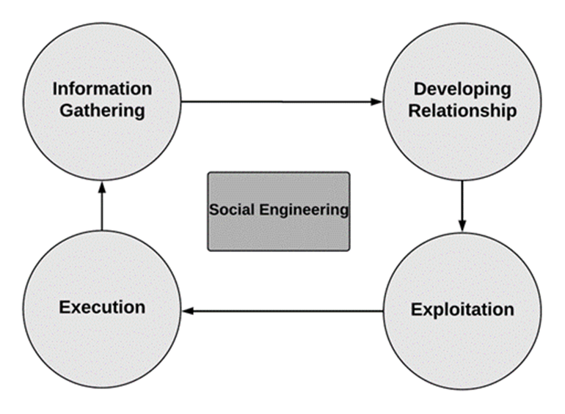
Interdisplanary group and partners
Andri Kaljumäe - Informatics
Santeri Kupiainen -International Relations
Taavi Liivat - Informatics
Marian Luht - European Languages and Cultures
Dan Nyberg -International Relations
Margus Sülluste - IT management
Kristjan Vaher - IT management
Katariina Viik – Psychology
Partners: Taltech and EU

Slide 4
Goal of the project
Increasing amounts of data and technology make us vulnerable for different kinds of security and privacy threats, therefore every kind of education and testing material helps us combat against threats like social engineering
Through solving the quizzes, personnel will firstly understand their current level and, secondly, will gain knowledge concerning cyber security and social engineering
Target group: Tallinn university staff

Slide 5
Working process and methods
Regular online meetings at discord between September and January
Division into three sub-groups: academic research, data-analyse and distribution
Every group member had also a common task to create from 10 to 15 questions that they deemed to have value for the final outcome

Slide 6
Final Outcome
Google form test: available for English and Estonian contain 23 selected questions
Questions, that group members created, were uploaded to google form after the analyze
The questions covers many aspects that cybersecurity and social engineering hold

Slide 7
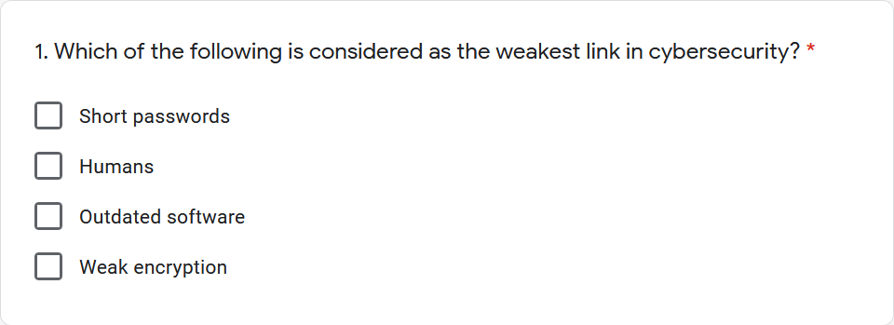
Final Outcome 2
For the feedback, all questions must be answered
The test will tell you afterwards, which answers were right and why
For motivated test takers, the test provides links to further material.
Our quiz has received third party feedback before the distribution
Test question example

Slide 8
Questions?
Links for the tests: English https://docs.google.com/forms/d/e/1FAIpQLScXqn1ar_8yAUMv77owe0LUli3ceu8mLOQ2leI_-eitK_8bEQ/viewform?usp=sf_link
Estonian: https://docs.google.com/forms/d/e/1FAIpQLSdZ-VXo-u-Lisdt4B3qvbpFbpkJy4m9nXo51eyUoORXeYZBVg/viewform

