Slide 1
Games of research methods 2 team #3
07.01.2021

Slide 2
Group:
Vakhtangi Kachukhashvili, Digital Learning Games
Mosisa Kulu Rindal, Politics and Governance
Vahur Vogt, Informatics
Erkki Sula, Informatics
Henri Tammo, Informatics
Kristian Paekivi, Informatics
Instructors:
Martin Sillaots
Mikhail Fiadotau

Slide 3
Main Problem to solve is...

Slide 4
Problem:
How to make research-planning process more interesting for the students
Challenge:
There aren’t many examples

Slide 5
Goal

Slide 6
Goal and what we wanted to achieve
To design and develop digital learning mini-games that focus on a specific research method or topic.
How do we know we have achieved our goal
We have created a mini-game that focuses on testing research method

Slide 7
Smart Goal
Goal is to create a ready-to-play mini-game, that is based on testing research method.
We have a team who can achieve that
It will be ready by 7th of January.

Slide 8
Importance

Slide 9
There is a need for games that would focus on making different methods of research more interesting and motivating for students

Slide 10
Process

Slide 11
Meetings
Setting up the plan
Designing
Developing
Researching

Slide 12
Scientific approach

Slide 13
This ELU project is part of bigger HITSA initiative
Creating mini-games around different research methods

Slide 14
Project Results

Slide 15
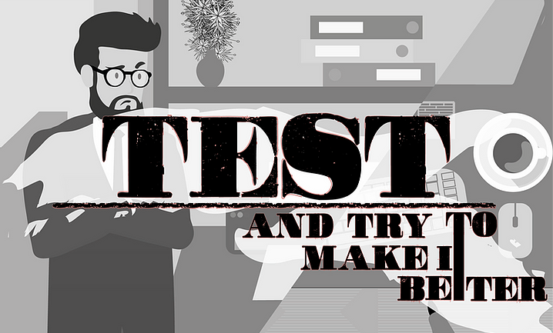
Created a mini-game based on testing research method
Potentially part of a bigger project

Slide 16
Conclusions, Summary

Slide 17
We have created a mini-game that can help students be more motivated and interested to learn about research methods
It takes good planning to create a good game

Slide 18
Thank you for listening!

