Slide 1
Game of Research Methods 2 5 Clever
15.01.2021

Slide 2
Team:
Ali Vojdanianardakani, Project Manager
Asuka Kawaguchi, Designer / Developer
Urmot Rosenberg, Developer
Christiana Ngowo, Researcher
Abdolhossein Rezvani, Writer
Supervisors:
Professor Martin Sillatos
Mikhail Fiadotau

Slide 3
Problem

Slide 4
Problem
Students sometimes consider research is difficult
Difficulty in research methods may affect their quality and thus result
People used to adapt themselves with traditional textbooks

Slide 5
Solution
People tend to engage while learning
Playing game makes people engaging
Using game to teach research methods gives more motivation and understanding of the subject
Designing a game that focus on research methods will solve problems

Slide 6
Purpose
Teaching research methods through a game
Engaging students to the subject
Motivating students to learn by playing the game
Making a better visualization with the game assets rather than traditional textbooks

Slide 7
The Persona Game
Purpose: Creating the persona
The key is to create the right persona

Slide 8
Poster

Slide 9
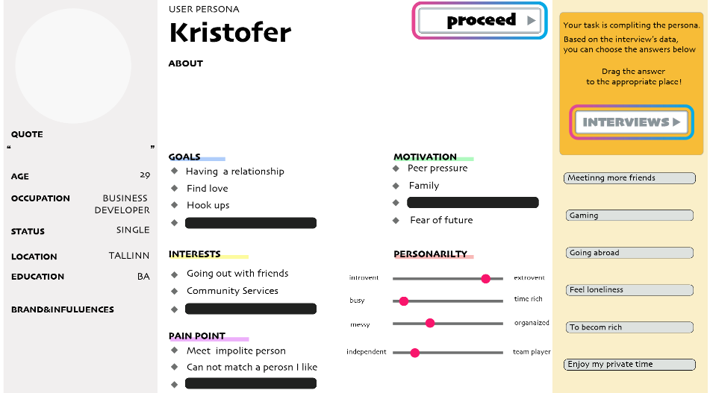
The Game
Players must create the right persona
There are couple of fields that are unanswered and must be filled

Slide 10
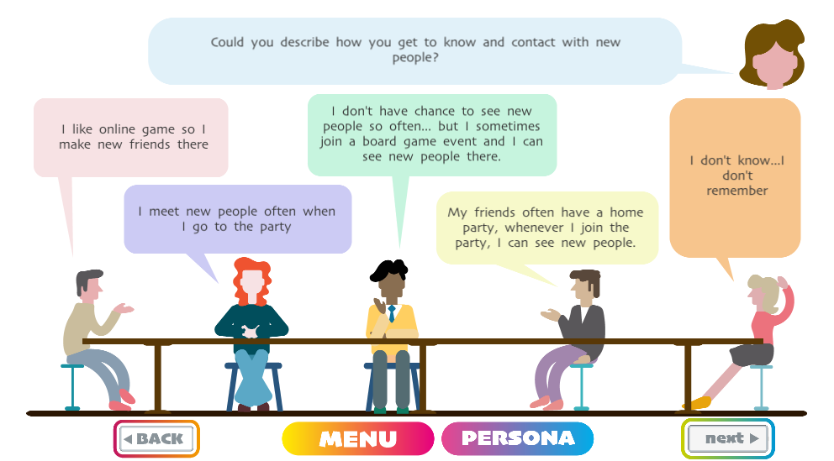
How to answer
Players must interview group of people
After interviewing they can create the right persona based on what they learned from people

Slide 11
Research methods
The research method is Qualitative
Data collection is through group interview
Players lean this method and data collection after playing the game

Slide 12
The Game
Two possibilities after creating the persona:
1- Players created the right persona:
It shows the learned the research method well enough and the game is completed.
2- Players created the wrong persona:
It shows they didn’t learn the research method well enough. They need to do it again to learn the research method and then complete the game.

Slide 13
Play the game
Click on the link to play the game
http://www.tlu.ee/~urmotr/persona/

Slide 14
Thank you

