Slide 1
STORYBOARD NOIR
TEAM 4
07.01.2021

Slide 2


contents
Group members, specialities
Instructors
Problem, goal, importance
Process
Scientific basis
Results
Conclusions, summary

Slide 3
Group:
Andrey Babichev, educational technology
Kristjan Põldmets, informatics
Natalie Mets, sociology
Yugishtha Ashokbhai Shrivastava, digital learning games
Instructors:
Martin Sillaots, Mikhail Fiadotau

Slide 4
problem

Slide 5
Research methods are seen as intimidating to study and students do not see the value until they have a need for it, impacting the quality of their theses.
The lack of interactive demonstrations of scientific methods.
The specific research method we were tasked with is storyboarding.

Slide 6
GOAL

Slide 7
Our goal is to introduce the player to the concept of research through a storyboarding method.
We wanted to create a visually and mechanically interesting minigame that would not be a chore to play.
We have reached our main goal once our game is fun and educational.

Slide 8
Smart GOAL
The outcome of the project is a point and click game to introduce storyboarding.
The goal of the game is to piece together information to recreate an event.
The game has multiple levels, each further level presenting more difficulty.
The game will have a working prototype by the end date.

Slide 9
IMPORTANCE

Slide 10
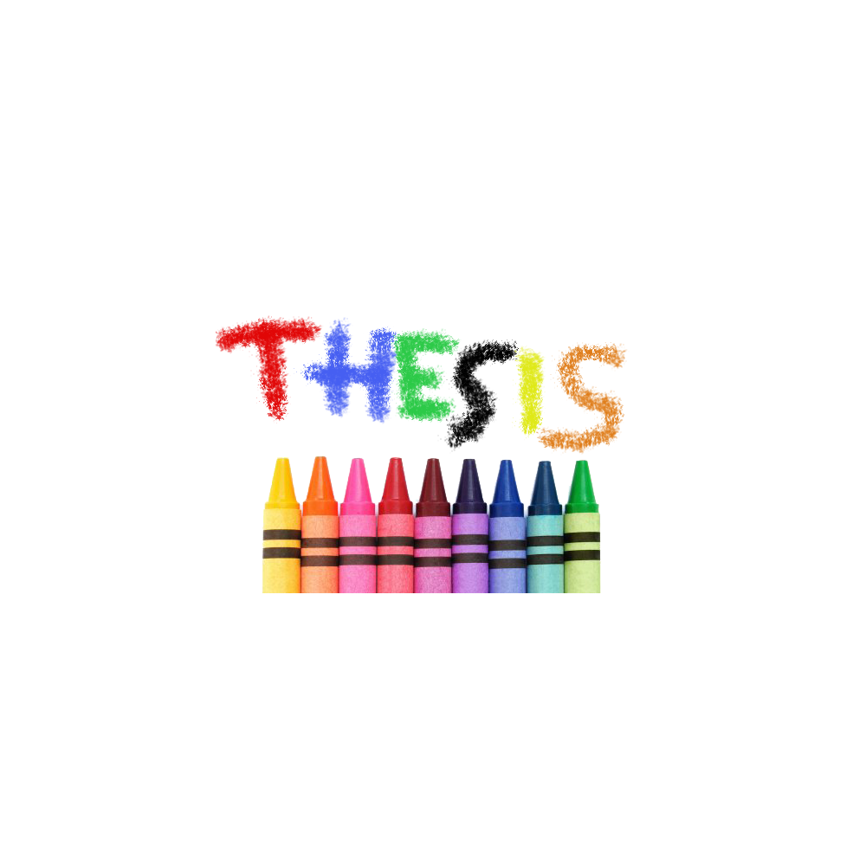
The subject is and will continue to be topical as it directly attempts to increase the quality of dissertations.
Storyboarding can be used to help visualize the path from start to finish for such things as articles, events and processes.

Slide 11
The subject is and will continue to be topical as it directly attempts to increase the quality of dissertations.
Storyboarding can be used to help visualize the path from start to finish for such things as articles, events and processes.

Slide 12
ProCess

Slide 13
We utilized multiple programs such as Blender, GIMP and Mixamo to create assets.
The project was put together in Unity.
As actions the project development is as follows:

Slide 14
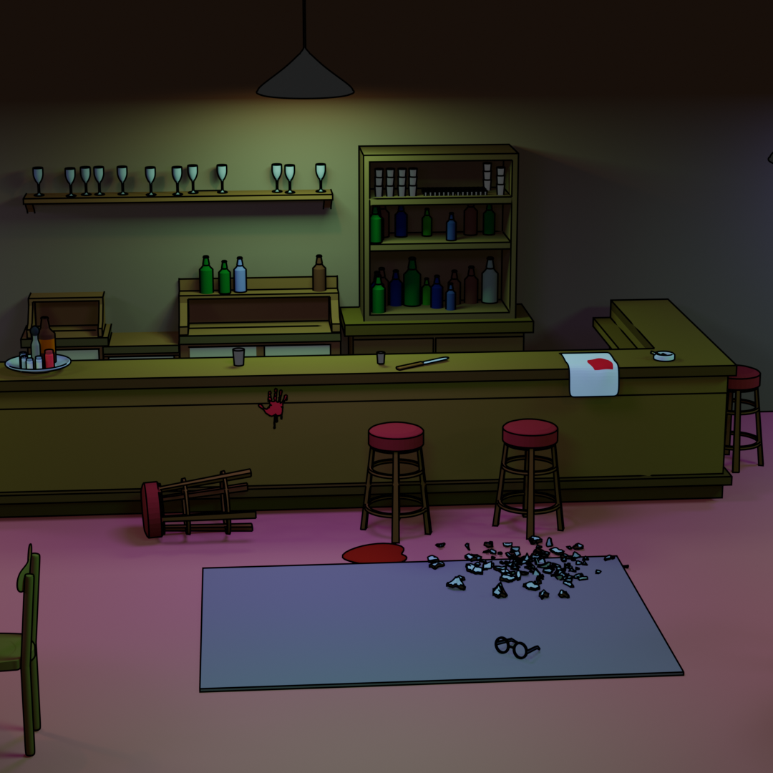
Coming up with the ideas.
Create a project plan.
Create a game-design Document
Create the assets.
Create a prototype.
Polish and finish mechanics.

Slide 15
SCIENTIFIC BASIS

Slide 16
We see the issues as insecurity and disinterest into the subject of scientific methods. The project attempts to combat such feelings with the aspect of play. We used storyboarding-related material as the basis for our work. Several articles and examples were studied to come up with ideas for the game.

Slide 17
RESULTS

Slide 18
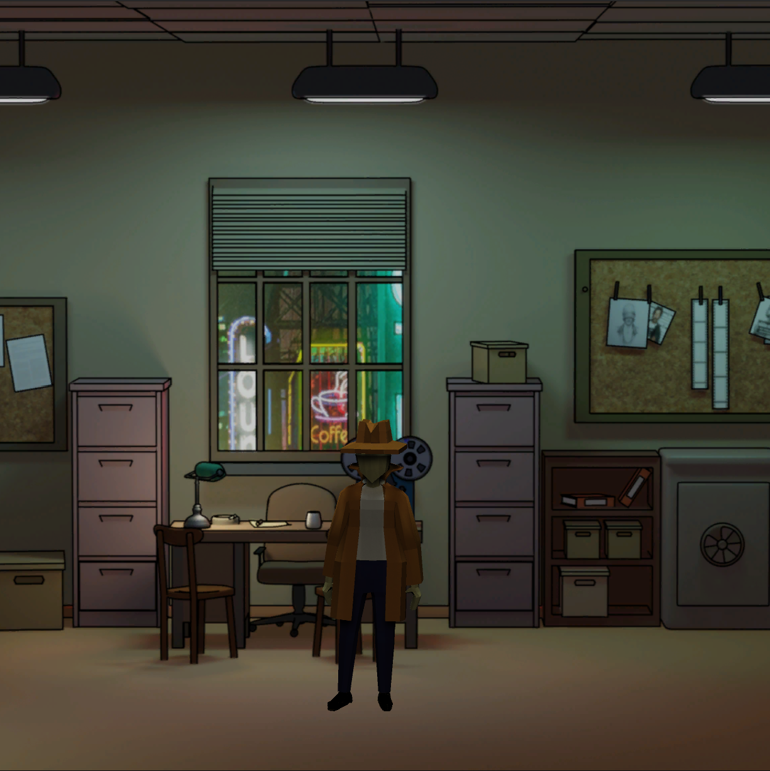
Project results
The current build of the game is still missing core mechanics and only the artistic side and movement mechanisms can be showcased.
As such, the project is yet to teach anything to anyone but the development team.

Slide 19
CONCLUSION, SUMMARY

Slide 20
The idea to introduce research methods through games seems valid, as long as the player is entertained.
A lack of experience and aiming too high has hindered the completion of our project.

Slide 21
THANK YOU

