Slide 1
From the project
“We bring future technologies to the
selected courses today!“
EDUCATIONAL
ROBOTICS
Notes:
Report https://docs.google.com/file/d/1Bgp9We3fx_xTzSwDBICqIaM_JM75jS7w/edit?filetype=msword
Portfolio https://onedrive.live.com/edit.aspx?resid=3C4DCD4C2AF69C5F!2753&ithint=file%2cdocx

Slide 2
Group members:
Usama Talat, Communications Management - Marketing Guru & Co-Lead
Anna Kaisa Jämsä, Audiovisual Media - Super Administrator & Co-Lead
Christopher Das Raaj, Politics and Governance - Customer Success Manager
Arnel Jose Dalino, Law - Scientist
Abiola Emmanuella Adeniran, Politics and Governance - Learning Designer
Supervisor(s)/mentor(s):
Janika Leoste and Jaagup Kippar
Partner(s):
Professor Tiiu Tammemäe and Professor Maire Tuul
Notes:
Usama

Slide 3
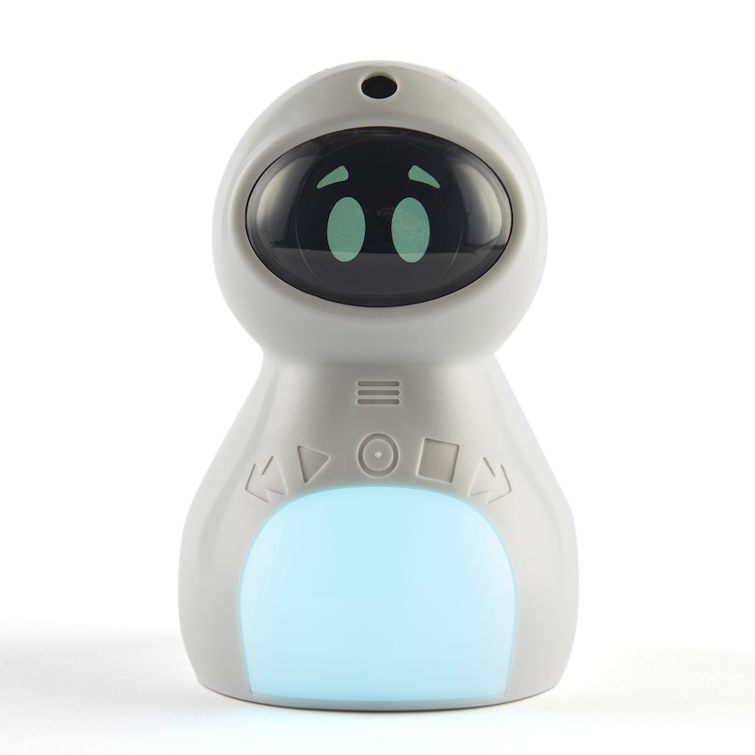
Problem of the Project
What was the problem you were solving?
The KITT robot that the university is having, Had a lot of potential but faculty members were not using it; they did not know how educational robots could enhance their teaching and the students’ learning and studying.
How do you know that this is a problem?
Scientific studies prove that there has been challenges with introducing educational robots into teaching system; and thus teachers have worries over robots as they are not used to.
Why is it important to deal with this subject?
Traditional teaching and learning is preferred, but the robot could make them more interesting.
Some learners, for example people with learning difficulties can really benefit from the use of educational robotics, such as the KITT robot.
Notes:
Part 1 - Chris

Slide 4
Aim of the Project
What was the aim of the project?
We wanted to introduce the KITT robot to lecturers of childrens’ education and make them in general more interested in the usage of educational robotics and see how it could improve children lives.
We also wanted feedback of the KITT robot from people of education and who would understand children and we could share problems that may arise with the manufacturer of the robot.
How did you measure the success of your project?
We noticed that the majority of the lecturers on the presentation day were asking a lot of questions about the KITT robot and they shared their opinions on how to improve the robot and our learning design.
Notes:
Part 1 - Chris

Slide 5
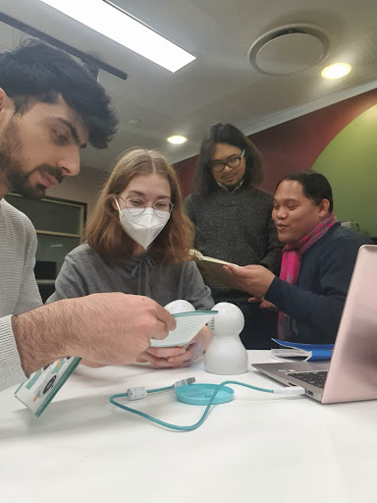
ACTIVITIES
Which activities and/or methods did you use to reach the aim of the project?
We became familiar with the KITT robot ourselves and thought about it critically to understand how it could be best utilised or improved for both the teacher and learner.
With this information and the opinions of our partners we created the Learning Design to show how the KITT robot could work the best in teaching.
We met up with and introduced the KITT robot and the Learning Design to a small group of lecturers of education and later on with more than 80 in-service kindergarten professors.
We collected feedback from them in order to improve the robot to their and childrens’ needs.
Notes:
Part 2 - Usama

Slide 6
RESEARCH BASE
Which sources/previous research did you rely on in your activities?
Research literatures on innovation of robots.
Innovations in pedagogical techniques.
Potential adaptation of these innovations based on studies.
Designing a project in a learning setting.
How did knowledge from different disciplines help to achieve the desired result?
Our academic discipline consists of Communication Management, Film Studies, Law, Liberal Arts and Politics. These disciplines are research and communication based and students are trained to exercise critical and analytical thinking. Besides the fact, We as a team values the importance of communication and collaboration. Thus, we believe that by using those skills, we can come up with a solution that resonates well and responds to the challenges posed to us by the client-teachers.
Notes:
Part 4 - Arnel

Slide 7
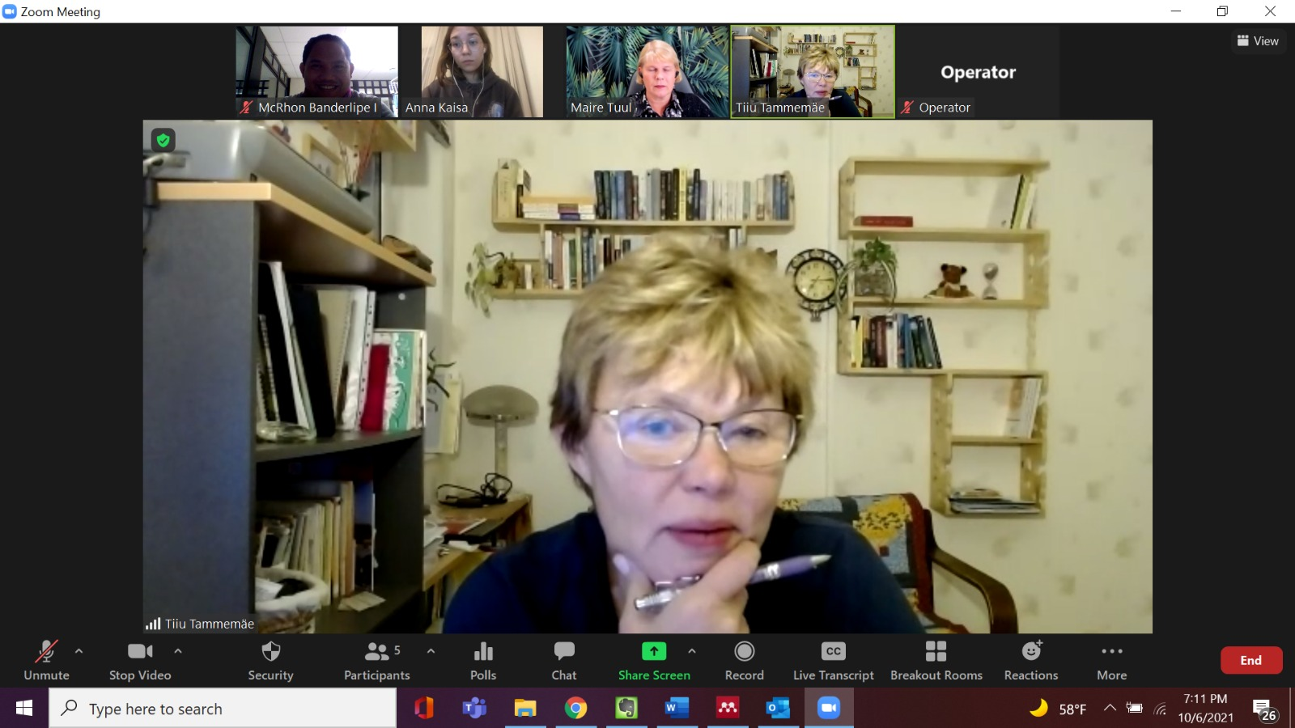
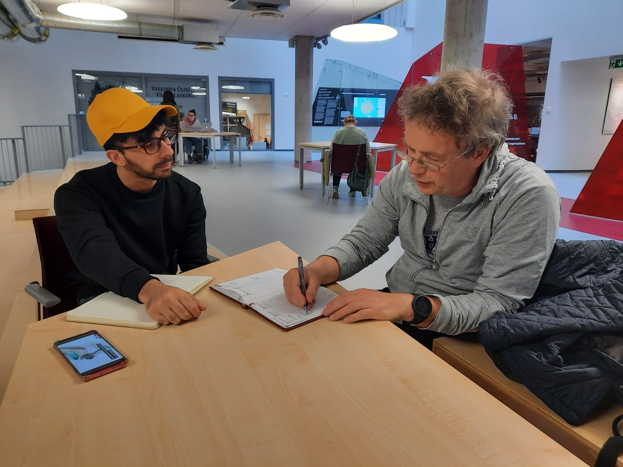
ACHIEVEMENTS
What and how well were created?
Coming up with Learning Design (educational activities) for the robot
Introduced the KITT robot to lecturers of the university three different times: to our partners, in person to 10 lecturers and on Zoom to 80 lecturers
Video showing how to use the KITT robot
Also a written introduction to the KITT robot in Estonian langage.
Collaterals, blog posts, Scoial Media Platforms.
Notes:
Part 7 - Anna Kaisa?

Slide 8
TARGET GROUP
How big was the target group?
Our partners: Professor Tiiu Tammemäe (lecturer on special needs) and Professor Maire Tuul (associate professor on math didactics in early childhood)
On the Educational Day there were about 10 lecturers who teach pre-school teachers at Tallinn University
On In-service teachers seminar, More than 80 teachers have been introduced with KITT robot.
How many lives were changed?
Ours by seeing and continue advocating for the usage of educational robotics
We helped the KITT robot manufacturers to see what can be improved.
Some of the lecturers were interested in educational robotics and we hope they would help start using robotics with children: we hope this will ease some children’s learning and make it more fun.
Notes:
Part 7 - Anna Kaisa?

Slide 9
Results
What can you conclude from the results?
The KITT robot should be improved a lot in order to utilise it more in terms of educational activities.
The KITT robot has not been in use for the universities, pre-school or in elementary school.
Lecturers and teachers have became more interested in educational robotics when they are introduced to the robot and shown how it can be used in teaching and learning.
Traditional learning is being improved by Educational robots awareness.
Notes:
Part 7 - Anna Kaisa?

Slide 10
Results
What is the summary?
Our Project team has shown to lecturers how the KITT robot can be used in learning activities which is helpful to eliminate traditional learnings and improve. Also, remarks and concerns raised by lecturers delivered to manufacturer that how their product can be improved in terms of its features & characteristics in upcoming future versions. For this purpose, we had to contact Estonian Market Respresentative or distributor of KITT robot product who has firstly informed us about their efforts to improve and appreciated the effort made by our team as our project has bring valuable insights for their product upgrade and to keep it according to Estonian Market demands.
Notes:
Part 7 - Anna Kaisa?

Slide 11
THANK YOU FOR LISTENING

