Slide 1
IRIS Connect
and 360-degree camera
We bring future technologies to the selected courses today!

Slide 2
Disciplines represented:
Educational Technology, Andrei Rudz (Estonia) IT Management, Kalvi Tammalu (Estonia) Social Entrepreneurship, Jesulayomi Mercy Ojo (Nigeria) Crossmedia in Film and Television, Aliisa Rantanen (Finland) Crossmedia in Film and Television, Nikita Petrov (Estonia) Information Science, Indrek Vimberg (Estonia)
Supervisor(s)/mentor(s):
Janika Leoste, Jaagup Kippar, Sirly Väät, Marika Kutškova
Partner(s):
IRIS Connect and Tallinn University
Notes:
indrek

Slide 3
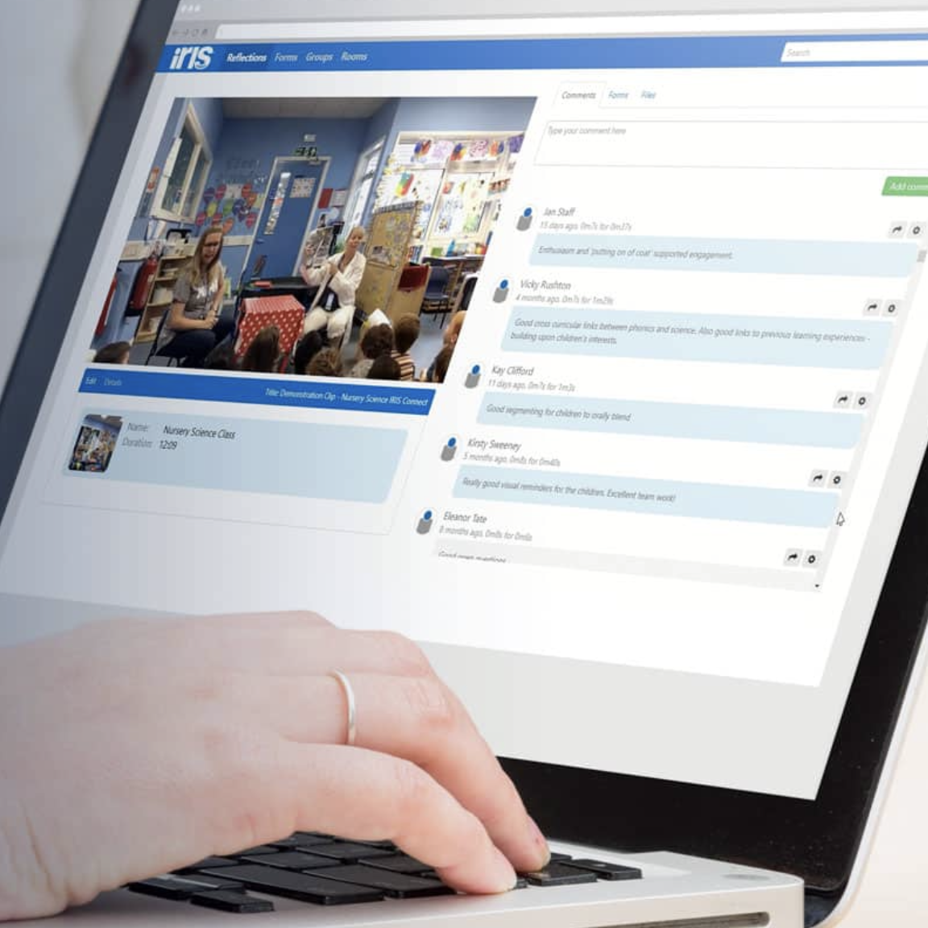
WHAT IS IRIS-CONNECT?
Reflection tool for teachers/lecturers.
How does it improve teachers?
Why is it important to TLU lecturers and students?
Notes:
Andrei (1 min)
IRIS Connect is a video-based, online professional development platform for teachers.It Improve teaching quality.
It's totally secure and enables all of the key professional development activities needed to improve classroom outcomes.
IRIS Connect is a secure, personalised platform for teachers to record, analyse and reflect on their practice.
(benefits, why is good.)
Main benefit is:
that you can film your classroom and comment on timeline.
Everything is private and secure (Main value is privacy)
and study shows that video reflection improves teaching practices (and pedagogy.)
Iris connect improves teachers by giving them opportunity to reflect on their work.
The platform is an online solution that can be accessed from both the app and the browser,
and it has been made as easy as possible.
The teacher can film their own lessons and share them with colleagues who can give feedback.
And based on this feedback, the learning process can be improved.
The platform is mainly intended for teachers, but can also be used by others.
Tallinn University uses a platform in teacher training to analyze students' practices.
and our group was tasked with helping to use and set up the platform.
(to using video observation and coaching in teacher development.)
(For teachers to collaboratively reflect on classroom teaching,)

Slide 4
CHALLENGE, GOALS AND OBSTACLES

Slide 5
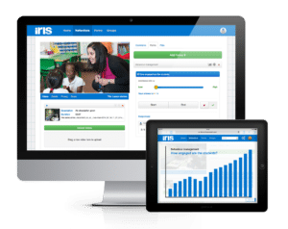
CHALLENGE
Input from Tallinn University
Implementing IRIS Connects into the teaching process
To improve teaching process using new technologies
Notes:
kalvi
How we defined our challenge: our challenge is to implement IRIS into…
Initial input we got from …
our overall aim was to improve teaching ..

Slide 6
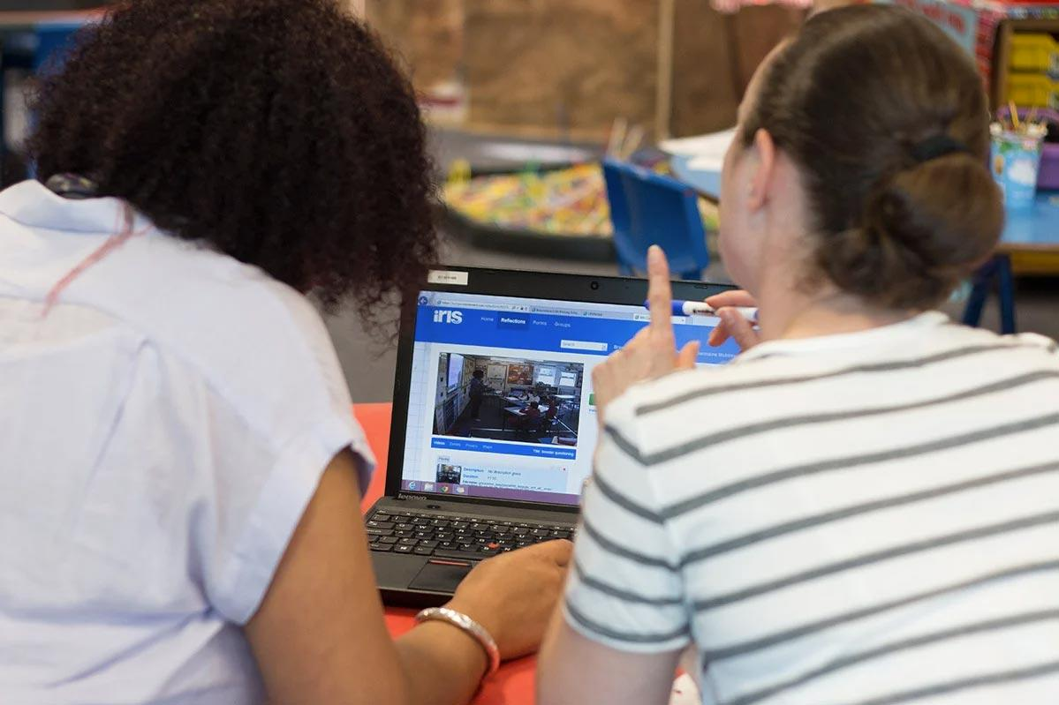
GOALS
Implementing IRIS Connect into the teaching process
4 lecturers have skill to use it and are able to introduce it to their colleagues
Creation of supporting documentation and promo materials in 2 languages
Notes:
kalvi
When we had defined our challenge we set our goals. Again - overall goal was to implement…
But from measurable goals we wanted 4 teachers..
and to create materials .. for when the project is over

Slide 7
OBSTACLES
Main Obstacle:
New technologies and new processes
Notes:
kalvi
Few obstacles we thought we might stumble upon, were that often people don’t like changes and new things that much

Slide 8
ACTIVITIES IMPLEMENTED
Notes:
Aliisa

Slide 9
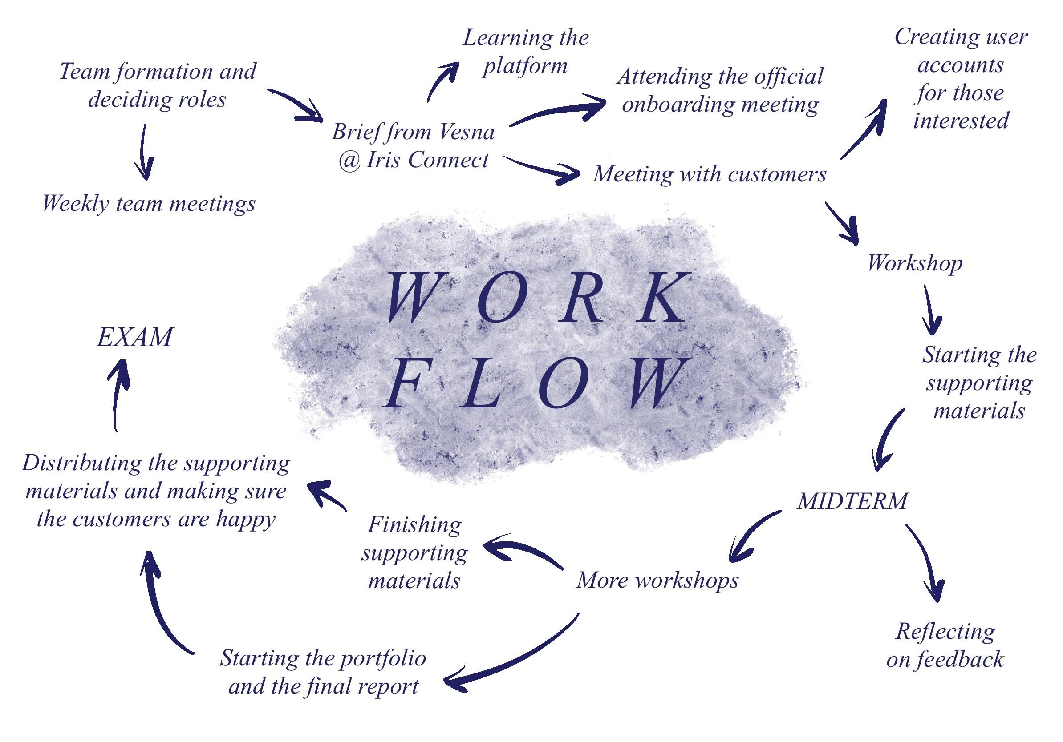

Slide 10
RESEARCH BASE AND INTERDISCIPLINARY APPROACH
Notes:
Nikita (2 parts one academical, second is skills and background of the team)

Slide 11
SOURCE BASE FOR ACTIVITIES
Activities are backed by scientific knowledge and research
Teacher self-captured video: Learning to see. Phi Delta Kappan (Sherin & Dyer, 2017).
Video is an important tool in teacher education and professional development (Sherin & Dyer, 2017).
Learning to Think like a Teacher: Effects of Video Reflection on Preservice Teachers’ Practice and Pedagogy. Action in Teacher Education (Gibbons & Farley, 2020).
The use of video as a tool for reflection with preservice teacher (Xiao & Tobin, 2018).
Classroom Behaviour Problems: The Relationship between Preparedness, Classroom Experiences, and Self-efficacy in Graduate and Student Teachers (Giallo & Little, 2003).
Students from different areas enrich the project with knowledge and skills.
Notes:
So the source base for our activities are:
Well Firstly, we have Activities which are backed by scientific knowledge and research, meaning that we have actual concrete numbers to back up our project and you can see examples of what we used on the presentation slide.
And also our team is comprised of students from different fields that broaden the project with knowledge and skills it otherwise wouldn’t have had.

Slide 12
PROJECT RESULTS

Slide 13
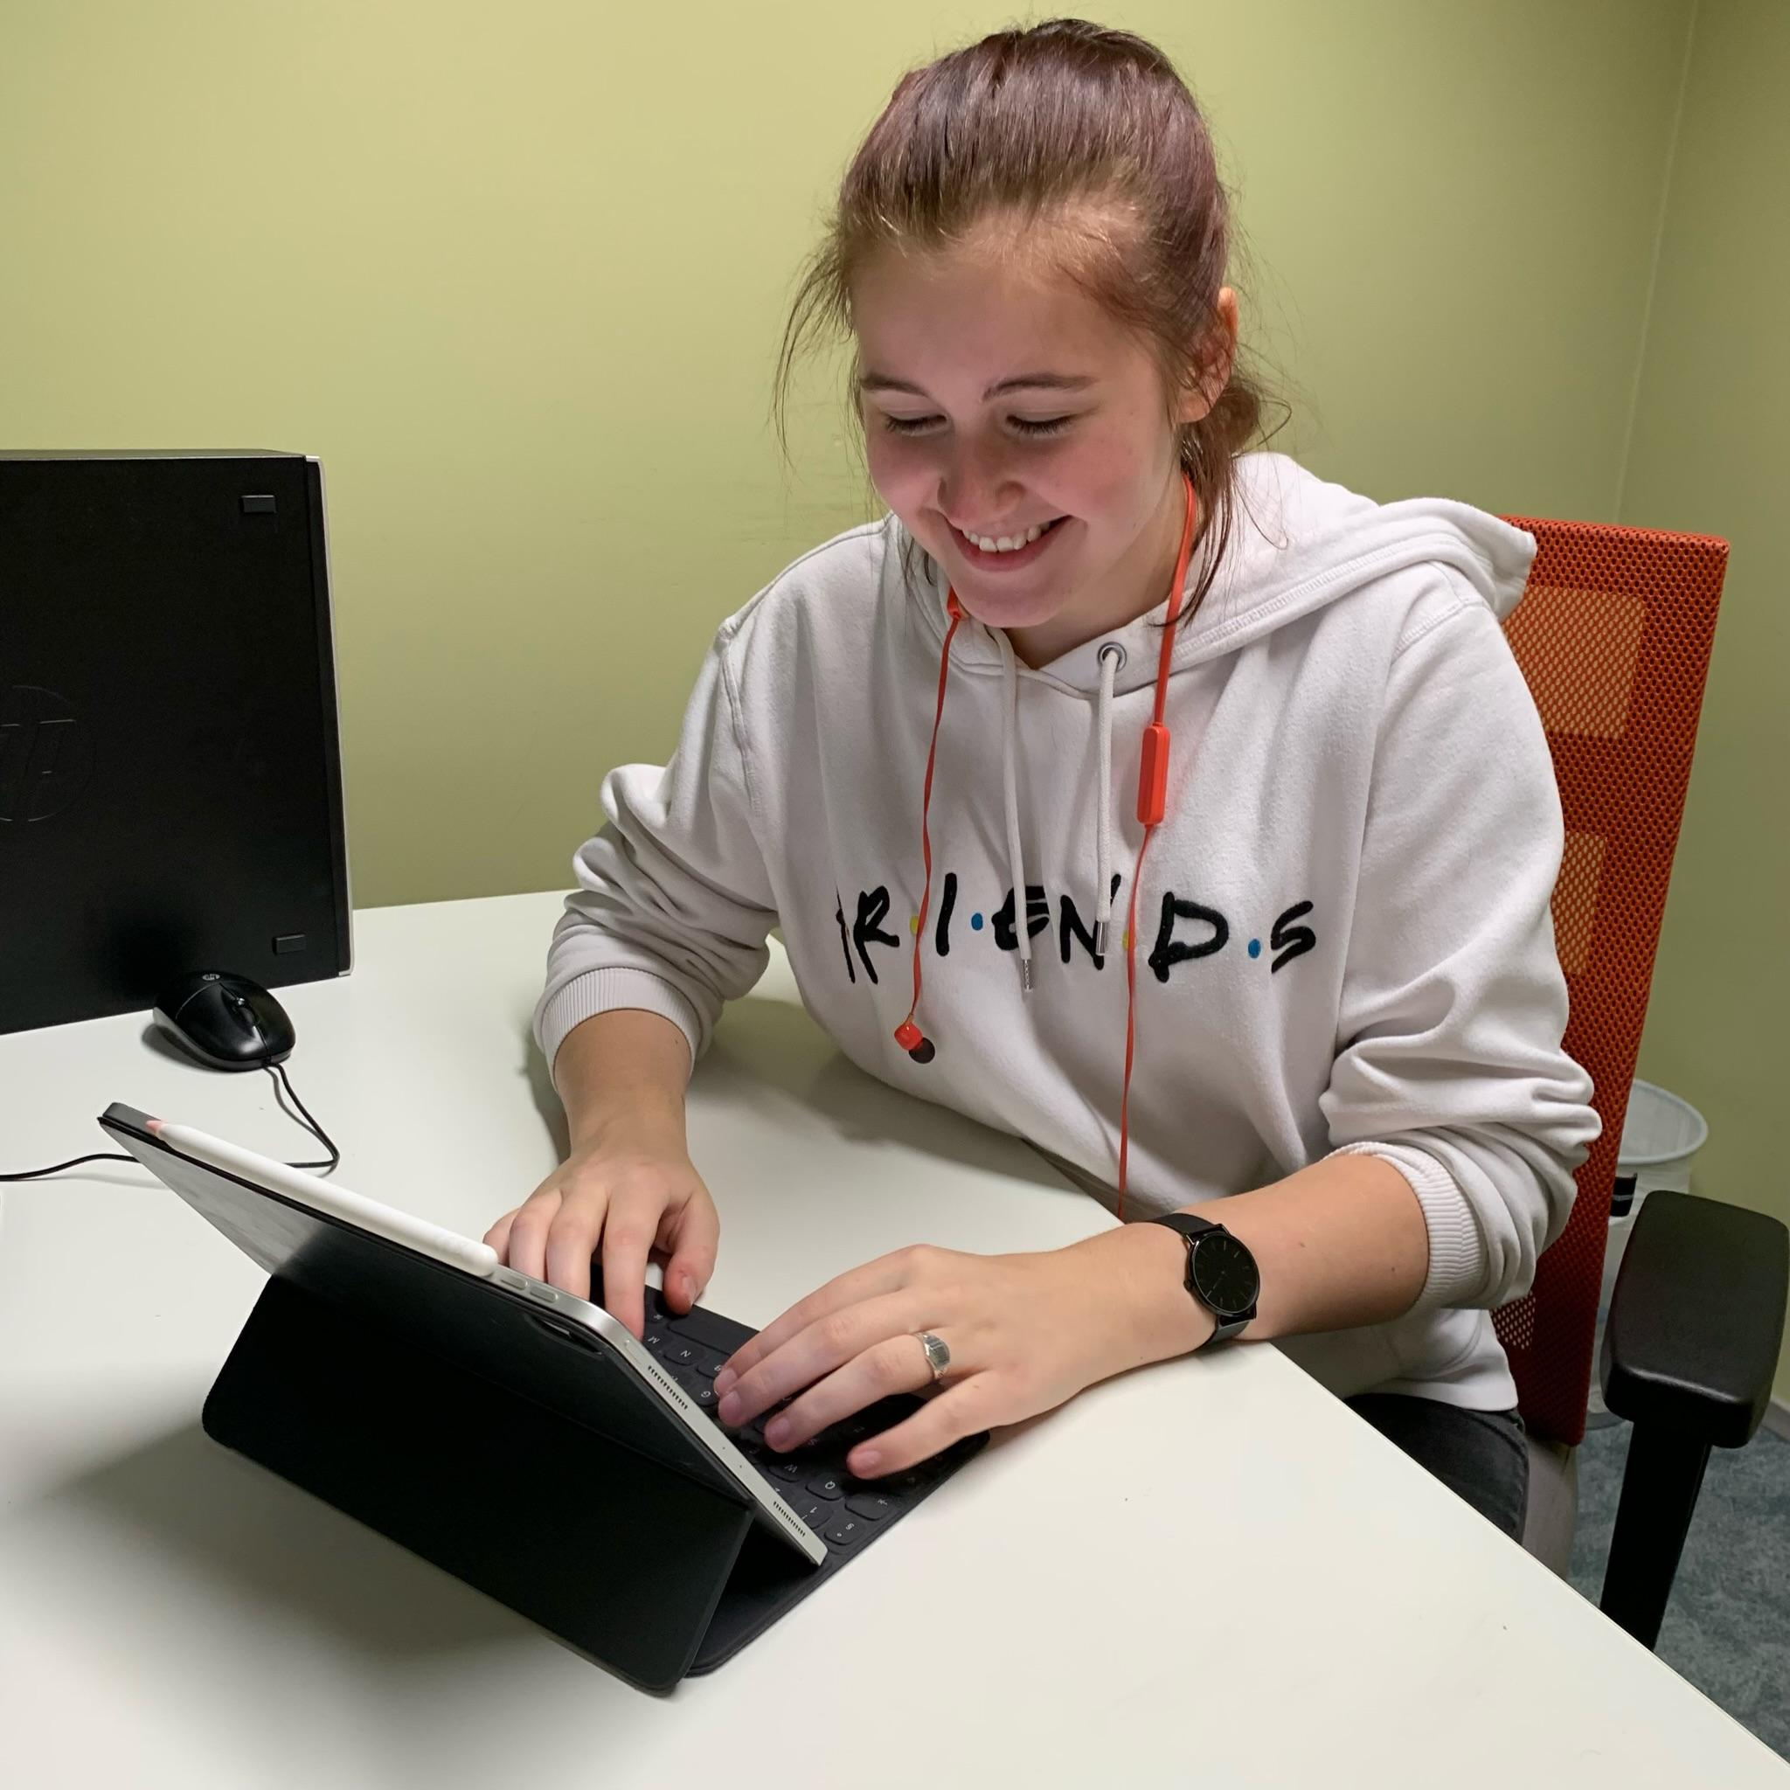
RESULTS
Met 6 lecturers
30 students
Manuals created in 2 languages

Slide 14
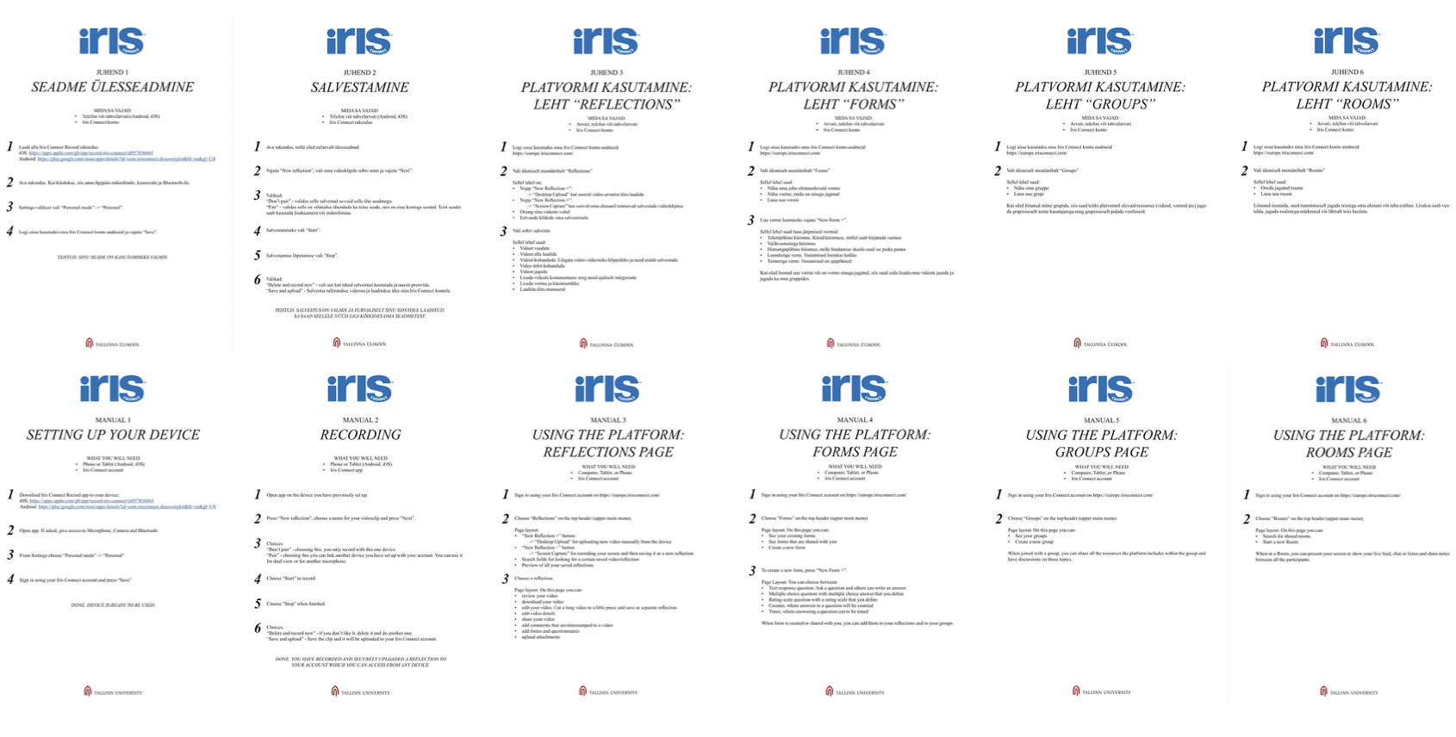

Slide 15
CONCLUSIONS

Slide 16
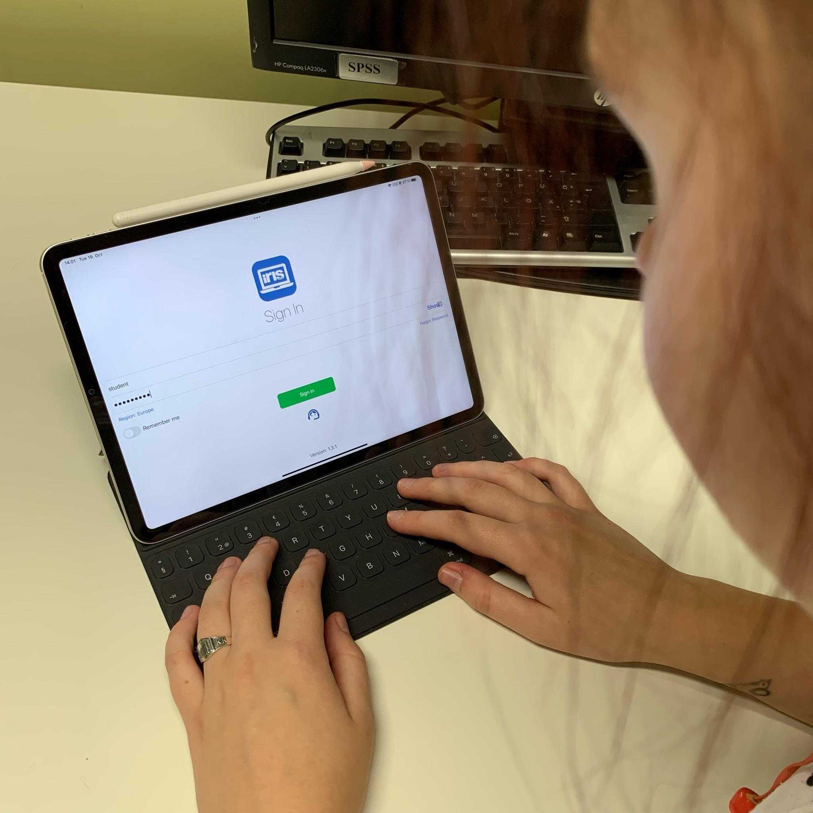
CONCLUSION
No need for 360 Camera
Setting up an account and getting the licence are barriers
Interest is there. Needs advocates amongst the lecturers

Slide 17
THANK YOU

Slide 18
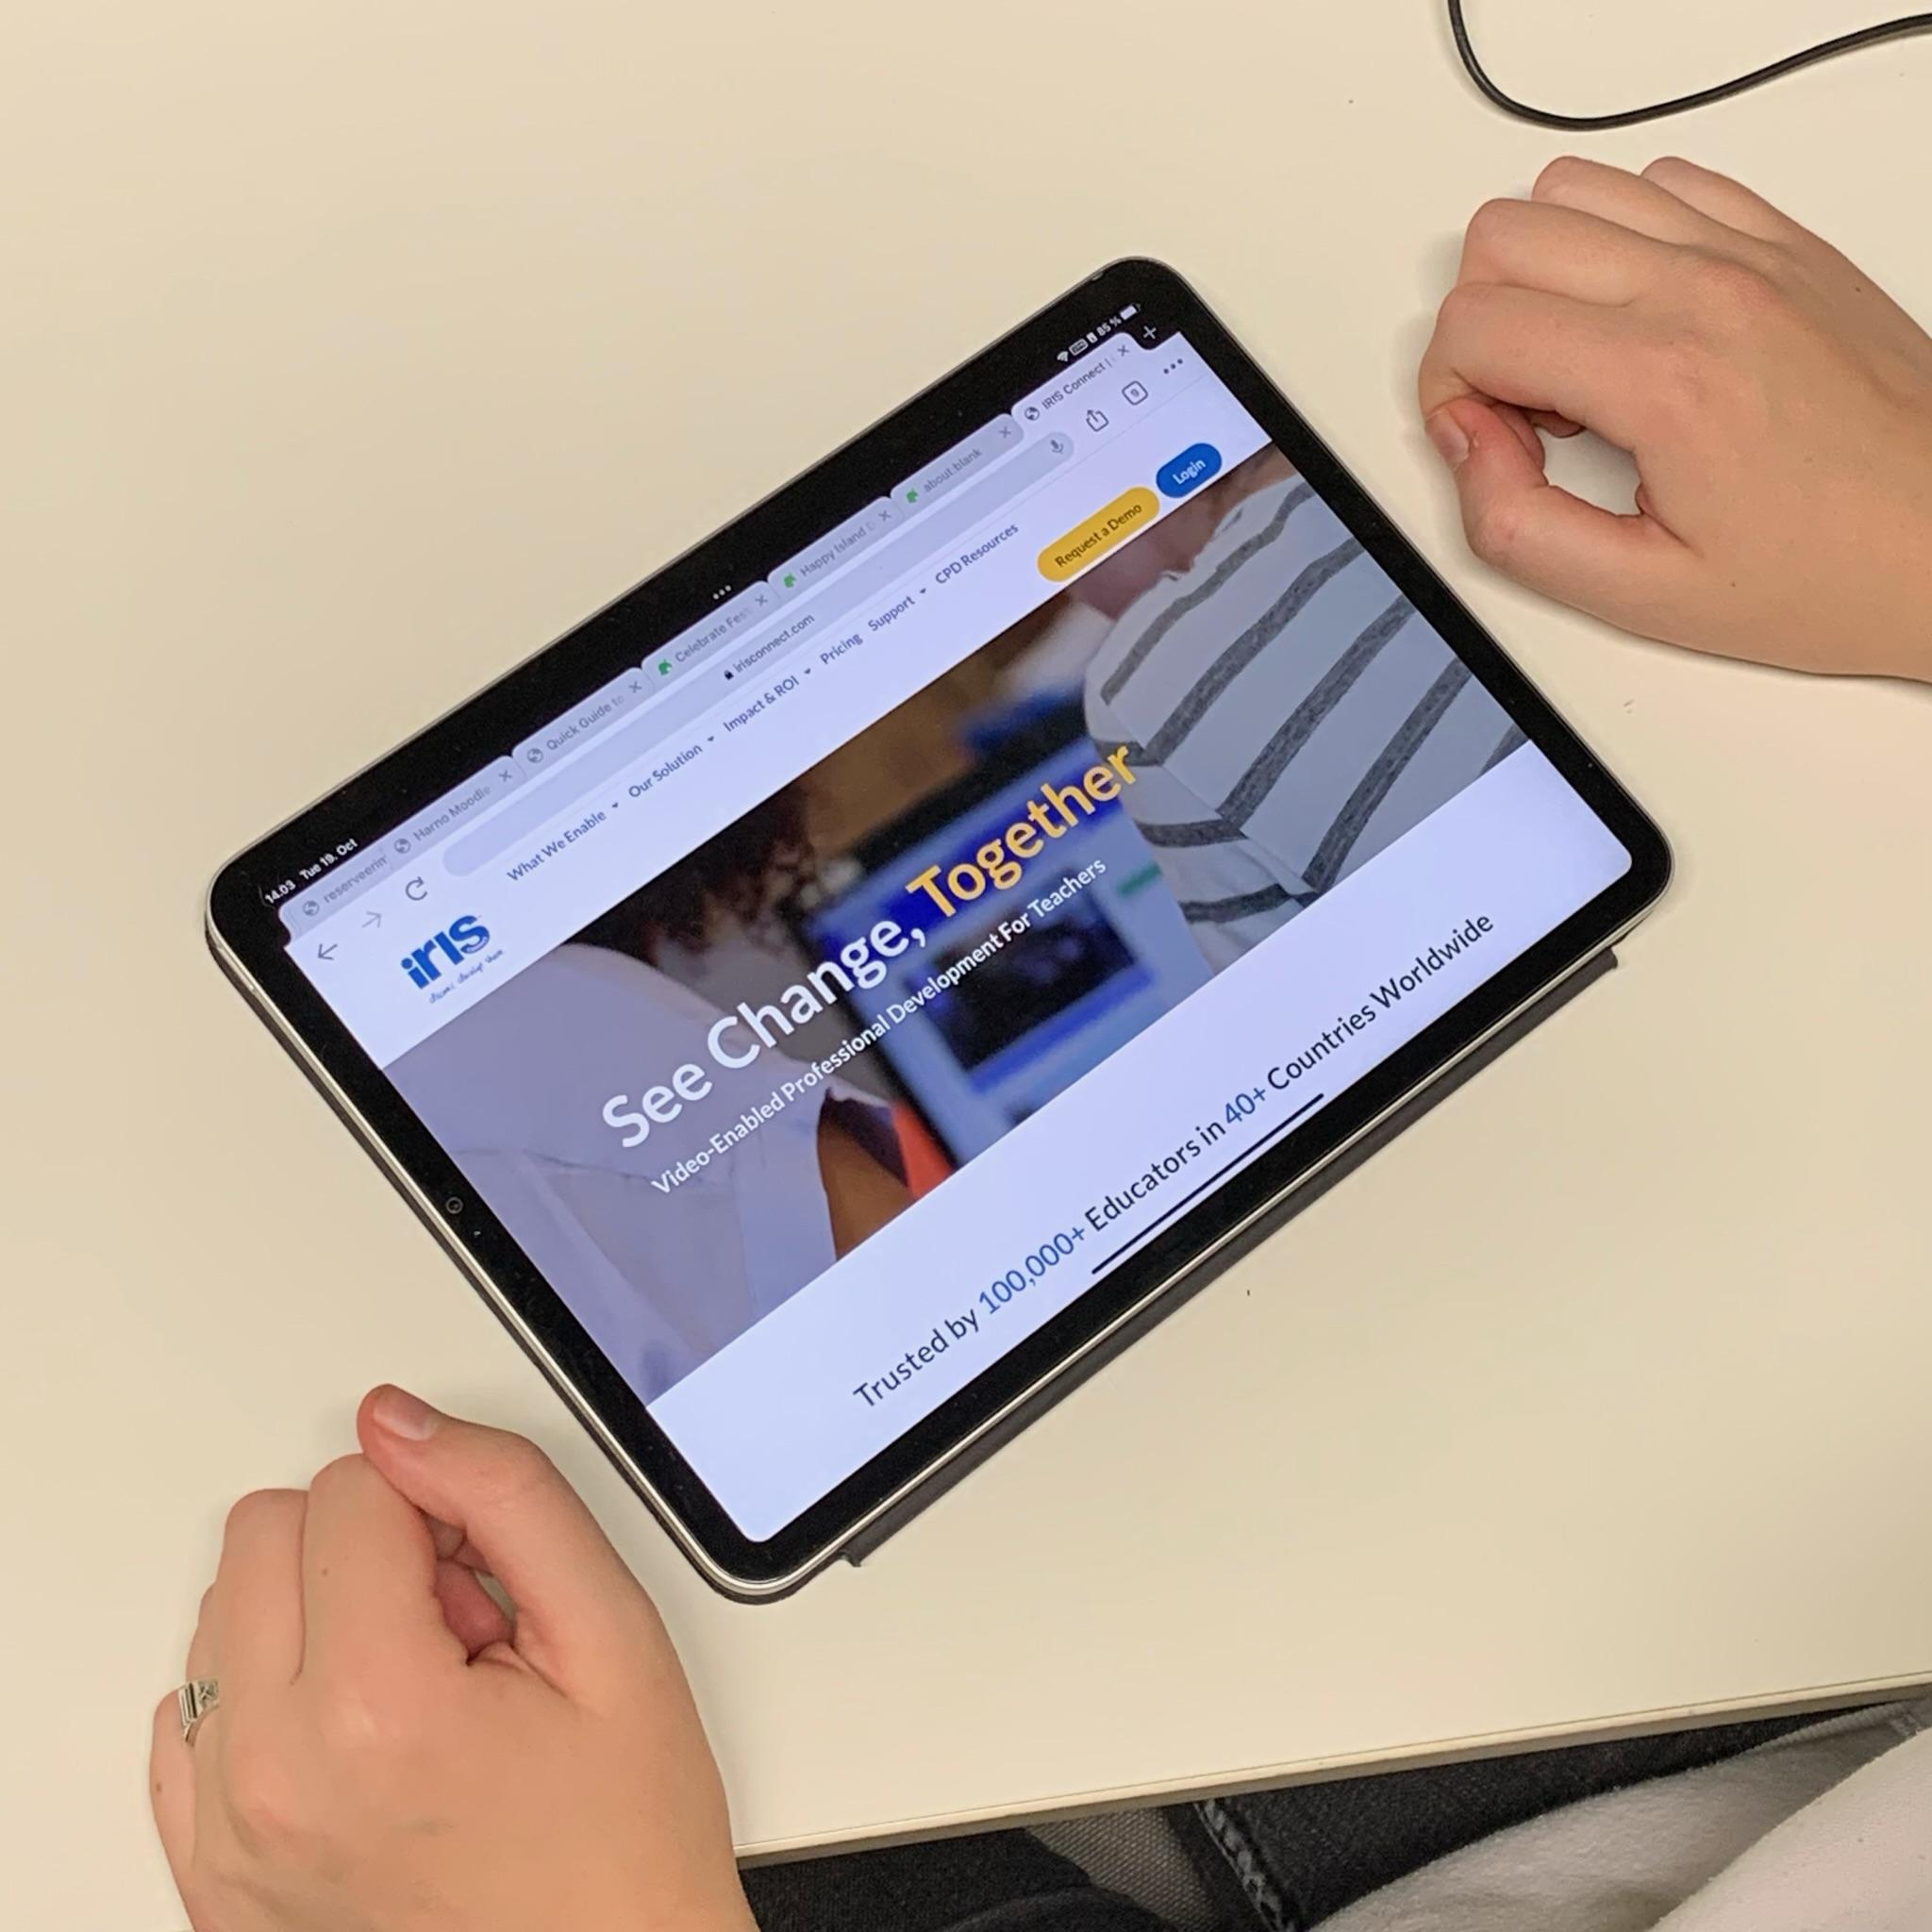
WHO ARE WE?
Nikita Petrov - Scientist of the project. Skilled in audiovisual content creation and academic writing.
Andrei Rutz - Team Leader. Skilled in communication and is the person keeping our ship afloat.
Kalvi Tammalu - Marketing Guru, 14 years of experience in IT in telecommunications and software development fields.
Jesulayomi Mercy Ojo - Customer Success manager, possesses 6 years of experience in the medical field, therefore knows how to work with people and is presently pursuing masters in social entrepreneurship.
Aliisa Rantanen - Learning Designer. Has a keen eye for visuals, 11 years of experience in audiovisual and text-based content creation and design.
Indrek Vimberg - Super Administrator, has 12 years of experience in marketing and communication, business development in information and communications technology (ICT) industry.
Notes:
And a little bit more about that in detail

