Slide 1
INTERACTIVE BOARD

Slide 2
Disciplines represented:
Interdisciplinary social sciences
Social entrepreneurship
Computer science
Supervisor(s)/mentor(s):
Janika Leoste, Jaagup Kippar
Partner(s):
Professor Larissa Jõgi, various doctoral students, students and teachers outside of TLU

Slide 3
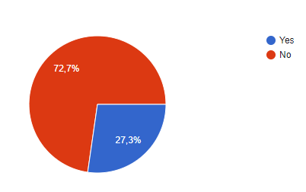
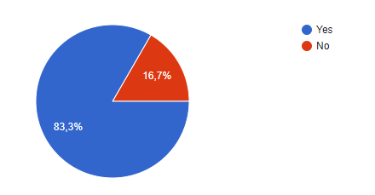
Have you ever used or been in contact with an interactive board?
Students
Teachers, people with teaching experience
Sample size: 110
Sample size: 6

Slide 4
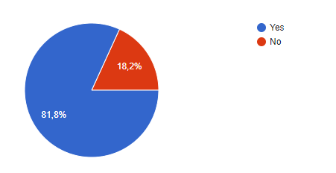
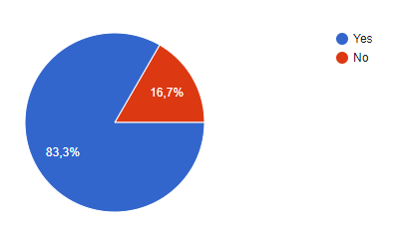
Do you see any potential use for IB’s in learning environments?
Students
Teachers, people with teaching experience
Sample size: 110
Sample size: 6

Slide 5
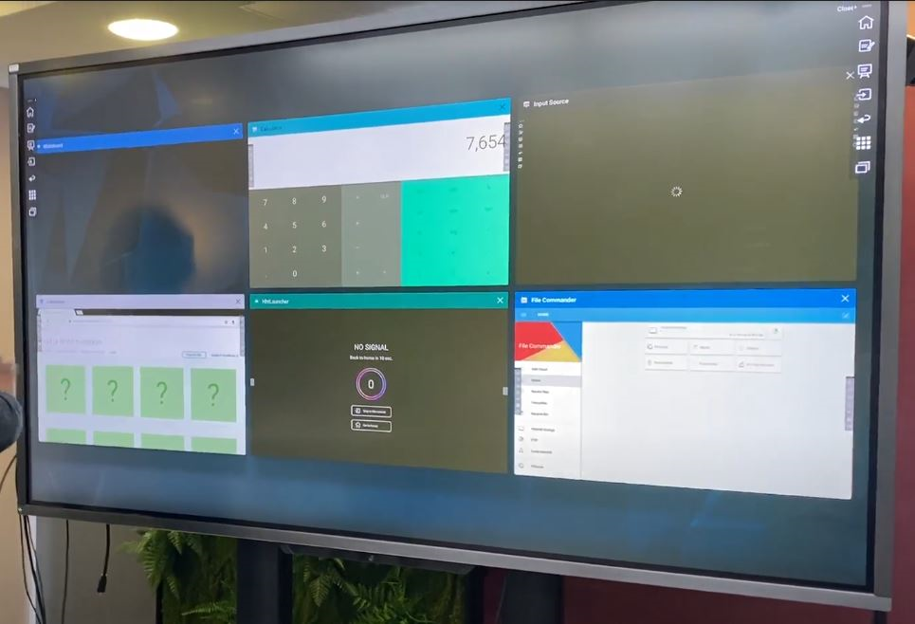
Major Factors Why Teachers Dislike Interactive Displays
Too complicated to use
Not agile enough to fit today’s teaching pedagogy
Lack Classroom System Integration Processes
Need extensive rollout, professional development, and organizational adoption
Lack file conversion ability

Slide 6
Activity plan

Slide 7
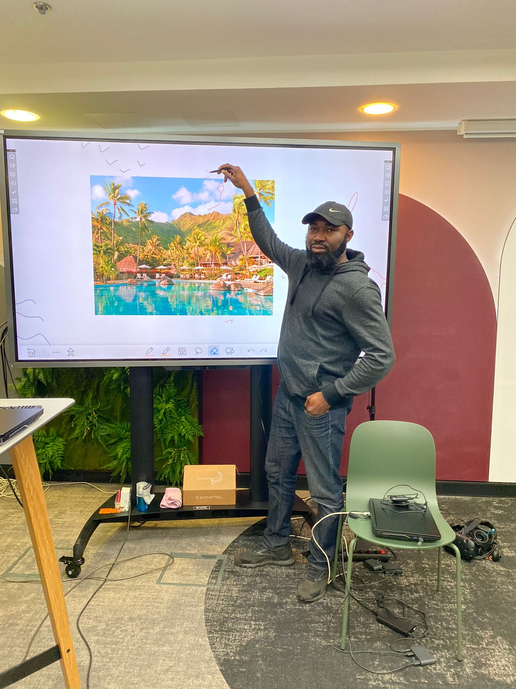
Keys to Success for Getting Teachers to Adopt Interactive Whiteboards
Preparation
Communication
Execution - Trainings, seminar sessions, discussions etc.

Slide 8
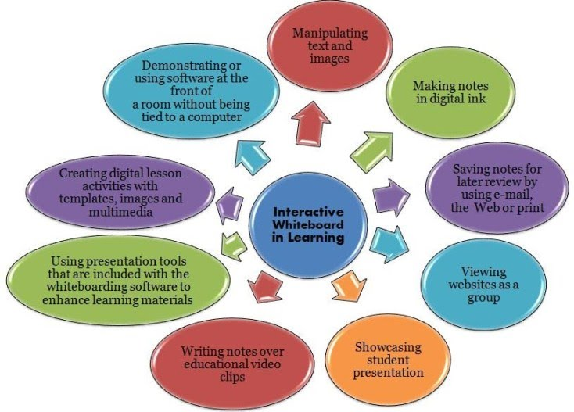
Benefits of using the interactive board
Teachers can use web-based resources in whole-class teaching.
Provide materials such as text, pictures, sounds, video segments, and animation.
Teachers can save & print elements from the board, including notes made during the lesson,
Allows lecturers to share and re-use materials, reducing workloads.

Slide 9
Research and disciplines
the English language teachers of Jeddah Schools, KSA
Karadag, M., Koc, A.& Kalkan, U. (2017). The impact of smartboard usage on the class management.
“Smart board usage has a positive impact on in-class communication and makes the courses fun and entertaining.”
THE OBSTACLES OF USING SMART BOARD IN TEACHING ENGLISH AT TABUK SECONDARY SCHOOLS Dr. Mowafaq Momani Academic Supervisor of the ELC.University of Tabuk, SAUDI ARABIA

Slide 10
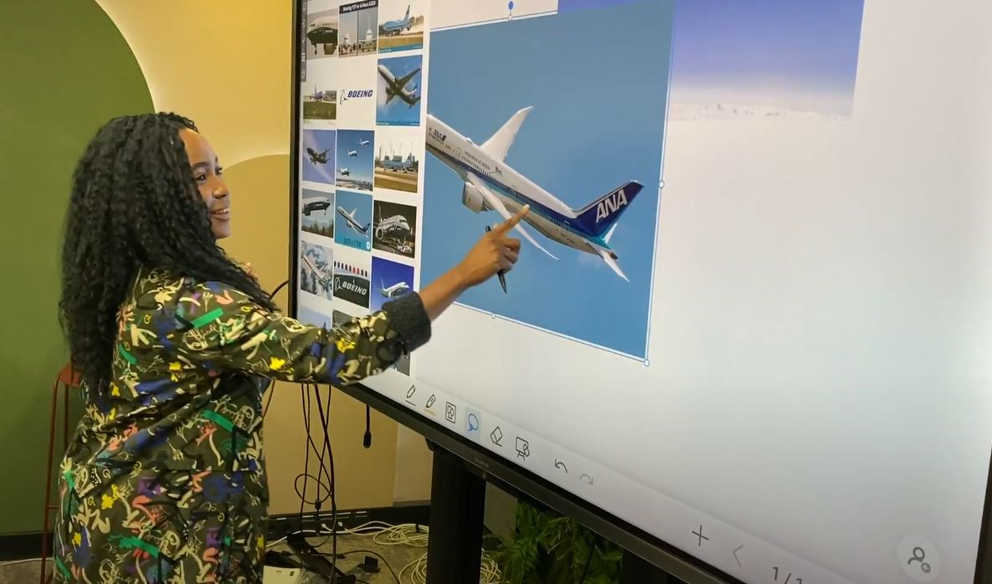
Findings and Feedback
Teachers might still face numerous challenges due to many reasons
Current technical support might be insufficient
The schools’ administration should have a clear vision concerning the smart board, providing materials and resources.
The number of IT technicians should be increased in the beginning stages of Interactive Board use.

Slide 11
THANK YOU FOR LISTENING

