Slide 1
Project Logopuu
Portfolio

Slide 2




TABLE OF CONTENTS
Project Report
Project Action Plan
Results
Self-Reflection Reports

Slide 3
PROJECT REPORT

Slide 4
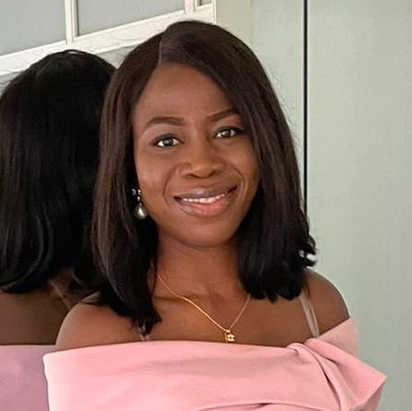
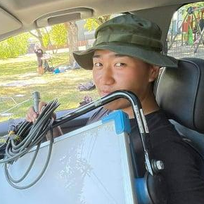


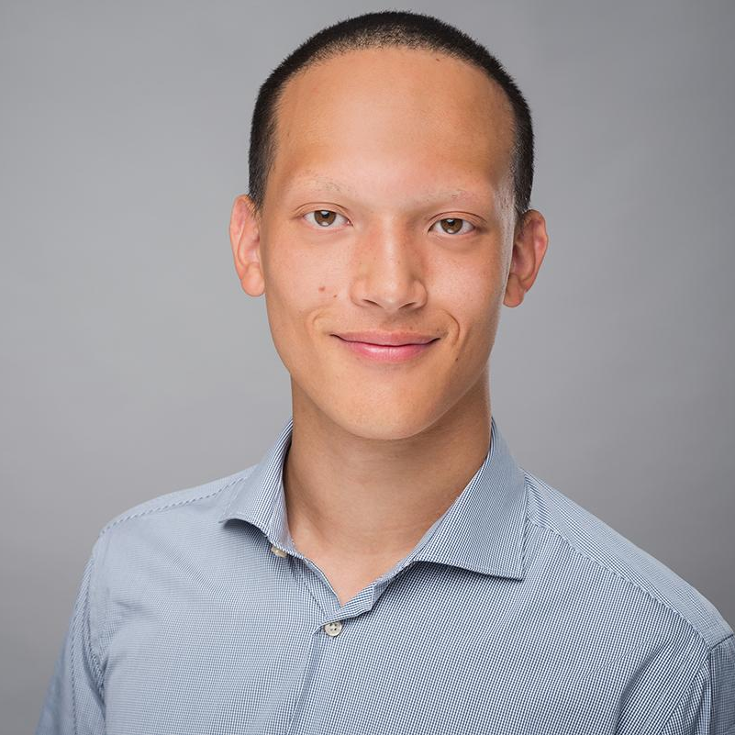
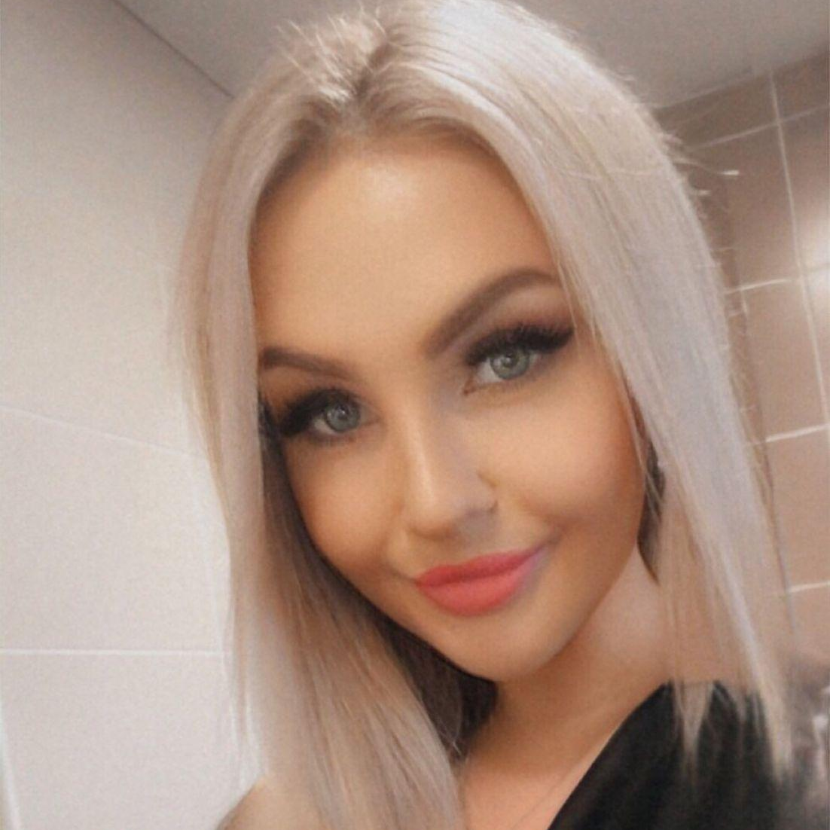


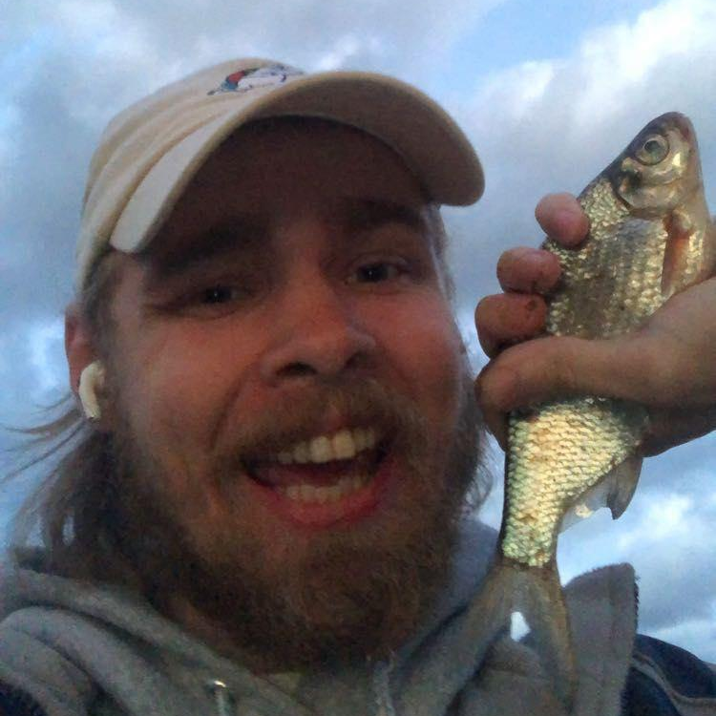


Project Team
The team for this project was diverse and multidisciplinary representing six different countries and backgrounds.
Ajibola Tobiloba
Politics and Governance
Do Hyun Kang
Audio-Visual Media
Kieu Tran
Human-Computer Interaction
Maris Jool
Computer Science
Mohamed Gamal
Estonian Studies
Ville Närhi
Cross-Media

Slide 5

LOGOPUU
Logopuu is a NGO whose mission is to contribute to the development of Estonian children's speech and communication.
In 2020, the team at Logopuu participated in NULA incubator where they reached the finals with their idea. Now, Logopuu is actively implementing their vision.
Name | MTÜ Logopuu
Logo
Website | https://logopuu.ee/

Slide 6
LOGOPUU’S CONCEPT
Logopuu noticed that the low amount of speech therapists in Estonia meant that parents had to wait for months in order to get appointments. As solution, their team developed a questionnaire with which parents can assess the speech development of their children themselves. This allows parents to instantly take action and get feedback about their child. The score they receive from the questionnaire can later be used as a base during the therapy sessions.

Slide 7
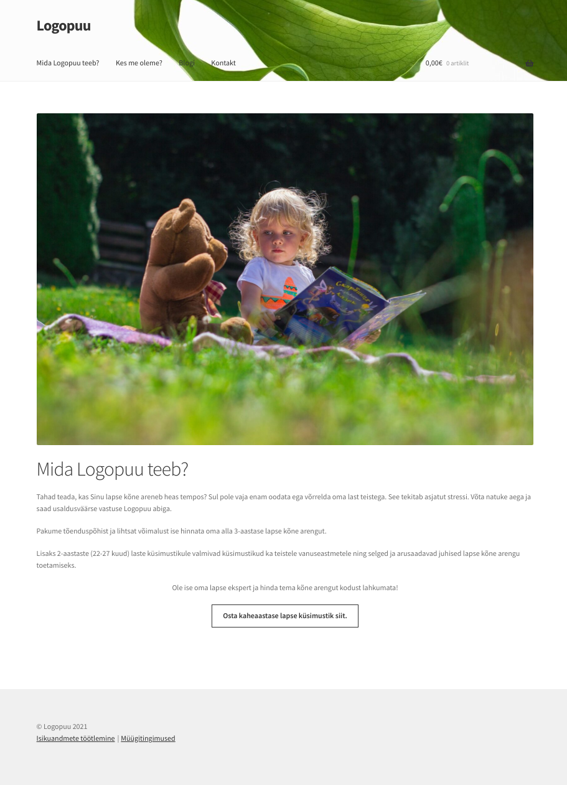
OUR MISSION
In order to reach parents and sell their questionnaire, Logopuu operates a simple website. However, the team felt that the site was outdated and, furthermore, they wanted to implement new features, such as the integration of the questionnaire into the website. When we tested the website with potential users many said that they would not buy a product there, because it did not feel credible.
Our task for this project was to design and create a prototype for their new website. The goal was to integrate the new features in an elegant way, but also to make the website more user friendly and seem more trustworthy.
Logopuu’s website

Slide 8
STAKEHOLDERS
Direct
Logopuu
The NGO will not only operate the website, but is directly affected by how successful it is.
Customers
Parents of young children will interact directly with the website and the products. It is important to deliver an optimal user experience.
Indirect
Children
Parents using the questionnaire will assess their children’s speech-development status. Identifying issues early will allow parents to take measures and improve the life of the child in the long run.
Speech-Therapists
Therapists consulted by the parents will be able to review the results of the questionnaire, giving them important information from the beginning.

Slide 9
PROCESS
Research
The first step in our project was to do research about the topic and the target audience. For this, we used a wide range of methods such as desk research, usability tests, surveys, and interviews.
We came out of the phase with research report describing the subject of speech-development issues, a persona representing our target audience, a customer journey map demonstrating pain-points and opportunities, and a list of user stories containing important functions for the site.
Iteration Cycles
After the initial research phase, we started working on the prototype. For this we did one week long iteration cycles. We started the week working the current version of the prototype, then tested it by the end of the week with representative subjects, and finally met up with Logopuu to present our new prototype and research findings. We concluded the meetings with tasks and goals for the next week.

Slide 10
Research Methods
Desk Research
In order to get a better understanding for the topic of speech-development disorders, we researched articles about the topic and summarizes the findings in a report.
Survey
Conveniently for us, Logopuu already sent a survey to their customers and were kind enough to send us the results. Analysing the answers helped us to gain more insight about our target audience.
Deep-Dive Interview
To truly understand our audience’s frustrations and needs we conducted multiple interviews with parents of young children. Additionally, we also interviewed members from the Logopuu team.
Usability Test
During the interviews we also let the parents navigate through Logopuu’s website in order to see how they would react and get their personal opinion.

Slide 11
OVERALL RESEARCH REPORT
Speech disorder is the difficulty in producing sounds which can effectively express the conceived idea of a person.
Speech disorder can be categorised into four party, a. Fluency disorders, articulation disorders, voice disorder and phonological disorders.
Common types of speech disorder in children.Stuttering, Apraxia of speech, Dysarthria, Dyslexia.
Apraxia of speech; Apraxia of speech is a motor speech impairment which makes children to experience difficulty in correctly and consistently producing speech in spite of knowing the words they intend to say.
Dysarthria: this is a neurological speech disorder which occur as a result of paralysis or weakness of the muscles which produce speech, such as muscle of tongue, jaws larynx, lips teeth and palate.
Dyslexia: Dyslexia is a speech disorder which causes difficulty in reading, spelling and learning word. Researcher can not specify the causes of dyslexia so it is believe that its hereditary. Dyslexia cannot be cure because it is not a disease but its a disability. Children with Dyslexia have their strength in different types of skills, e.g. drawing, creative, skills oral, design etc. dyslexia can be managed.

Slide 12
MARKETING RESEARCH
Six interviews with two different sets:
Mothers of kids with speech problems
Without speech problems.
The interviews were utilized to create two personas and a customer journey map.
We came to certain conclusions based on the interviews, which allowed us make some guidelines for both our developers and Logopuu.

Slide 13
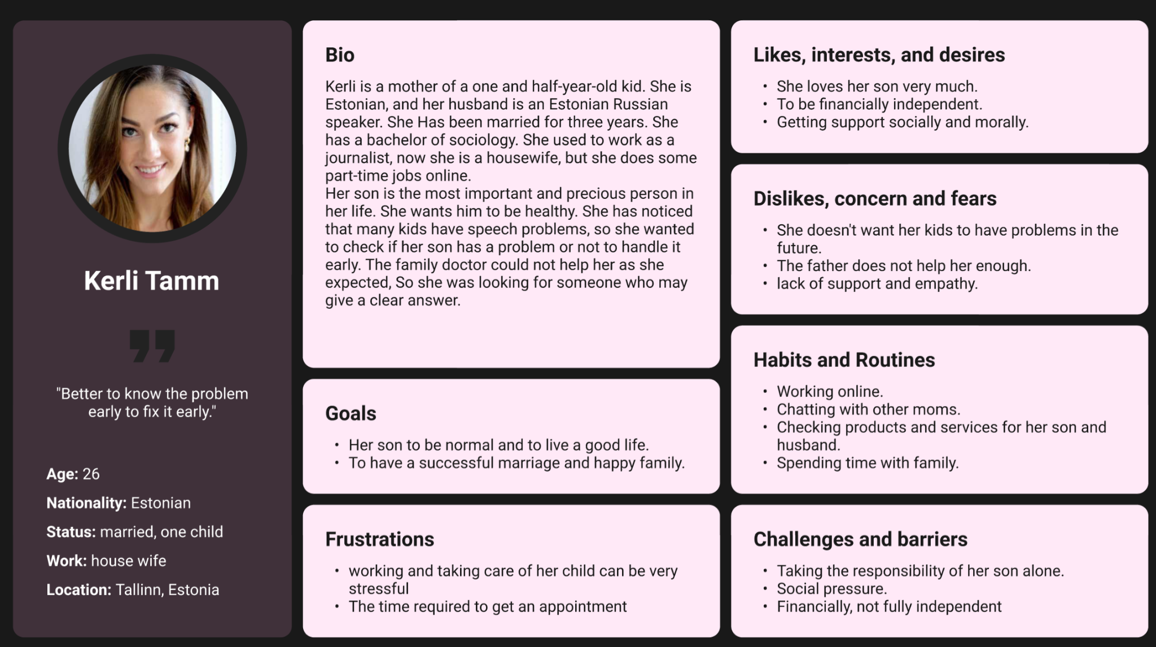
Persona
Based on the insight we gained from our initial research, we created the persona Kerli Tamm. She helped our team to keep an user-centric mindset.
In order to keep a user-centric mindset we always tried to think about Kerli when we made design decisions.

Slide 14
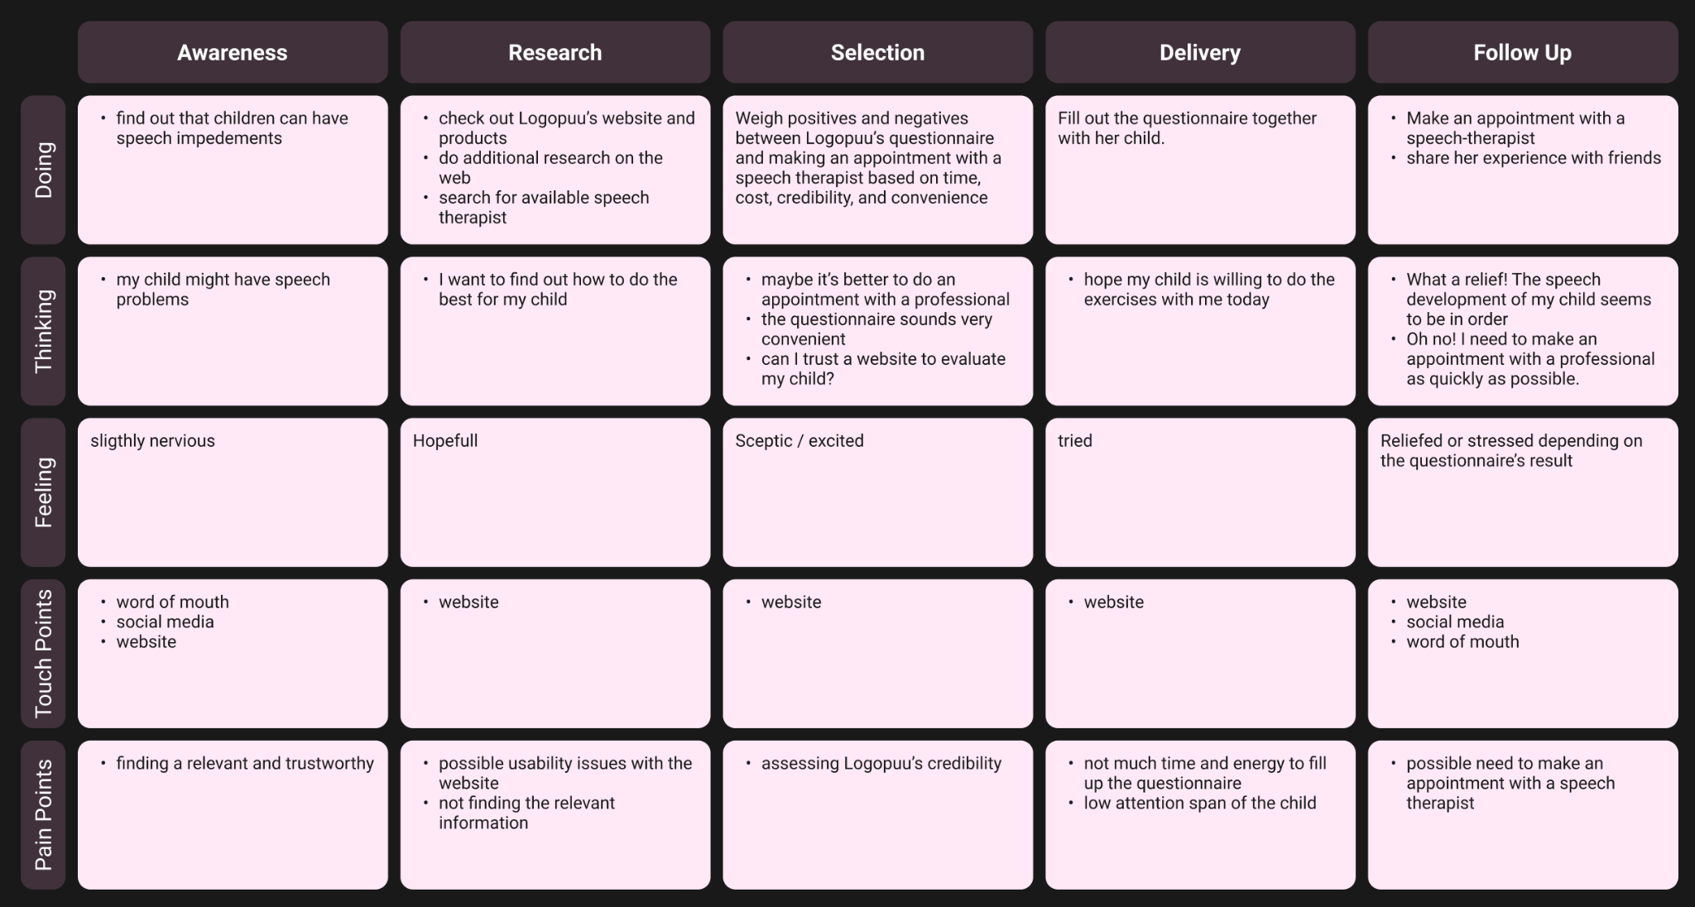
Customer journey map
After going through the research insights we collected, we created a customer journey map. We were able to quickly identify Logopuu's potential customers' objectives and opinions about the website using this artifact.

Slide 15
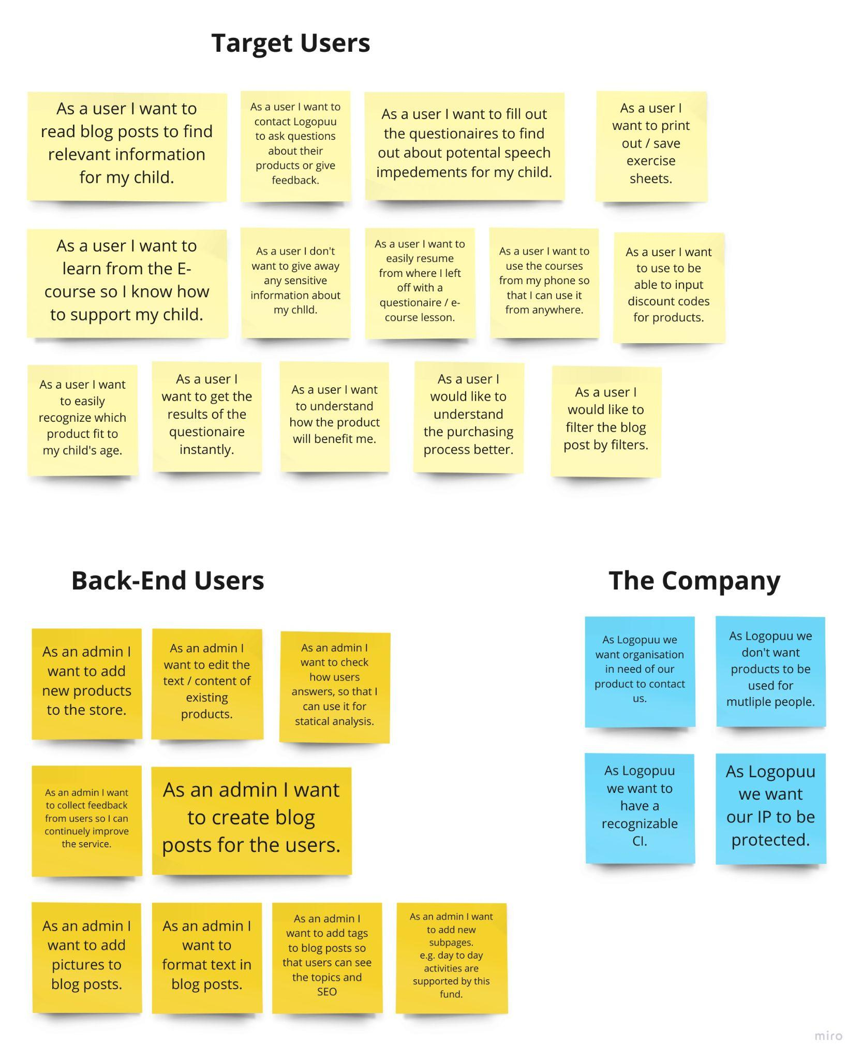
USER STORIES
To define the website’s features in a user-centric way, we created a board of user stories. We divided the stories into categories depending on the stakeholders that interact with the website.

Slide 16
ITERATION CYCLES
Prototyping
Throughout the project, we continuously worked on and improved our prototype. We started with a basic version in Figma and went more high fidelity in Adobe XD. In between we created multiple designs for the pages. The prototypes were interactive and therefore could be easily tested.
Evaluation
In order to get regular user feedback for our prototype we conducted usability test sessions. There, we gave participants tasks to carry out in the prototype and interviewed them afterwards.
Review
Once a week, our team met online with Logopuu to present our latest prototype and insights. By having this fixed and regularly occurring meet up we made sure that we created something new to show. Furthermore, by collecting feedback from Logopuu and discussing design decisions, we found new ways to solve issues and found the most suitable design option.

Slide 17
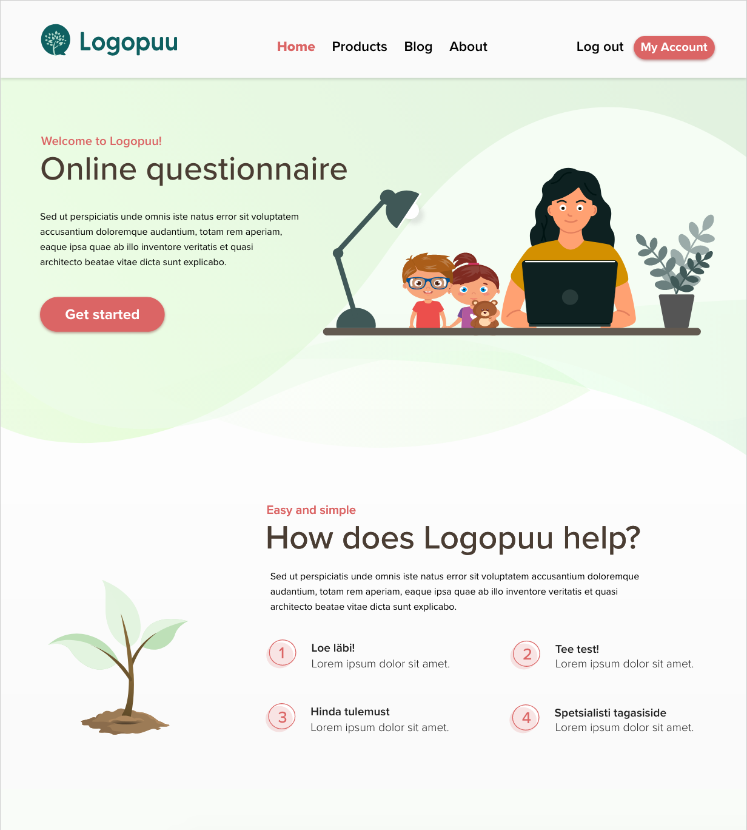
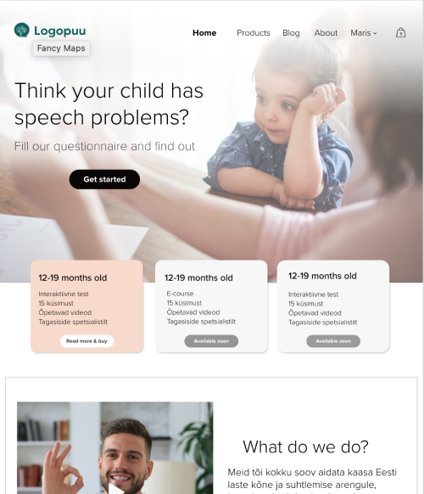
GRAPHIC DESIGN
We created two visual design variations of the website, which we presented to Logopuu:

Slide 18
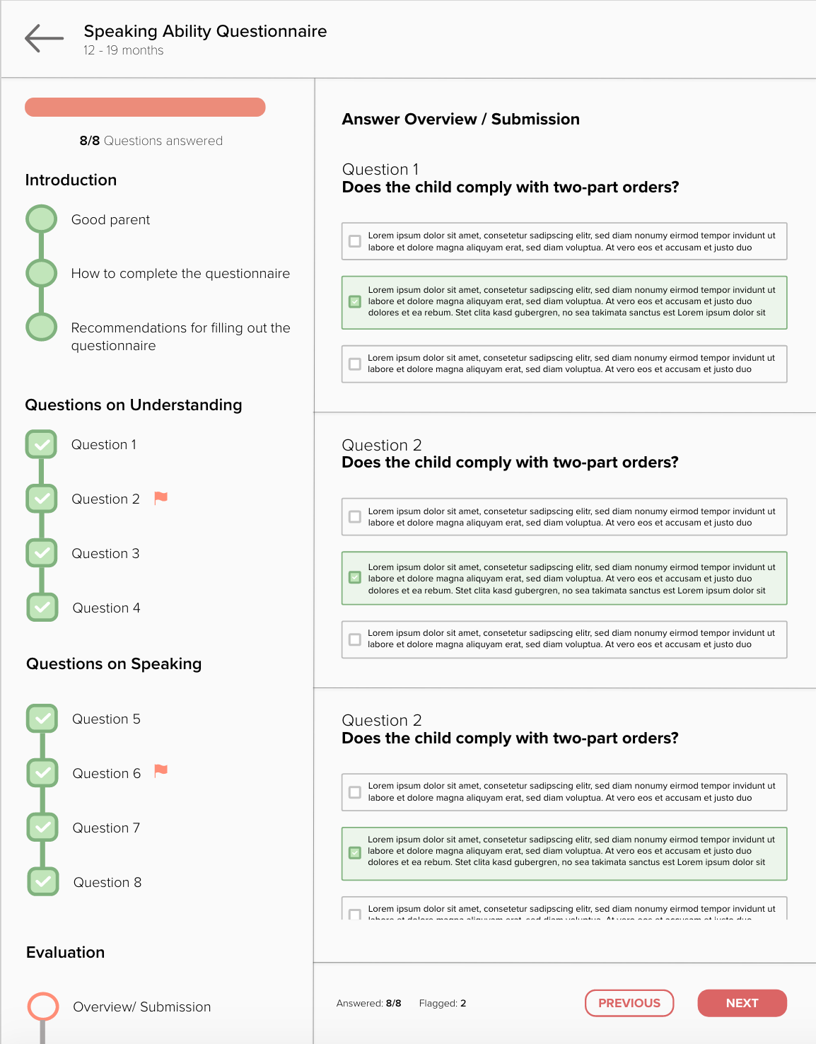
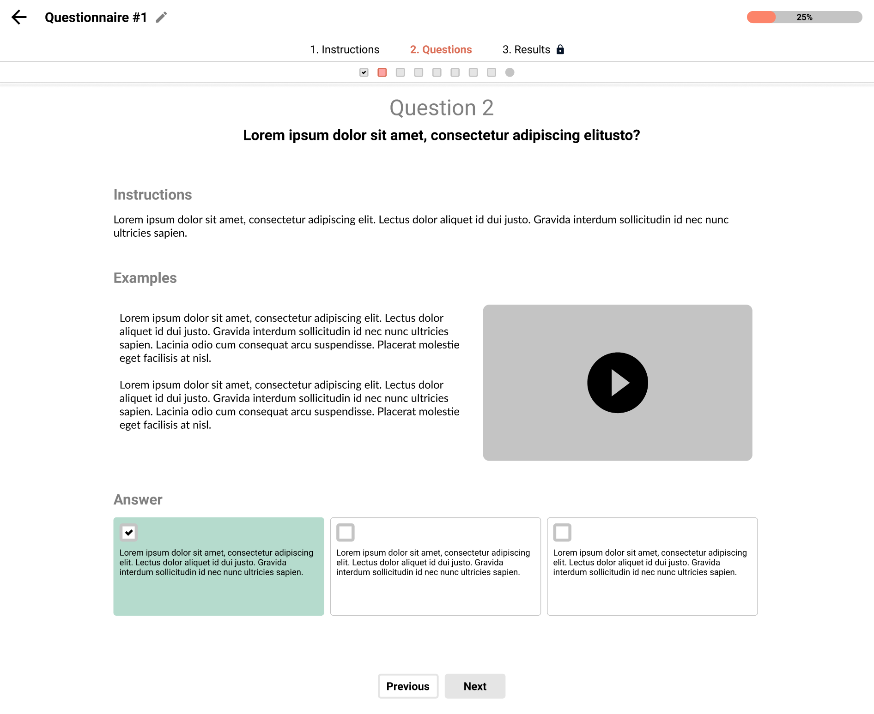
PROTOTYPE
Our prototype continuously evolved from a low-fidelity version to a high-fidelity one:

Slide 19
PROJECT ACTION PLAN

Slide 20
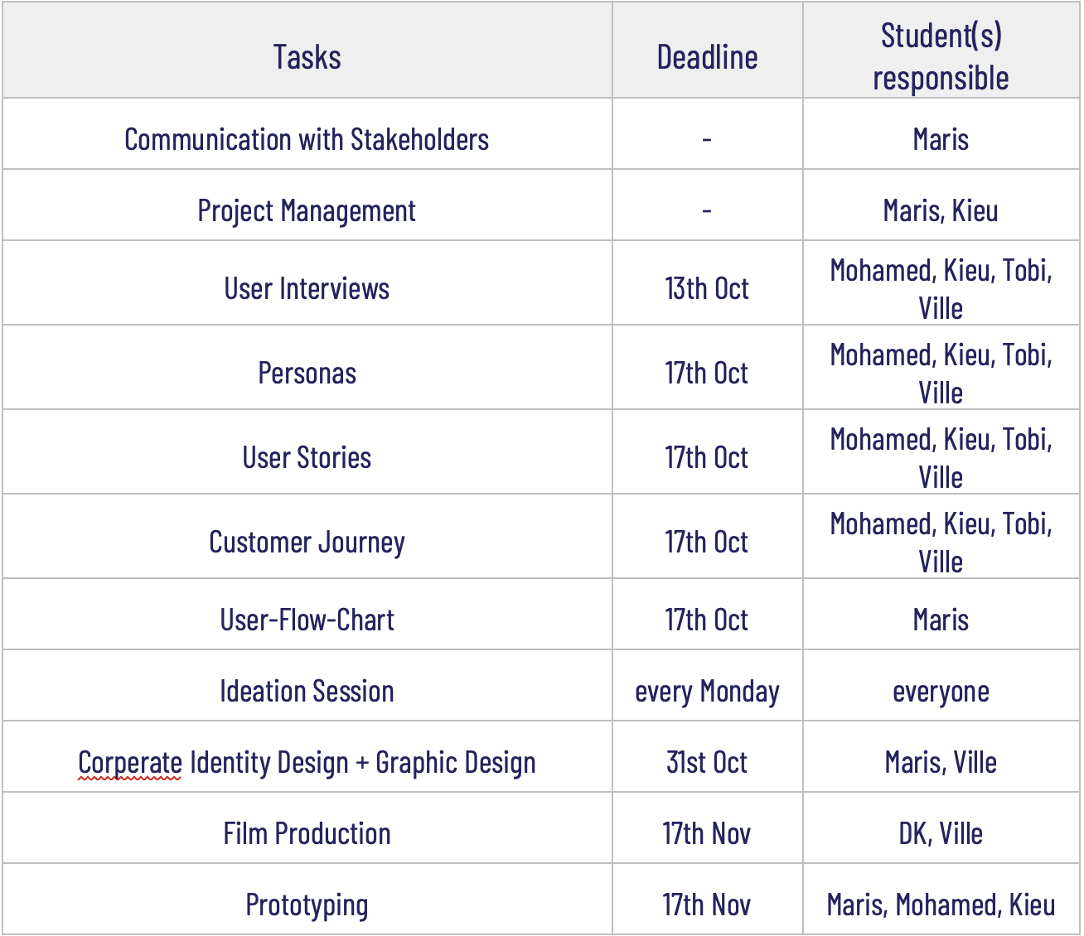
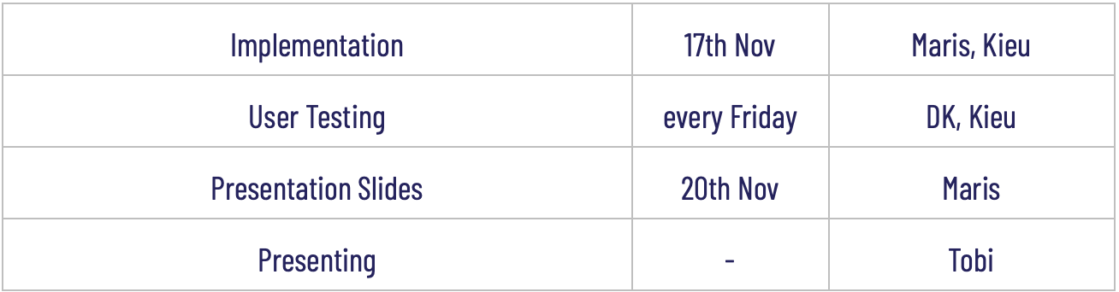
Tasks

Slide 21
RESULTS

Slide 22
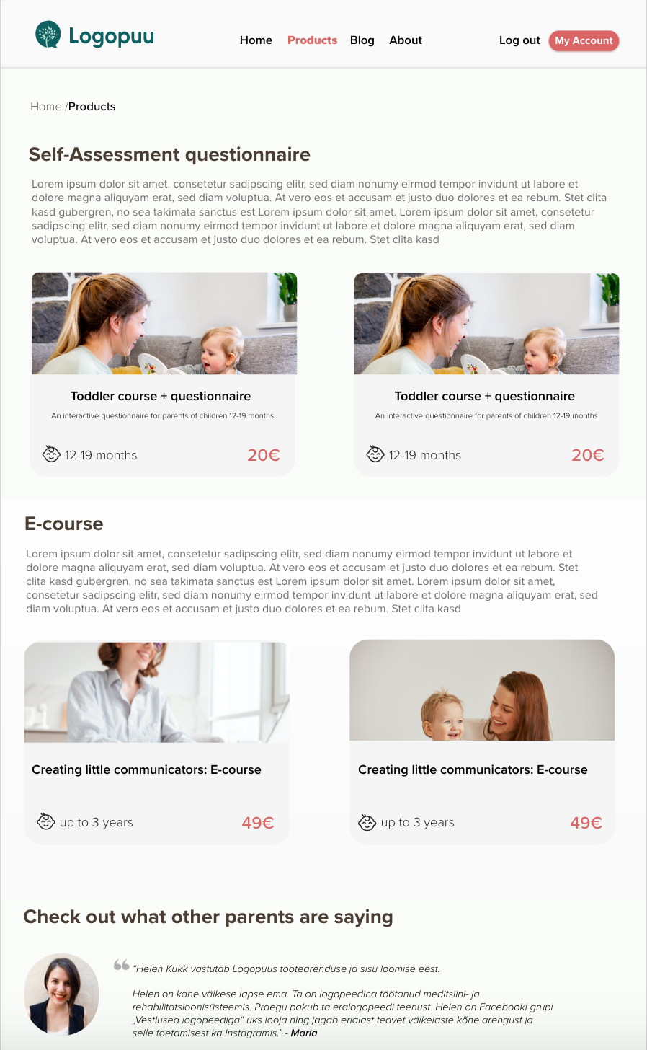
HIGH-FIDELITY PROTOTYPE
Landing page
Products page

Slide 23
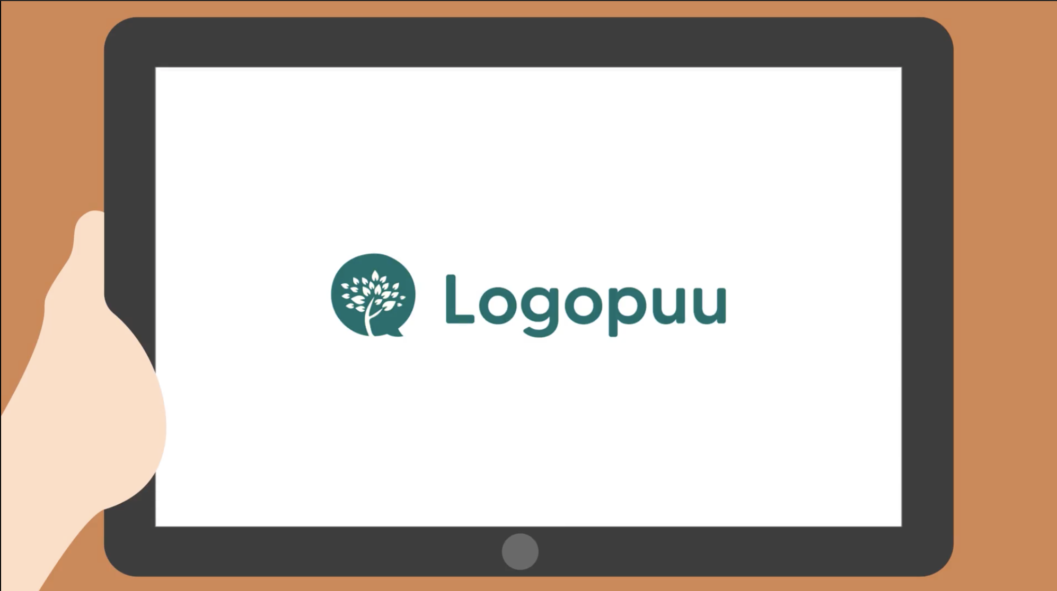
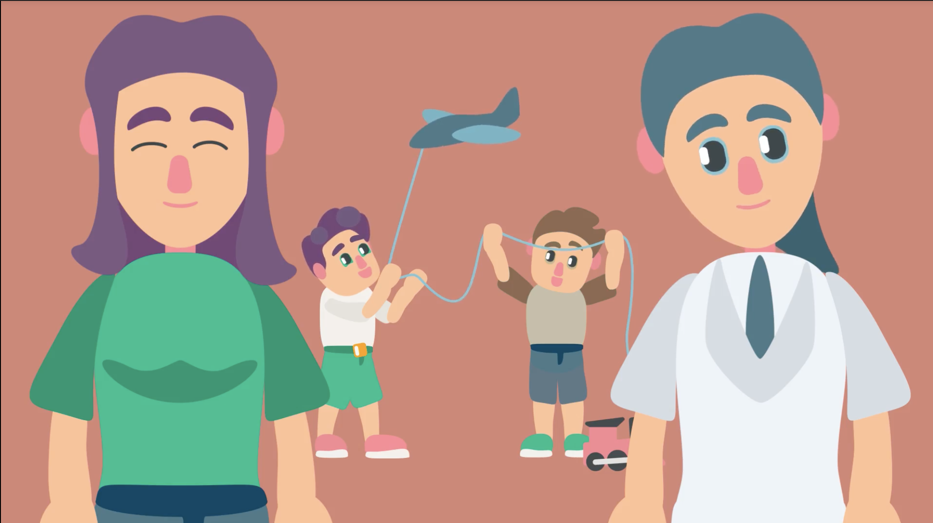
SALES-PITCH ANIMATION
Instead of a video, we have decided to create an animation, as that feels more welcoming and visually matches the website and the age group Logopuu is targeting. After taking the sales photos, we have discussed that the animations should represent similar to the photos. Furthermore, our aim with this animation is to bring awareness about speech impediment and show how serious it can be for a child’s social insecurity in the future, and how Logopuu helps parents identify the problems their children may have through the questionnaire, which they then connect the parents with a speech therapist. The animation will also provide instructions on how to navigate through the website, and will be maximum 1 minute long.
https://drive.google.com/file/d/1msS3KqwoBfmv3H6yGUWWFCBYvy3leId2/view

Slide 24
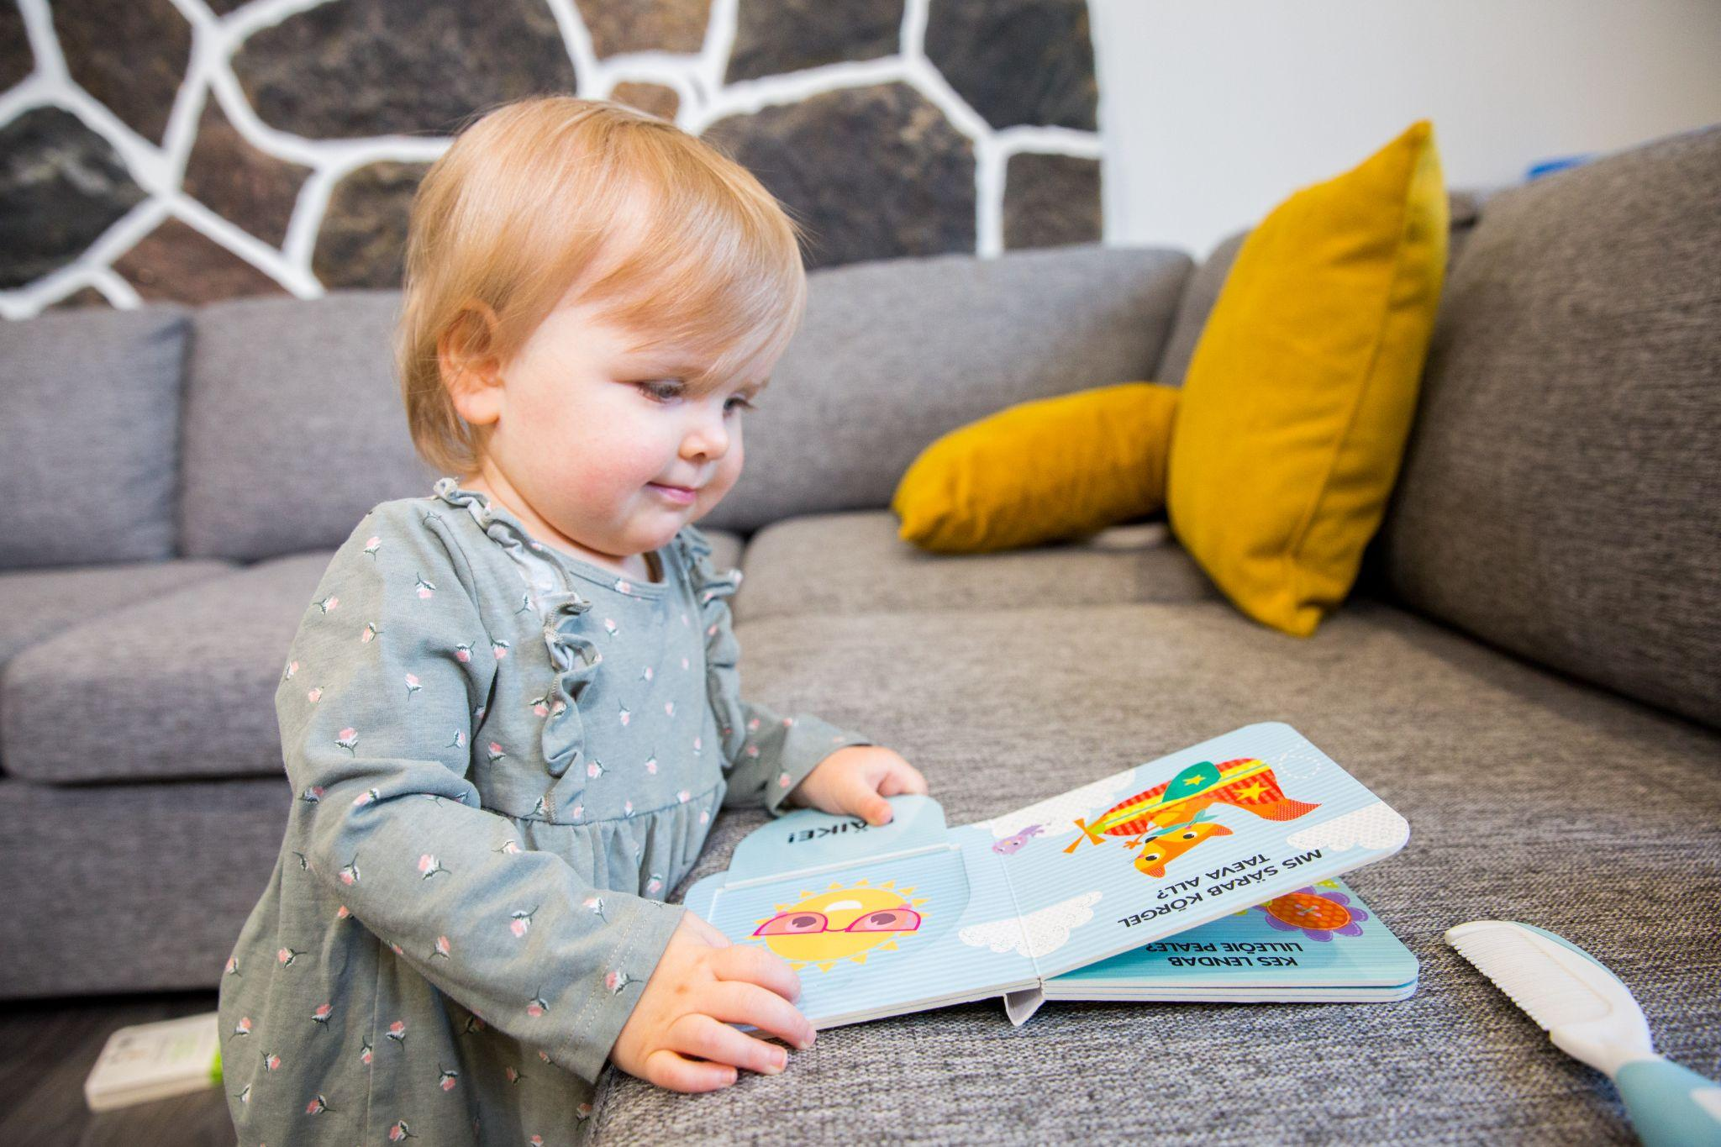
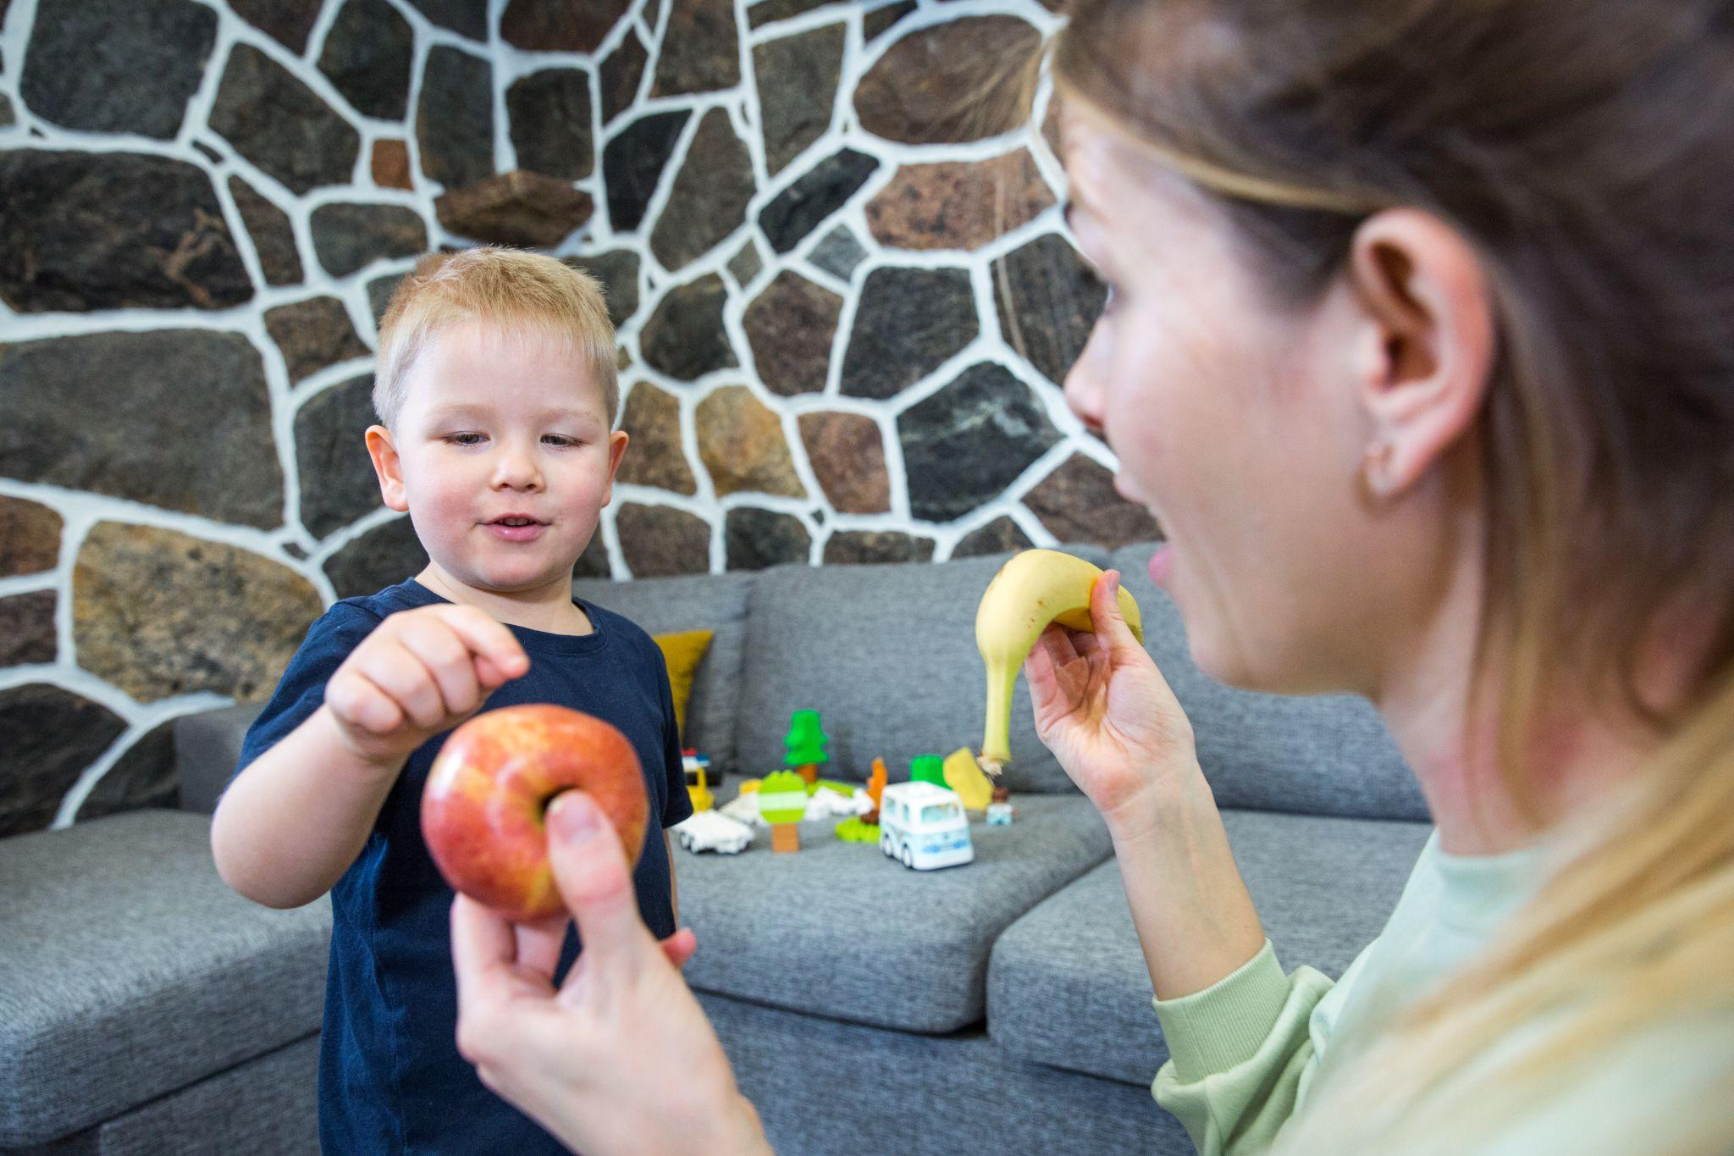
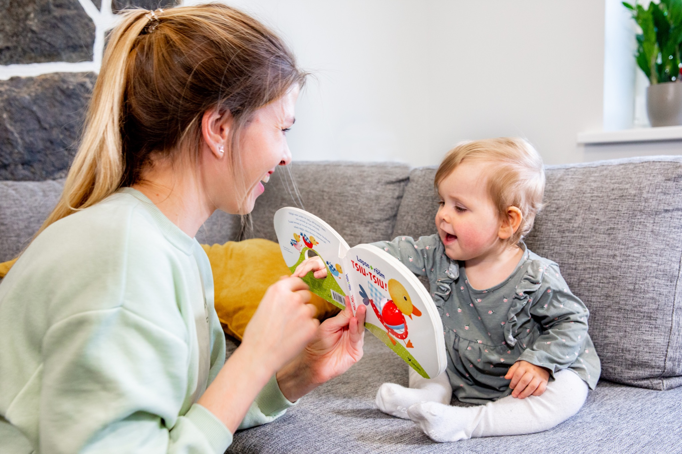
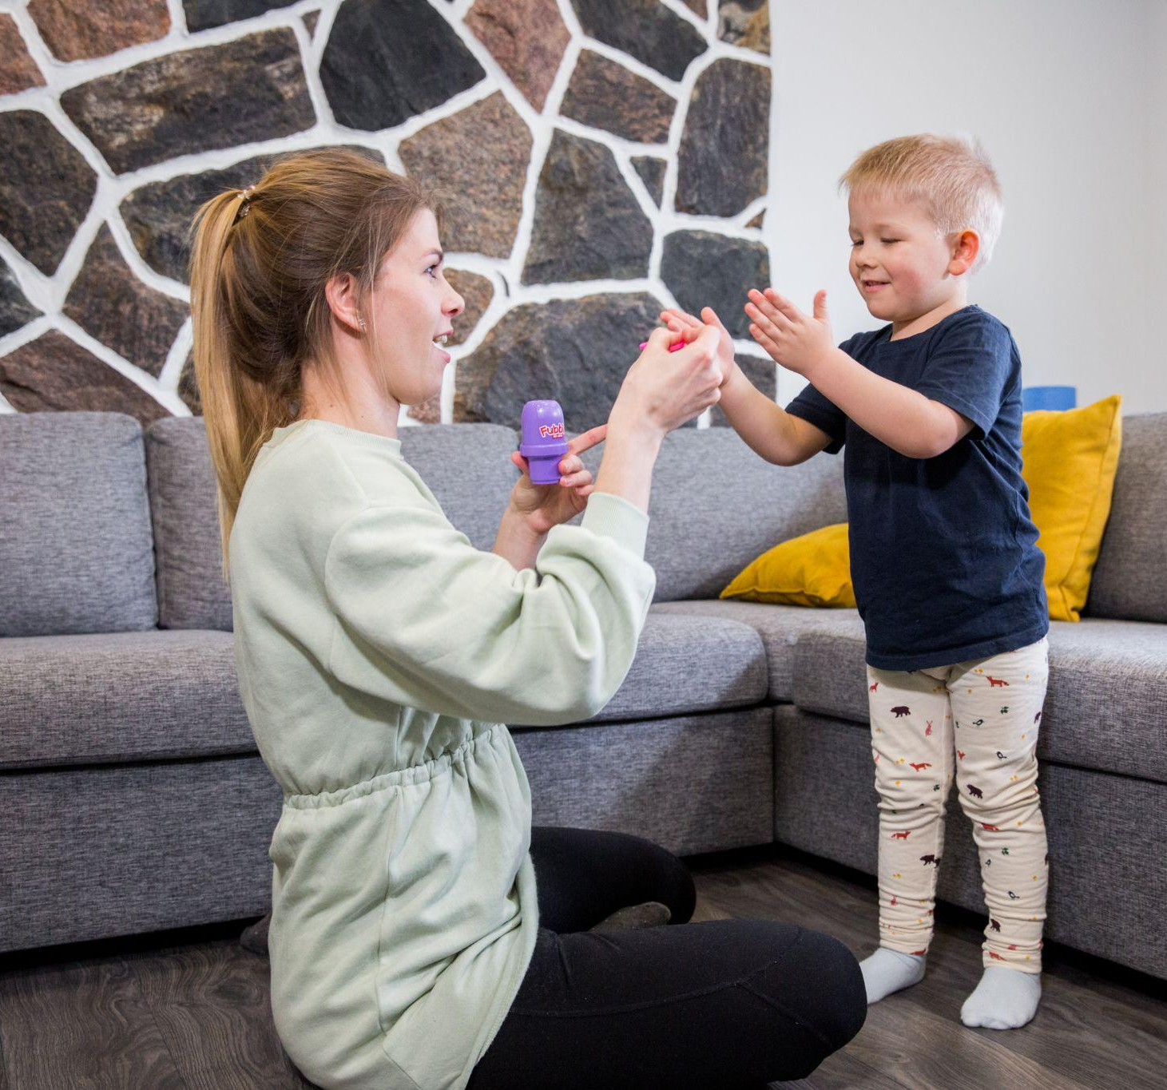
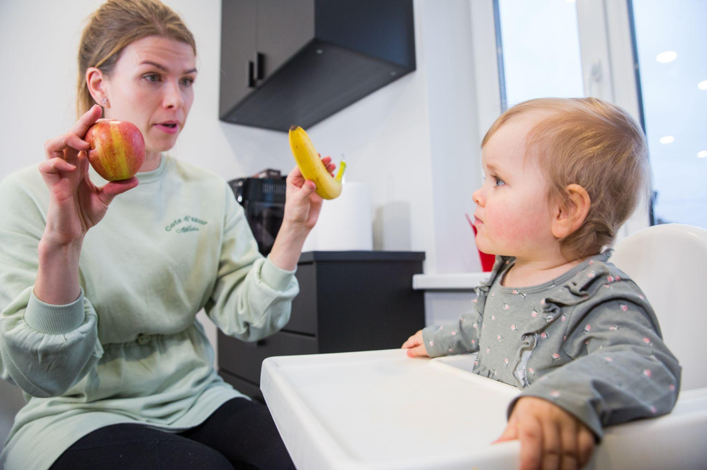
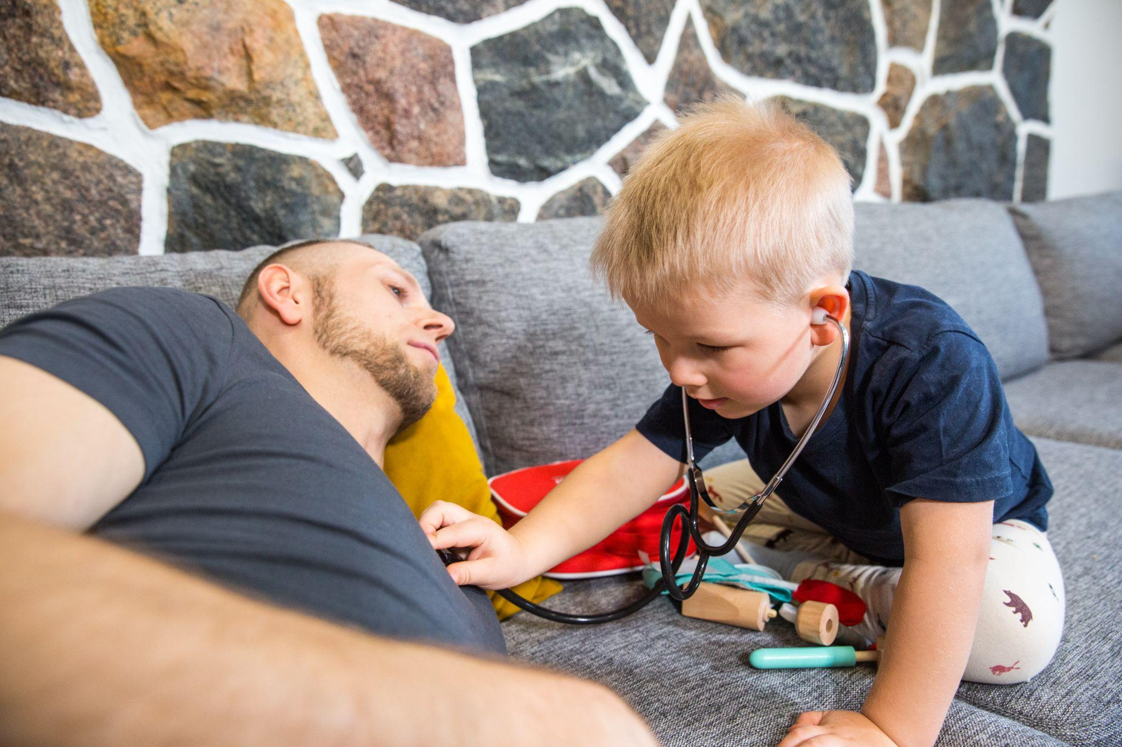
SALES PHOTOS

Slide 25
SELF-REFLECTION REPORTS

Slide 26
KIEU TRAN
For me, project Logopuu has been a challenging experience during which I have learned a lot about project management. The collaboration with the NGO and its inclusion into our iterative cycle worked very well, for example. However, other lessons were learned from things that did not work out as planned. In retrospect, I learned that it is important to include all team members early into the process and make everyone more accountable. However, I also learned that a few committed people can achieve a lot on their own. In addition, I was also able to learn new tools such as Figma and practice methods I haven’t used much before, e.g. customer journey mapping. In terms of the final result, I believe that we created a great prototype for Logopuu and that it will help the NGO achieve their goals.

Slide 27
MARIS JOOL
This has been one of the most difficult group projects in which I have ever participated. It has taught me a great deal about patience.
The communication with our chosen NGO was excellent. They were pleased with what we ultimately presented to them, but the process was not as smooth as it could have been. I realized that a small group of people who are truly dedicated to their work can complete tasks more quickly and efficiently. Overall, it was a great learning experience, and I am grateful to those group members who worked tirelessly to achieve the desired result.

Slide 28
DOHYUN KANG
This project has been very challenging for me as I came into the group not knowing anything about web designing, World Usability Day or the project in general. However, due to dedicated teammates, I was able to catch up to speed and understand what our goals and tasks were. It was interesting to learn about Figma and Miro and how much it helps with organization. As the one in charge of media, I wish I was able to do more but due to scheduling problems from my side, we weren’t able to do our original idea of shooting a video. However, we did end up finding a good solution, which was to create an animation instead and I believe it works well with the style and theme of the website.

Slide 29
AJIBOLA OLUWATOBILOBA O
I felt that I have participated in a very great project that lots of people will benefit from, I felt good to have finished the project successfully not only did learnt from the project academically but to have contributed to the growth of an NGO through which many children will get help for their speech problem and parent having easy access to more information and therapist on time and without much stress. I learnt more on how the cooperation of different student from different disciplines and background can bring out a good successful project.

