Slide 1
TLU STUDENT PODCAST FALL 2022

Slide 2
TOPICS
Disciplines represented, supervisors, mentors, partners
Problem and importance
Activities implemented
Research base and interdisciplinary approach
Project results
Conclusions

Slide 3
INTRODUCTION AND OUR GOAL
To conceptualize, create and promote 8 podcast episodes as a part of an ongoing series for the Tallinn University Student Podcast.
Episodes based in interdisciplinary scientific research
4 teams (6 members in each team)
Every team recorded and published 2 episodes
Episodes were scheduled for Mondays and Thursdays from 21st of November 2022 to 15th of December 2022

Slide 4
Disciplines represented:
Audiovisual Arts and Media Studies
School of Humanities
School of Governance, Law and Society
School of Digital Technologies
Baltic Film, Media and Arts School
School of Natural Sciences and Health
Supervisor(s)/mentor(s):
Terry McDonald and Avo Ulvik
Partner(s): Tallinn University, Estonian Theatre for Young Audiences
Interviewees: Kaire Talviste, Eva Koženevski, Kristina Mering, Karin Luiga, Saima Kuu, Kristi Koppel, Kristjan Port, Peadar Callaghan, Nafisat Gyimah and Seth Amofah.

Slide 5
THE PROBLEM AND IMPORTANCE OF THE PROJECT

Slide 6
PODCAST TOPICS - TEAM 1
Episode 50:
“Growing Up with a Suicidal Parent”
> to bring awareness to the suicide beravement of children
> to normalize talking about suicide and its effects on people
> to learn about the do’s and dont’s of a suicide (attempt) aftermath
> research + interviews
> Kaire Talviste as guest
> Eva Koženevski as guest
Episode 51:
“Why are people fascinated by true crime?”
> to understand the essence of true crime and the reason people listen to it
> why are there so many female listeners of true crime?
> to bring public attention the psychological and sociological background of the phenomena.
> research + discussion between hosts

Slide 7
PODCAST TOPICS - TEAM 2
Episode 52:
“Plant-based foods: the Impact on the Environment”
> to raise awareness on how food choices impact the environment
> to introduce the up and coming trends in plant-based foods
> research + interview
> Kristina Mering as guest
Episode 53:
“Translingualism and Diversity in the Classroom”
> to understand how translingualism affects the classroom in University
> to find out how to help translingual students
> research + interview
> Karin Luiga as guest
Notes:
The problem we are solving:
> Our planet faces an urgent need to restrain the use of natural resources and limits global warming. Food choices we make have a huge impact on the environment. Therefore, we want to raise awareness regarding the dietary changes that could benefit our planet.
> Translingual practices can have a considerable impact on the quality of communication among people from different backgrounds. In this approach, language differences are not seen as barriers to overcome or solve. Instead, they are seen as a resource for creating meaning in speech, writing, and reading. This episode investigates the effect of translingual practices on creating and evaluating academic content, and more specifically on academic writing.
The Importance of the episodes:

Slide 8
PODCAST TOPICS - TEAM 3
Episode 54:
“What are the negative sides of veganism and how can you avoid them?”
> as a counterargument for episode nr 52
> to understand the negative effects of veganism on one’s health
> to introduce safe ways to incorporate veganism to your diet
> research + interview
> Saima Kuu as a guest
> Kristi Koppel as a guest
Episode 55:
“Active mindset: the effect of
fitness lifestyle on people’s personalities”
> to highlight immense value of physical activity beyond health benefits
> Self-analysis and self-awareness
> Kristjan Port as a guest
Notes:
The problem we are solving:
> Raise awareness on how veganism can affect a person's' health negatively when the decision has not been researched and thought through well enough.
> Discuss the ways how active lifestyle can change a person's personality
The Importance of the episodes: With the first episode we want to discuss the negative health effects that veganism can cause in people. Often times only the positive effects are highlighted, but negative have been made more invisible. In the second episode we want to talk about how active lifestyle and personality are correlated with each other. This might help some people to analyze themselves and see why they act, react and think the way the do. Overall we think it is important to encourage people to be active and eat healthy, but still to make them aware of the risks and negative effects so that they do not go overboard with this healthy mindset.

Slide 9
PODCAST TOPICS - TEAM 4
Episode 56:
“Juggling family and school work”
> As a counter argument to episode 45 “The concept of being child-free”
> Sharing experiences, tips and tricks of how to balance family life and school work.
> Nafisat Gyimah and Seth Amofah as guests
Episode 57:
“Gaming as a new way of learning”
> Discussing the history of gaming not only as a new concept of learning but a process that occurs everyday even in our social life.
> Why gaming should be adopted by teachers.
> Peadar Callaghan as guest
Notes:
The problem we are solving:
> Highlight the importance of gaming as a method of learning for not only kids but adults as well.
> Discuss the challenges, tips and tricks that student parents face balancing family life with school work.
The Importance of the episodes: Shed more light on ways institutions can help student parents achieve their educational goals and factors that may hinder their academic success. The second episode, showcases why gaming is an important aspect of learning that can be used by teachers of all disciplines. Also ways educators, institutions and innovators can help ensure that game-based learning is all-inclusive.

Slide 10
DESCRIPTION OF ACTIVITIES AND REACHING THE STAKEHOLDERS

Slide 11
ACTIVITIES FOR REACHING OUR GOAL
First meeting: 08.09.2022 => splitting into teams (4)
Each team created an action plan (schedule for release dates as our Polaris)
Brainstorming the episode topics => research phase for each episode
Scheduling recording, booking guests, scriptwriting
Recording => editing
Releasing on schedule and marketing of each episode
Notes:
Our podcast episodes are aimed at our listeners of the Tallinn University Student Podcast. The podcast is hosted on spotify and has over 2000 airplay. An average of 17 plays per episode, currently, there are 57 episodes on the podcast. Our stakeholders include, students, Tallinn University and relevant policy makers that will find our research relevant and useful for further research and improvements

Slide 12
STAKEHOLDERS OF THE PROJECT
Listeners of the TLU Student Podcast
Invited guests and the organizations they are involved with
Tallinn University - providing the platform
ELU project team
Students assigned to the project
Notes:
Our podcast episodes are aimed at our listeners of the Tallinn University Student Podcast. The podcast is hosted on spotify and has over 2000 airplay. An average of 17 plays per episode, currently, there are 57 episodes on the podcast. Our stakeholders include, students, Tallinn University and relevant policy makers that will find our research relevant and useful for further research and improvements.

Slide 13
SUSTAINABILITY OF THE PROJECT
topics are relevant months after their release
people will find and listen to them even after the project is finished
chance to have a dialogue with any episode released to date
all episodes are based in interdisciplinary scientific research
idea for growth: better marketing strategy for the future
Notes:
In terms of chosen topics, all the episodes are designed to be sustainable in way that they'd not only address current issues but remain relevant months from now so that future new learners will also benefit from it. Our intention was to create a podcast topic that will stay contemporary in the future. As the TLU student podcast’s main target group are TLU students, all the episodes are related to education - social sciences, humanities, digital learning and so on. We believe that student audiences in the following year will be able to relate to our content. The platform where the episodes are shared is Spotify and it is one of the best platforms to host a platform. However, regarding accessibility, we believe that our project supervisor will ensure it remains available and accessible to listeners and fans of the podcast.

Slide 14
MARKETING AND BRANDING: NEW VISUAL IDENTITY
Author: Daria Litvichenko (Team 1)
Notes:
Part of marketing and branding was to introduce a new visual identity to the podcast feed on Spotify and also on Facebook.

Slide 15
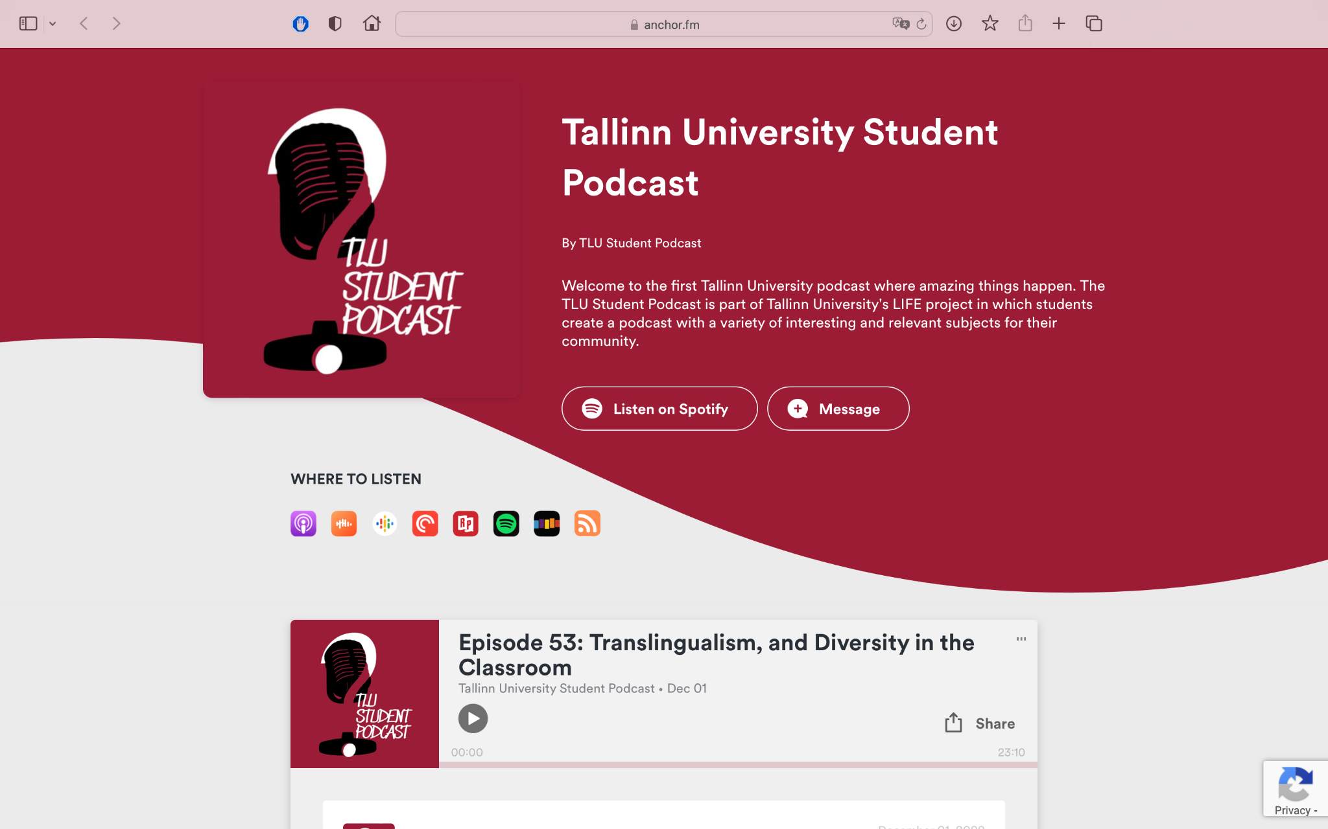
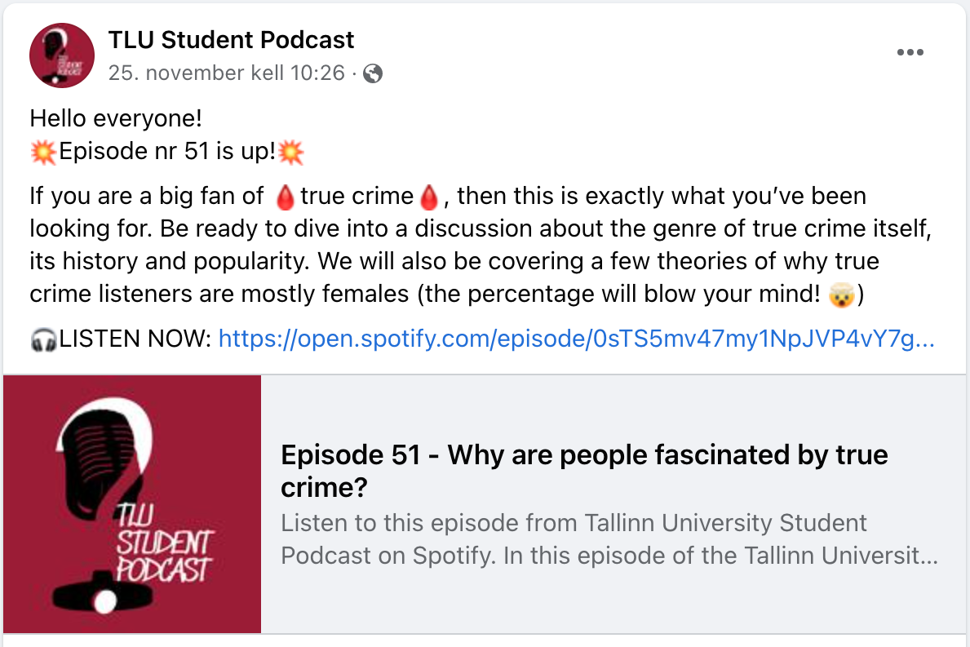
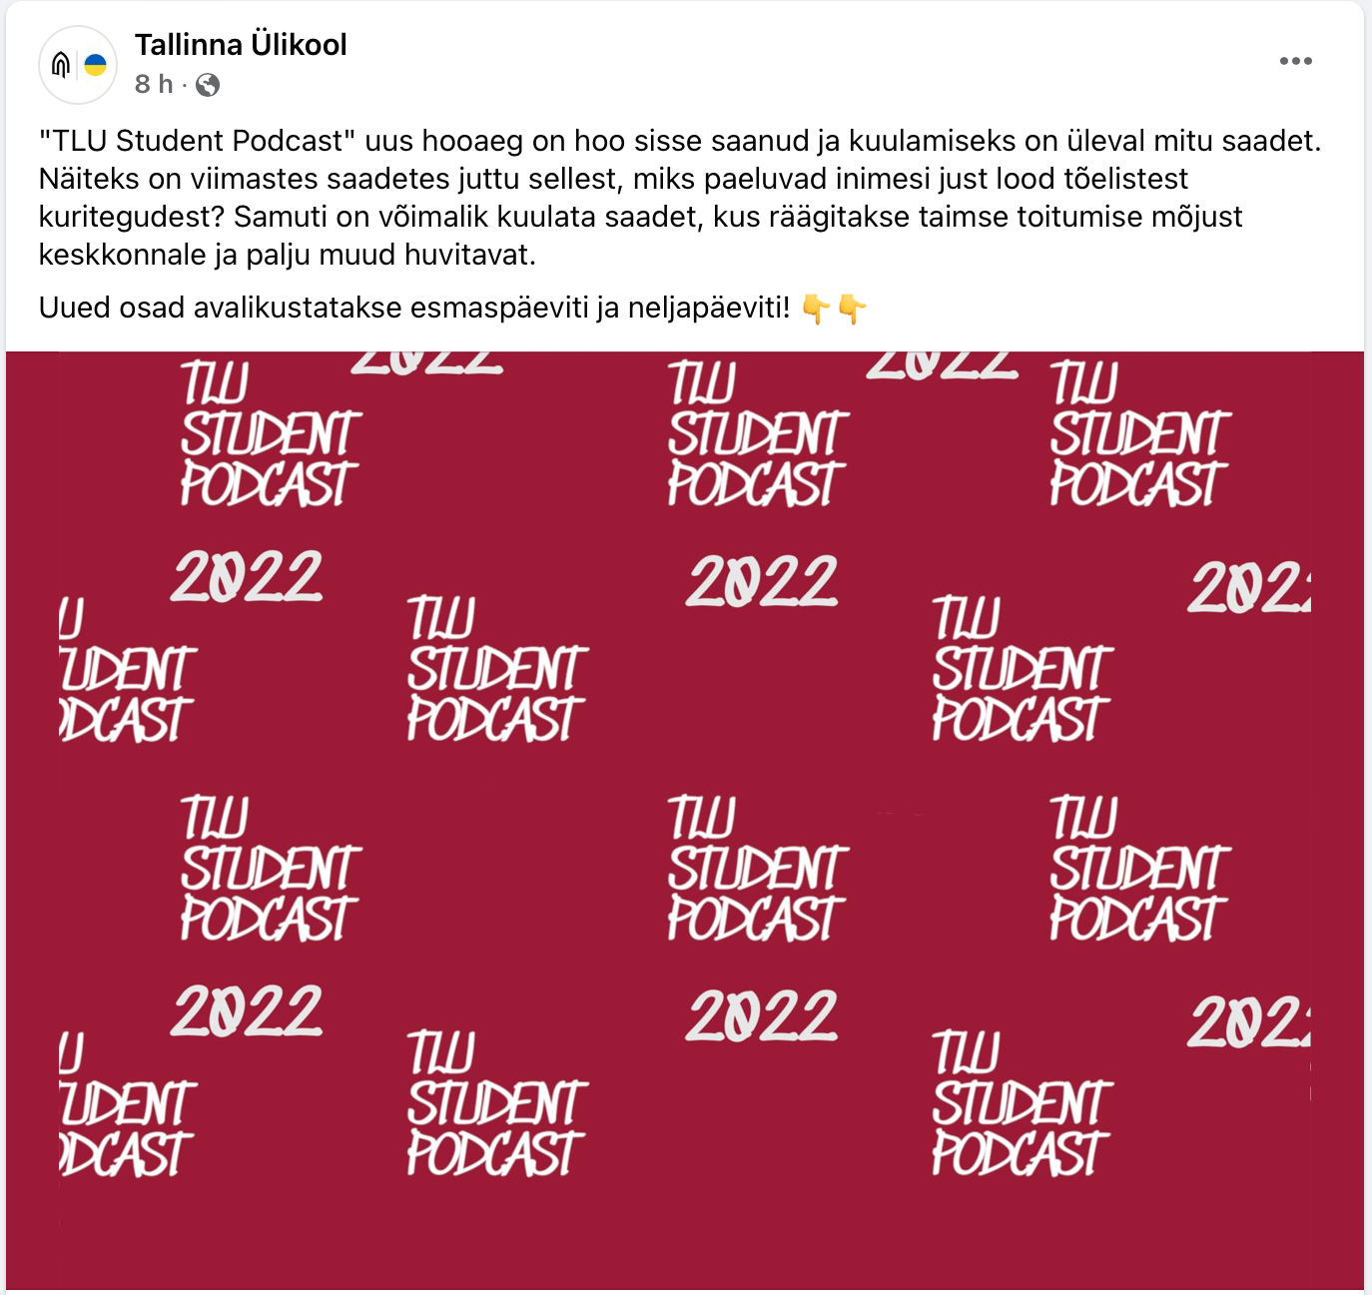
MARKETING AND (SOCIAL) MEDIA COVERAGE
Anchor.fm => Spotify and other platforms
TLU Student Podcast Facebook page
TLU Official Facebook Page
IN ADDITION
> our personal social media pages
> word of mouth
Notes:
> For airing our episodes, we used Anchor.fm which distributed the episodes to Spotify and other platforms.
> Episodes were recorded in the TLU studio, over zoom recordings and Audacity was used for editing.
> Marketing of the episodes was done through different platforms such as Facebook, WhatsApp, Instagram and word-of-mouth.
(each team was responsible for the marketing of the episodes they produced)

Slide 16
CONCLUSIONS

Slide 17
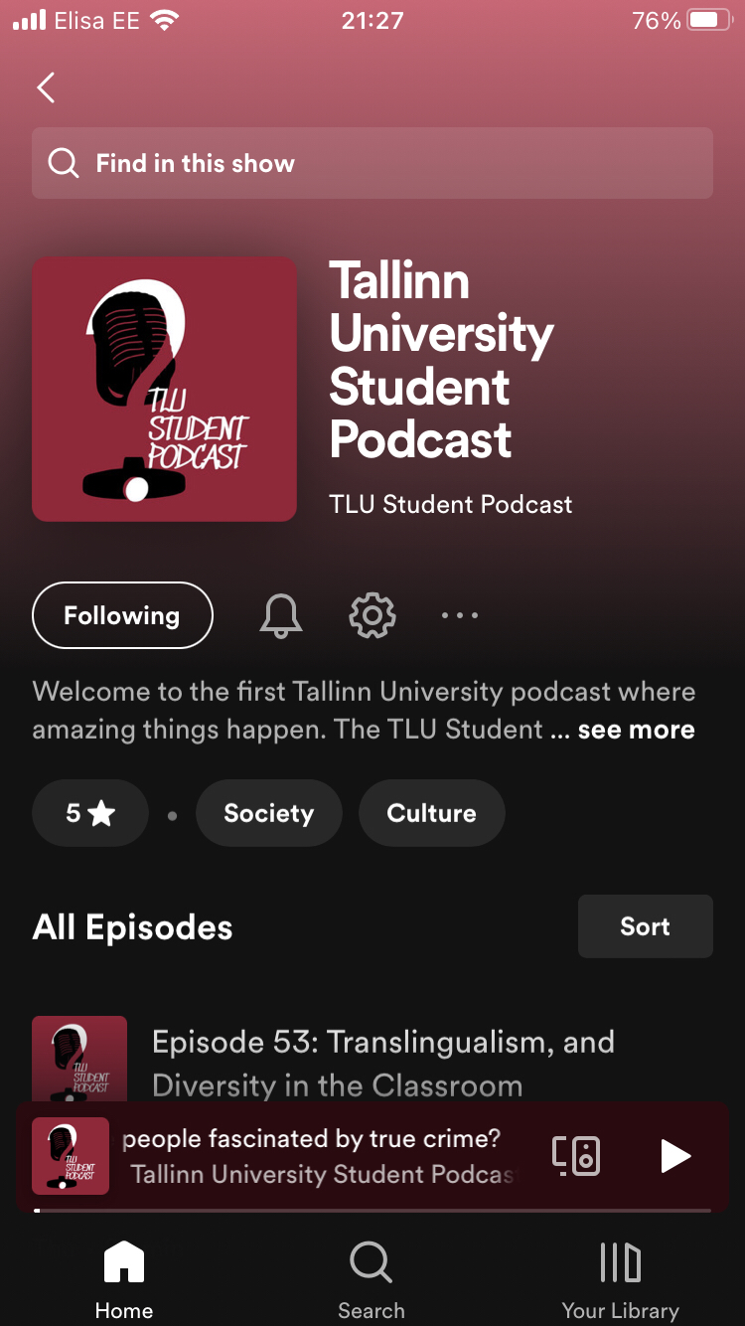
SUMMARY AND STATISTICS
All 8 episodes were released on schedule:
— Team 1
Monday 21.11.2022
Thursday 24.11.2022
— Team 2
Monday 28.11.2022
Thursday 01.12.2022
— Team 3
Monday 05.12.2022
Thursday 08.12.2022
— Team 4
Monday 12.12.2022
Thursday 15.12.2022

Slide 18
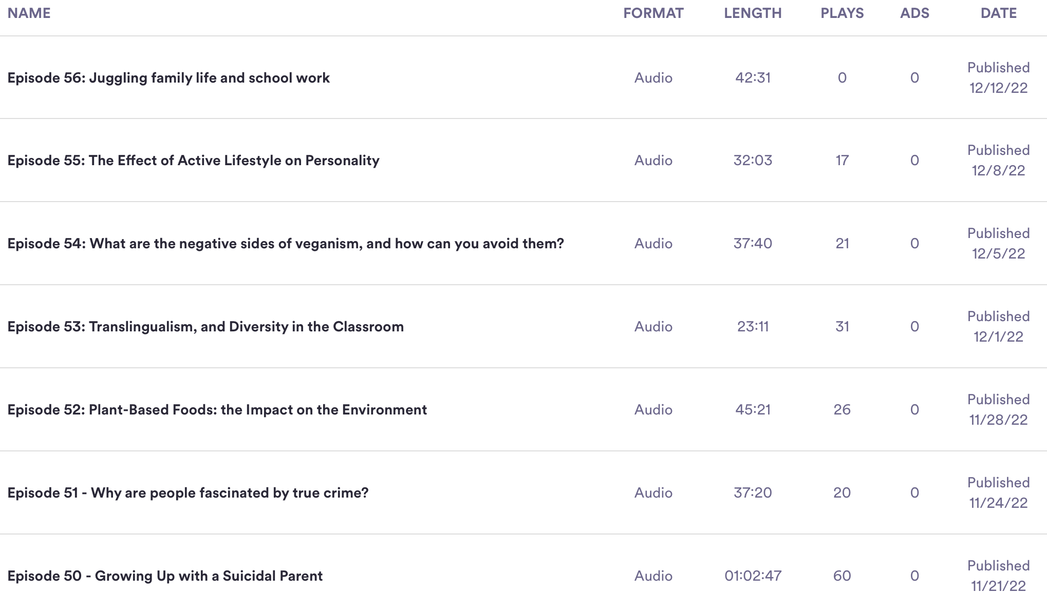
STATISTICS AND REACH I
Statistics and reach of each episode as of 12th of December 2022 4pm
Source: https://anchor.fm/dashboard/episodes

Slide 19
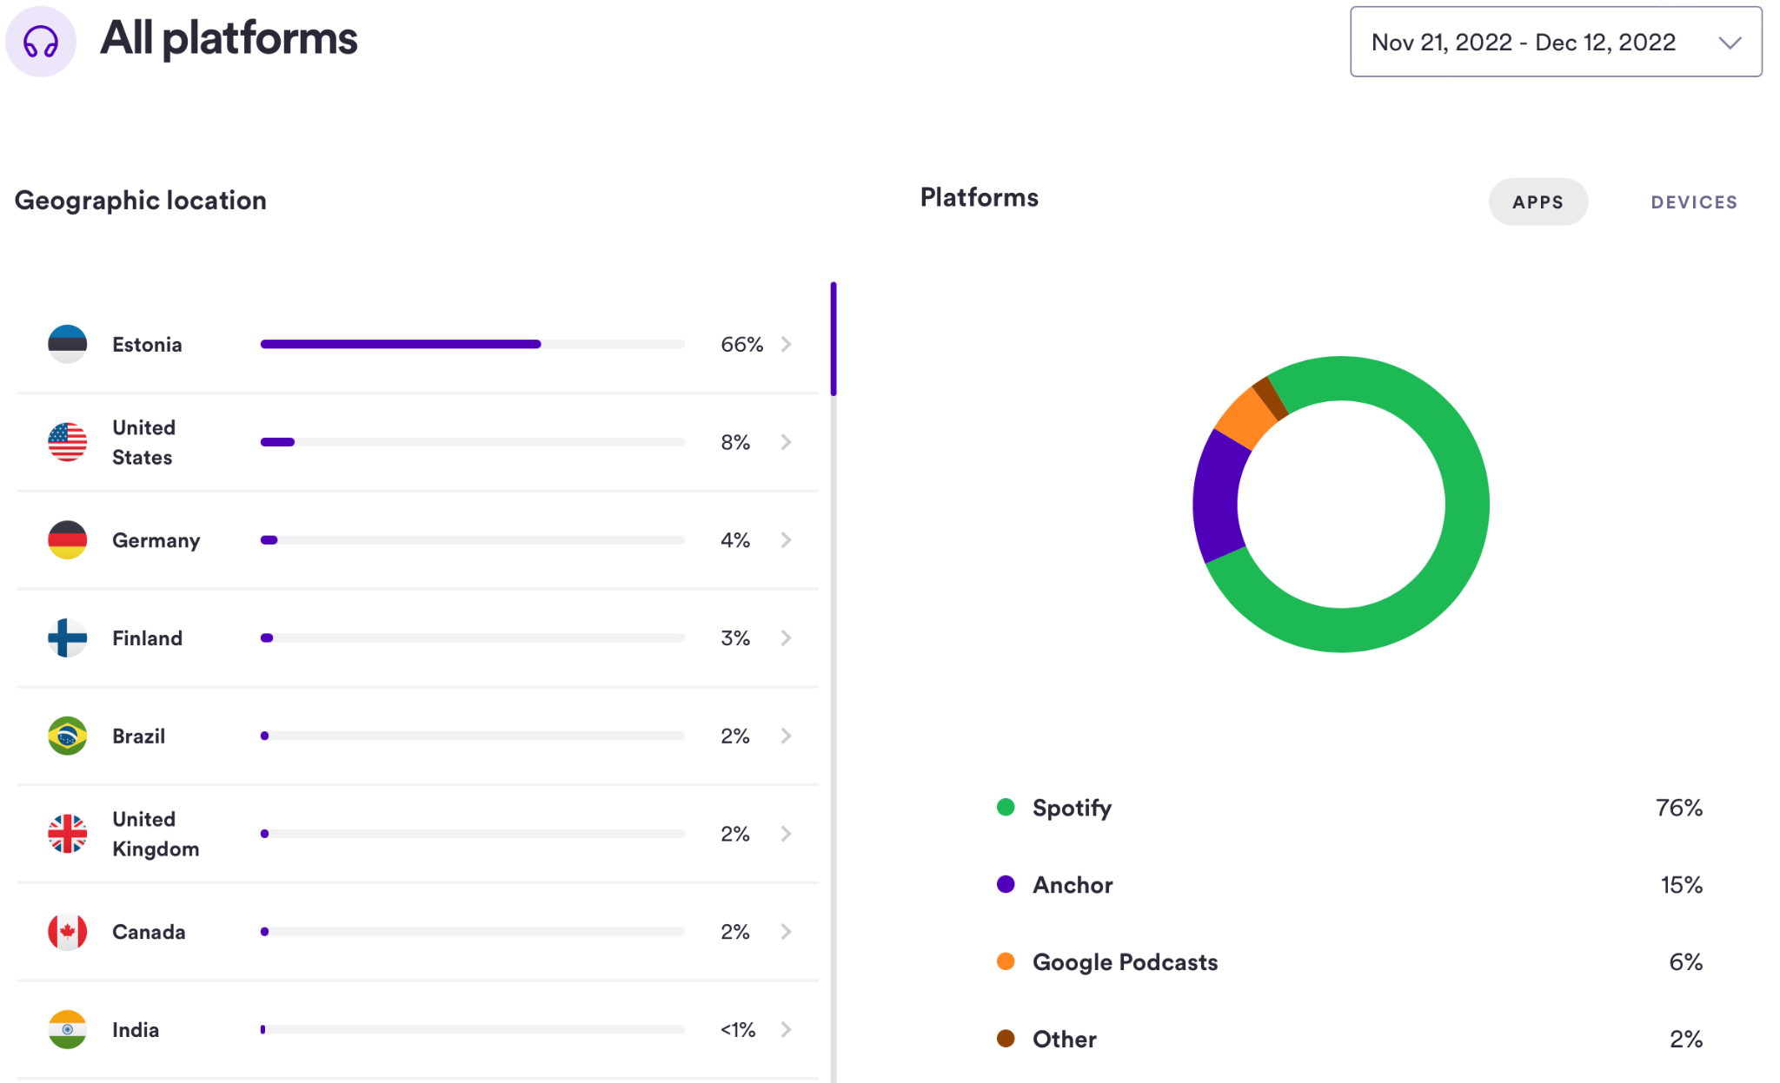
STATISTICS AND REACH II
Statistics and reach of TLU Student Podcast audience as of 12th of December 2022.
Source: https://anchor.fm/dashboard/analytics/audience

Slide 20
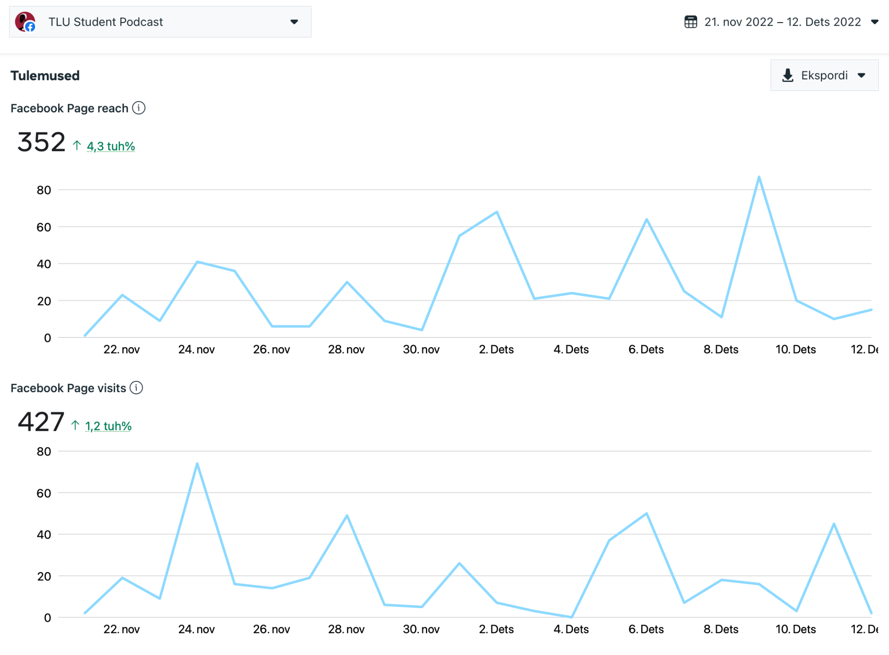
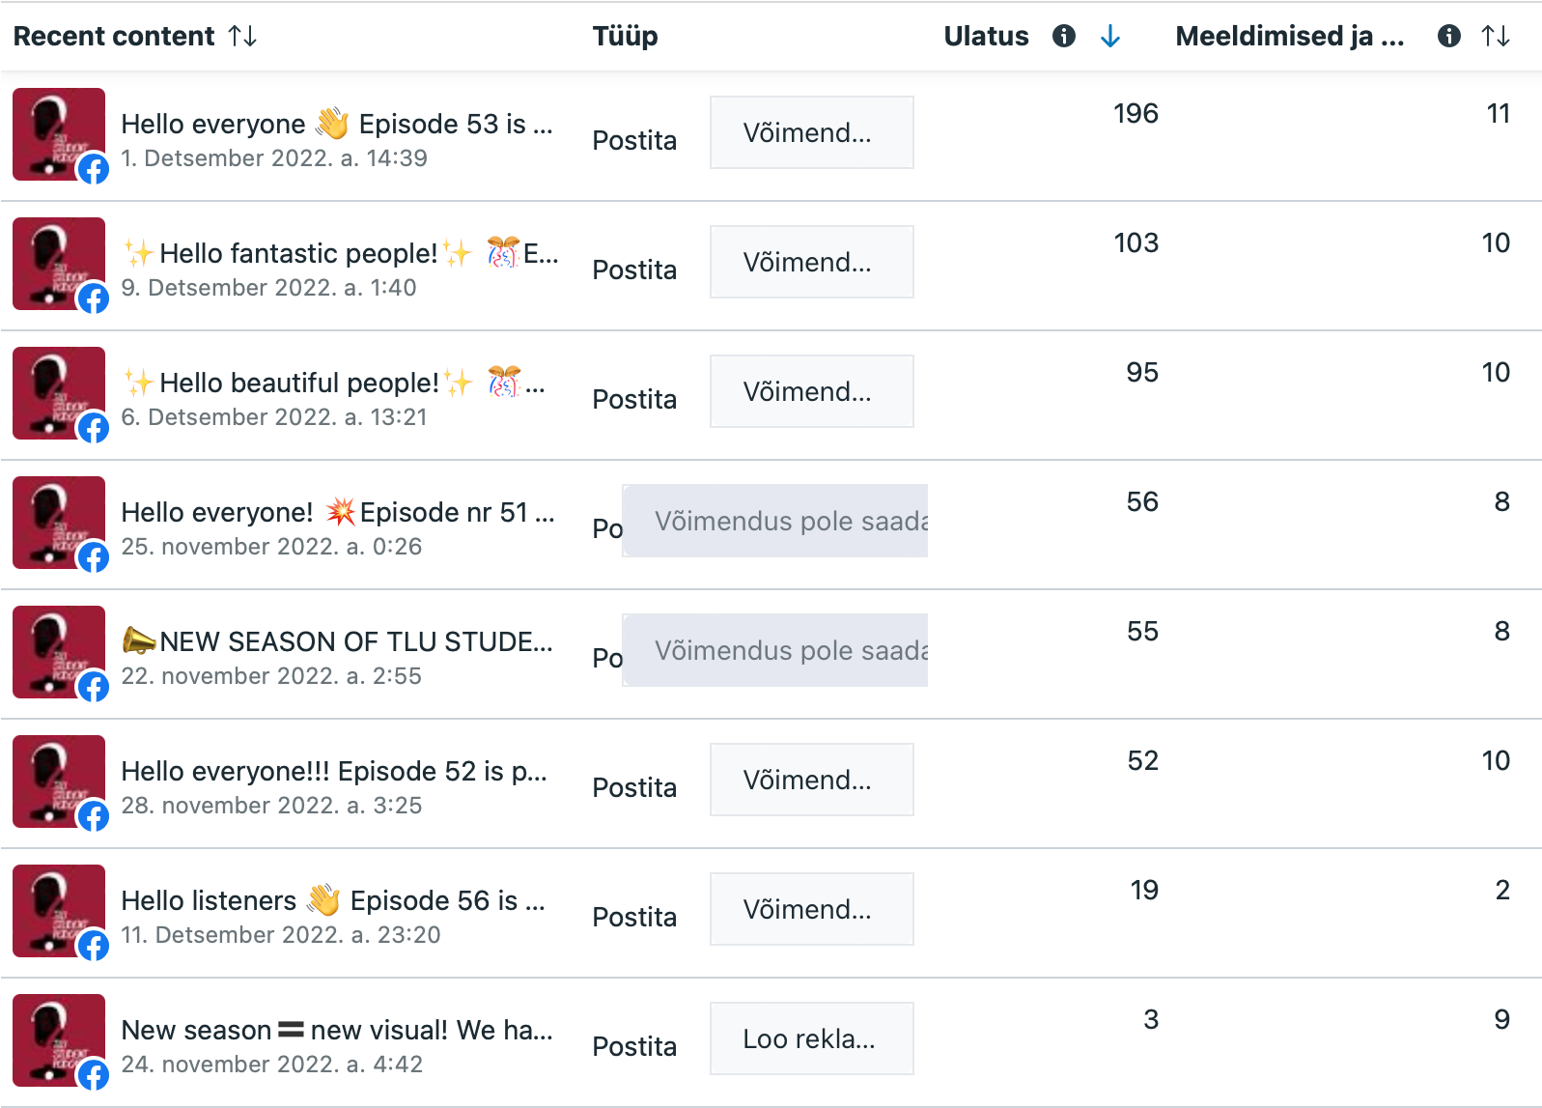
STATISTICS AND REACH III
Statistics and reach from TLU Student Podcast Facebook page
Source: https://business.facebook.com/latest/insights/overview

Slide 21
FEEDBACK FOR EPISODES
Episode 56
Episode 53
(no feedback to report, since the episode was published just on the 12th of December)
Episode 50
> heard the term for the first time
> interesting viewpoints from the academic
> important and great work
> the accents and forgetting about them
> heavy listening but worth it
Episode 51
> interesting topic
> a new podcast to
listen to every day
Episode 54
> interesting facts about nutrition
> mental health point of view was inriquing
Episode 57
Episode 52
> excited to try out
novel plant-based products
> great way to promote
volunteer work
> relevant topic
(no feedback to report, since the episode was not published as of 12th of December 2022)
Episode 55
> natural and smooth discussion
> really liked the idea, that active lifestyle is not just sports and nutrition

Slide 22
THANK YOU FOR LISTENING!

Slide 23
PARTICIPANTS OF THE PROJECT
TEAM 1
TEAM 2
Darja Litvitšenko - Audiovisual Media BA
Getter Meresmaa - Social Work BA
Joosep Soekõrv - Translation MA
Karmel Markov - Adult Education BA
Lauren Teesalu - Theory of Culture BA
Viktoria Novikova - Chinese Studies BA
Amaliya Khachatryan – Communication Management
Anthony Dike – International Relations
Artyom Grigoryan – Digital Learning Games
Carol Suurevälja – Organizational Behavior
George Konuwa – International Relations
Maliheh Keshmiri – Communication Management
Kerli Loomets - Japanese Studies
Anna Selivanova - Liberal Arts in Humanities
Kailiin Dubrov - Audiovisual Media
Gevin Genro Paas - Computer science
Mubarak Ajia Oseni - Communication Management
Maria Johanna Kaskor- Politics and Governance
TEAM 3
Cynthia Ogugua Amina Enemosah - Communication Management
Mercy Ugochi Onwuzulike - Human Rights in the Digital Society
Olivia Nkeonyere Emeto - Human Rights In The Digital Society
Omolade Abimbola Olorundare - Communication Management
Alia Hajiyeva - Literature, Visual Culture and Film Studies
Boonsita Limworaphan - Human Rights in the Digital Society
TEAM 4

