Slide 1
SPORTS IN INTERNATIONAL POLITICS
fall 2022

Slide 2
Presenters
Group 1
Oskar Joonas Rundu
Group 2
Kristjan Kallaste
Group 3
Dmitri Shasholin
Group 4
Aires Chung

Slide 3
Disciplines represented:
Political Science, Japanese Studies, Law, Crossmedia, Psychology, Sociology, Politics and Governance, Educational Innovation and Leadership, Human Rights in Digital Society, Physical Education, Public Relations, Asian Studies
Supervisor(s)/mentor(s):
Benjamin Klasche, Terry McDonald, Alena Darafeichyk

Slide 4
Academic Partners:
Tallinn University
Tallinn University Baltic Film and Media School
Social Media:
Youtube
Facebook

Slide 5
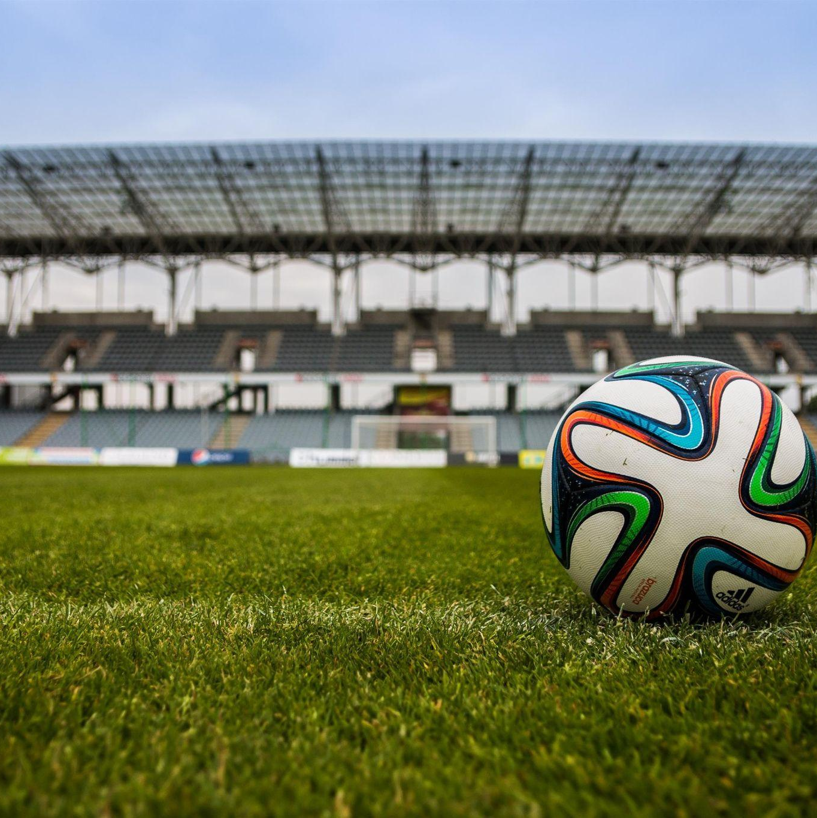
PROBLEM and AIM
To use International Relations theory to examine the impact of sports events on world affairs
Each team wrote and produced a YouTube video on a specific sports event, examining its effects on international relations and politics.

Slide 6
THREE MAIN ACTIVITIES
1st: RESEARCH - 4 written papers
2nd: PRODUCTION - 4 videos
3rd: PROMOTION - helped us reach our main goal of introducing International Relations through the field of Sports

Slide 7
RESEARCH / INTERDISCIPLINARY APPROACH
Sources: Historical for background about subjects; International Relations to provide a suitable theory; Mainly academic for analysis of respective events. We look at all of the events through the chosen International Relations theory.
Groups were made up of at least 6 people from different disciplines and backgrounds.
Each group had a liaison who was responsible for communication with supervisors.

Slide 8
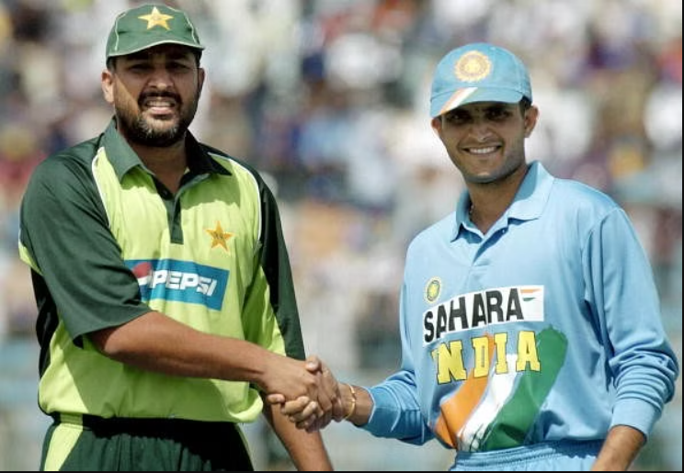
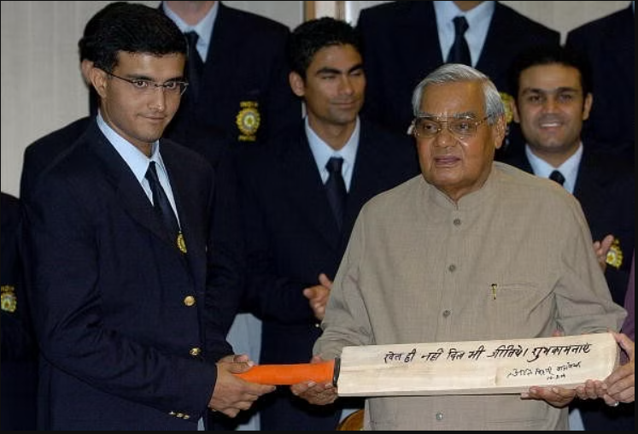
Group 1
India and Pakistan cricket rivalry and the 2004 Friendship Series
Liberalism and mutually beneficial exchange
Episode 1 was uploaded on 24.11.2022 and has 412 views (11.12.2022)
Sports in International Politics - Episode 5: India-Pakistan Cricket Friendship Series 2004

Slide 9
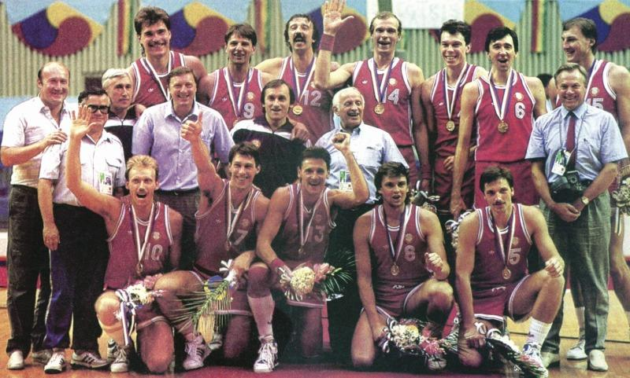
Group 2
Lithuanians refusing to play for the Soviet national basketball team
Post-colonialism
Episode 2 was uploaded on 28.11.2022 and has 85 views (11.12.2022)
Sports in International Politics - Episode 6 - Lithuanians refusing to play with the Soviets (1990) - YouTube

Slide 10
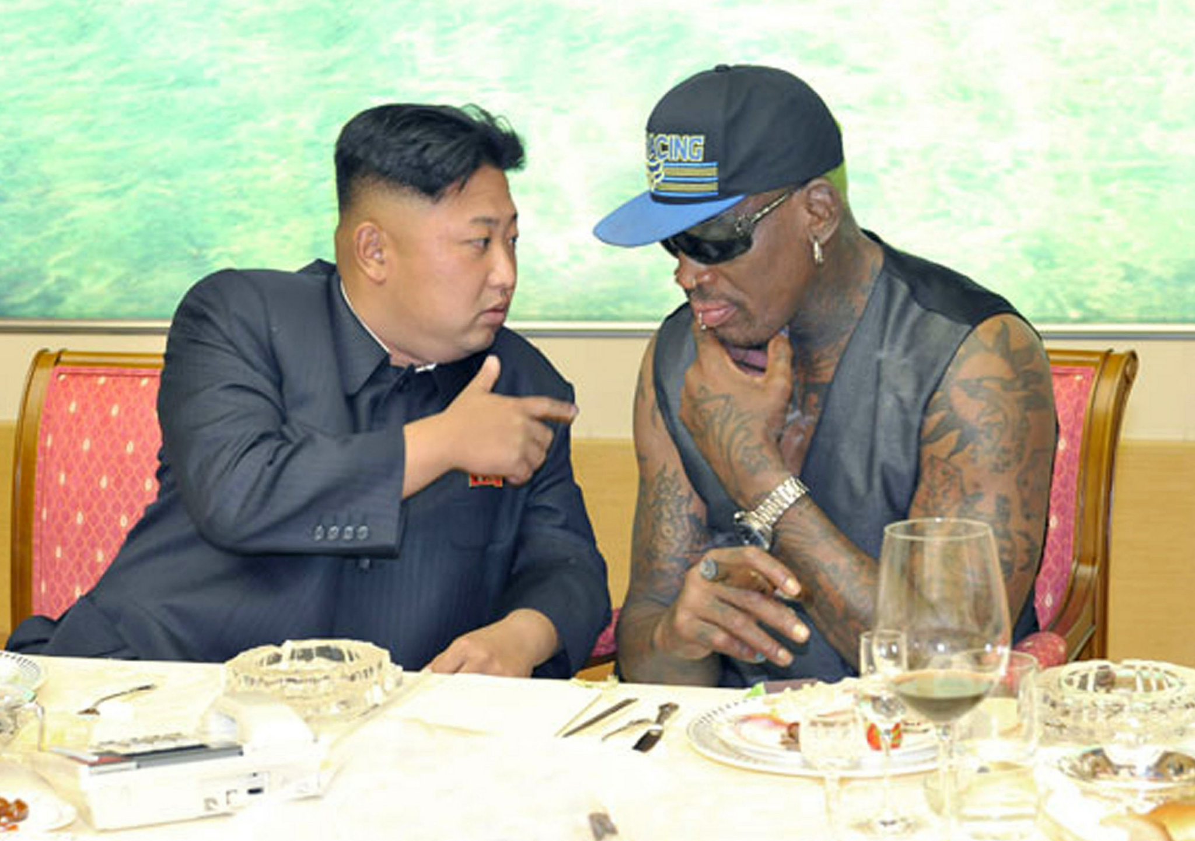
Group 3
Dennis Rodman visiting North Korea - Sociological Liberalism
Episode 3 was uploaded on 07.12.2022 and has 46 views (11.12.2022)
Sports in International Politics - Episode 7 - Algerian Wrestlers refuse to fight Israelis

Slide 11
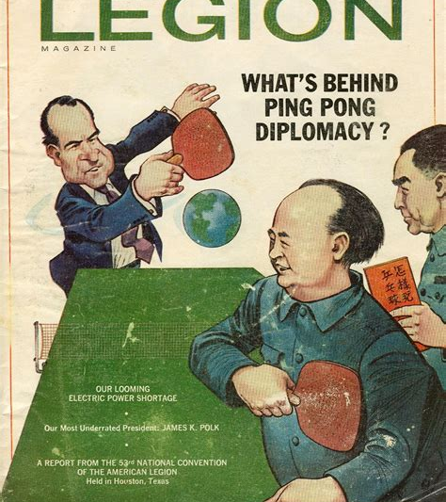
Group 4
Ping Pong Diplomacy (1971)- Relationship shift between the US and China
Constructivism
Episode 8 was uploaded on 09.12.2022 and has 149 views (11.12.2022).
Sports in International Politics - Episode 8 - Ping Pong Diplomacy

Slide 12
Results and Sustainability
The Ministry of Foreign Affairs and universities can contribute from the results of our project. The project has an informative goal for the general public, to raise awareness.
Videos are uploaded and shared on YouTube. The project can be continued in the following semesters.

Slide 13
THANK YOU FOR LISTENING AND ENJOY THE VIDEOS!
https://www.youtube.com/channel/UCGWC9wsa6nQEod_28kHUMMw

