Slide 1
Utopian
Visioning

Slide 2
Disciplines represented:
Audiovisual Media BA Politics & Governance BA
Crossmedia BA Psychology MA
Documentary MA
Curriculum
Supervisor(s)/mentor(s):
Luke Li Stange
Partner(s):
Baltic Film, Media and Arts School IZUM Youth Center
Tallinn University Tallinn School of Service

Slide 3
Imagine if the most marginalized people could shape Tallinn's future instead of the 1%. This project aims to gather the visions of those often neglected to spark public conversation and promote a more inclusive city for everyone, including the more-than-human world.
Our Mission

Slide 4
Utopian
Visioning
Video
Workshops

Slide 5
2.
3.
Video Crew
Workshops
Summary
The task of the video crew was to conceptualize and produce a video that informs potential workshop participants and facilitators about the workshops themselves as well as the goals of our Utopian Visions.

Slide 6
Our Approach…
B-Roll: supplemental or alternative footage intercut with the main shots.
Research about the topic
Set goal & target audience of the video
Conceptualise Video Outline & Scripts
Prepare facilities and equipment
Shoot talking heads & B-Roll
Post-Production

Slide 7
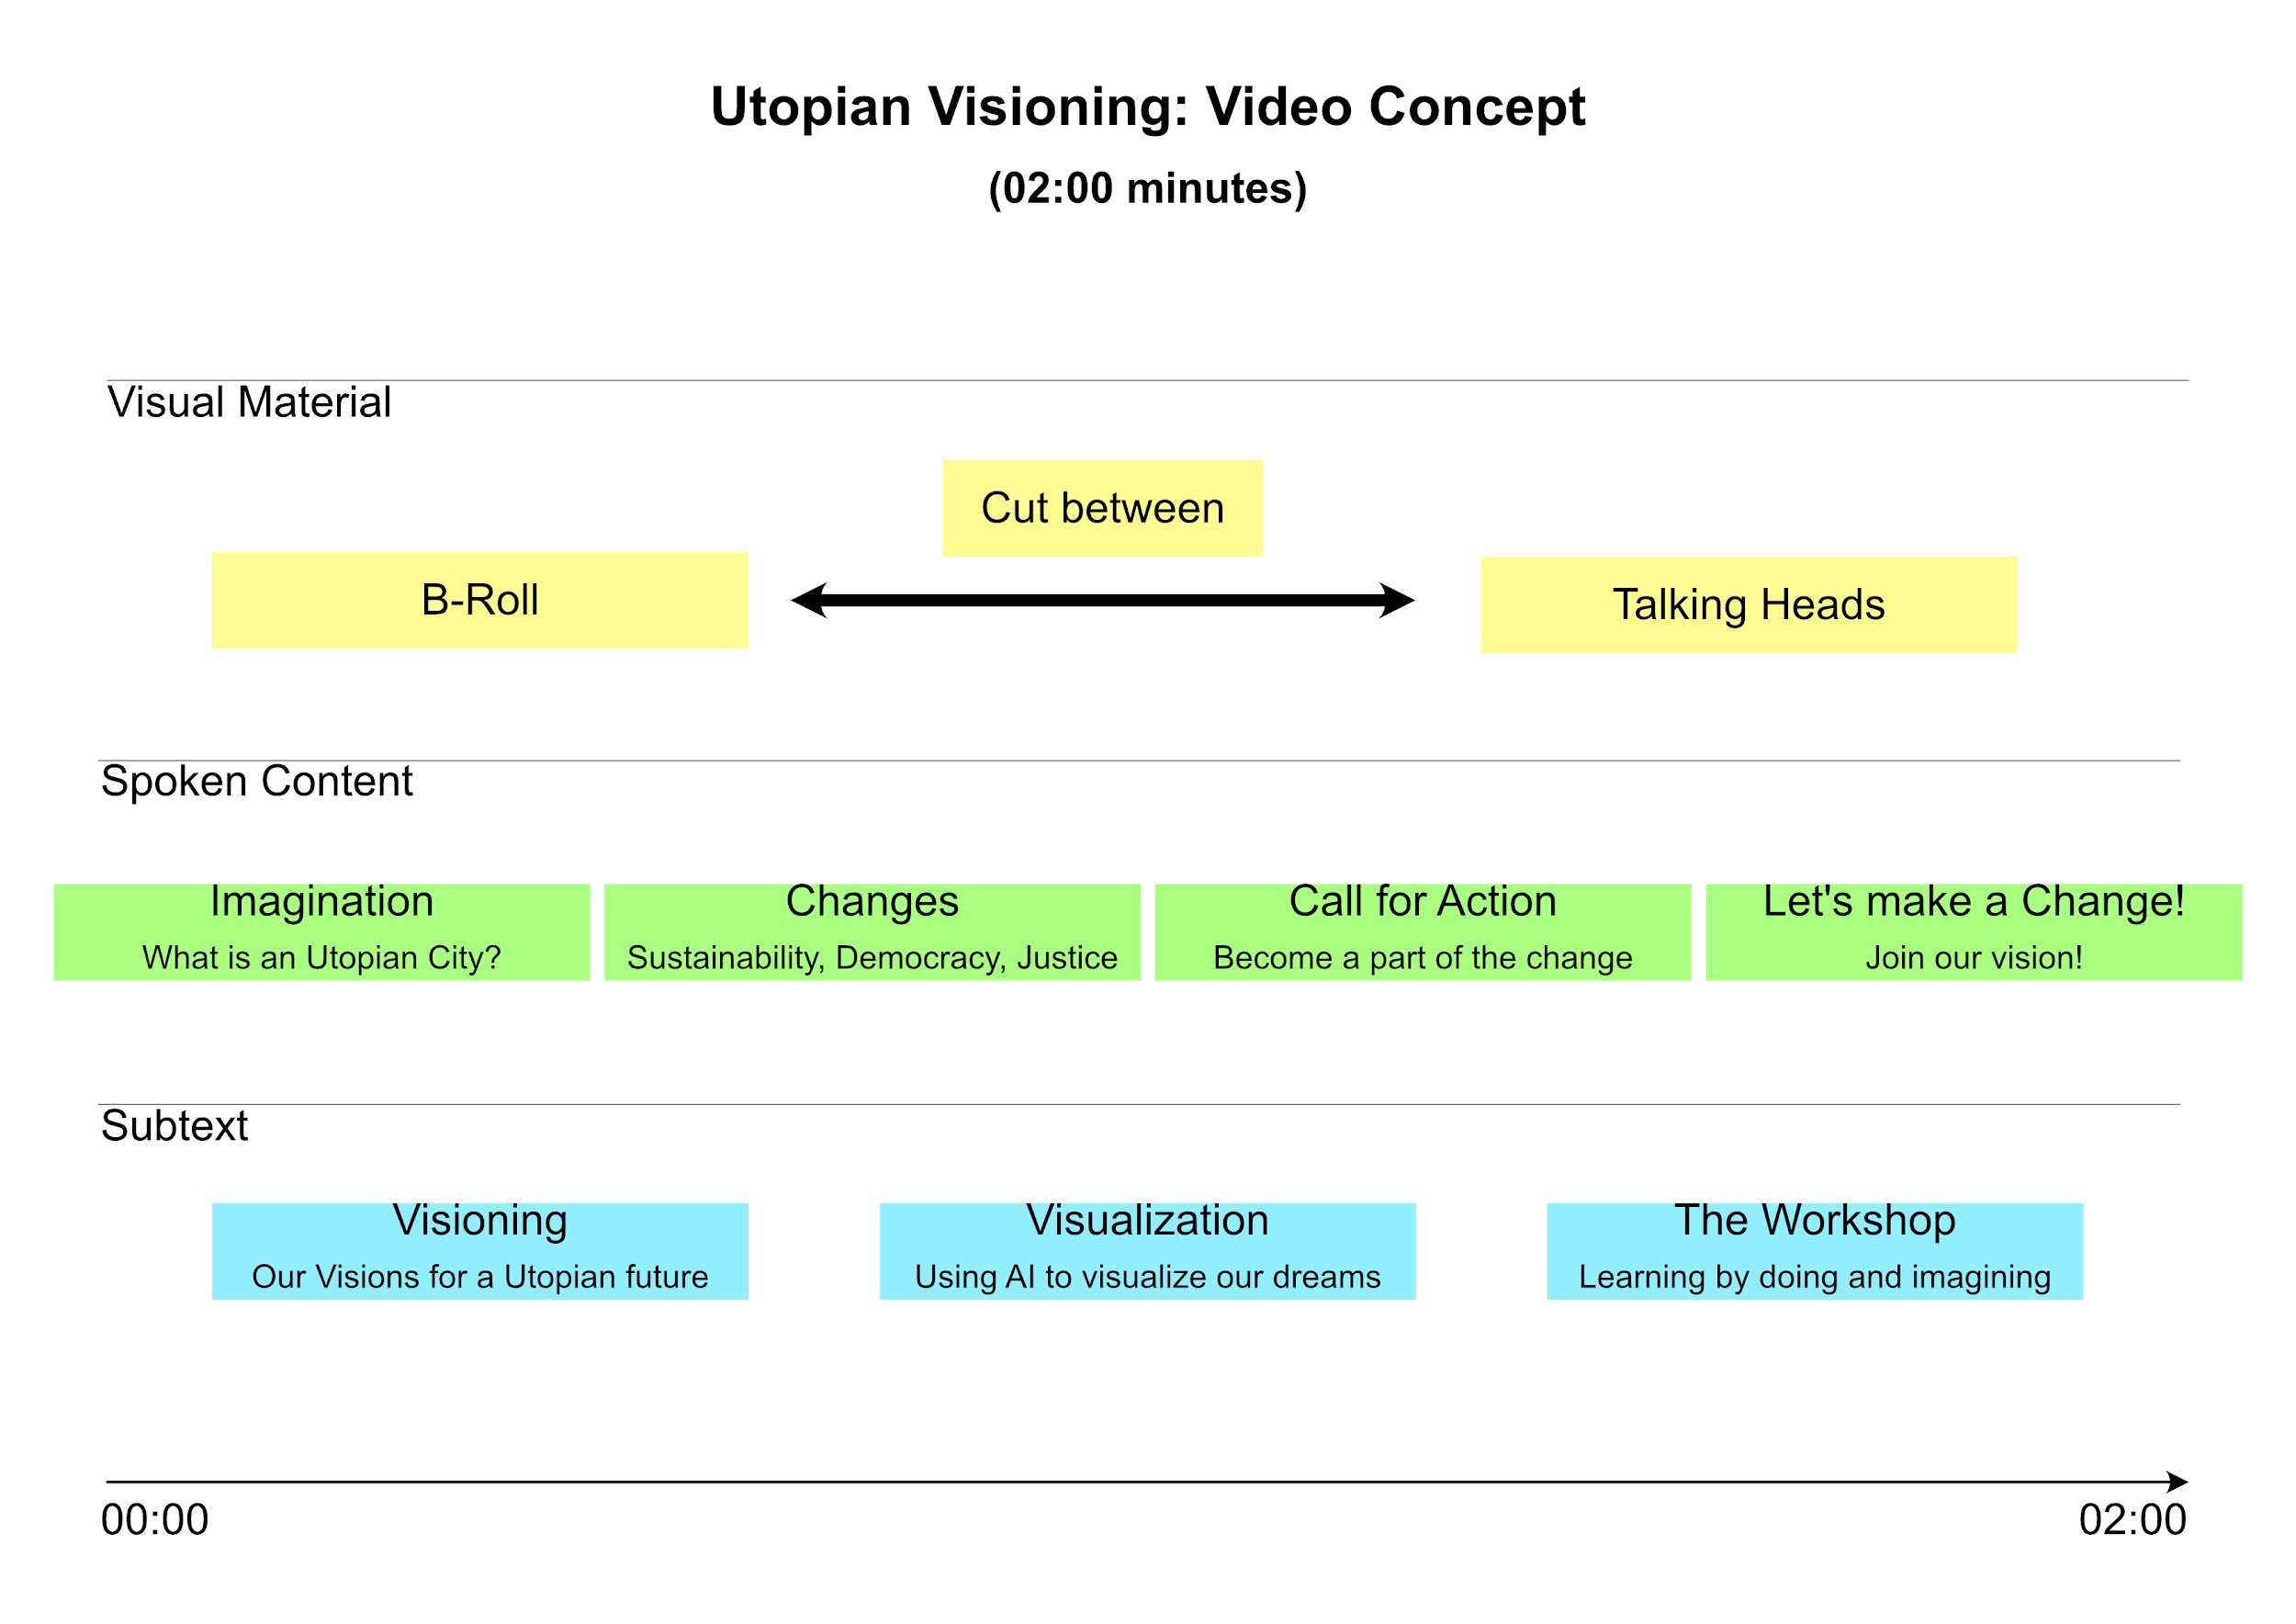

Slide 8
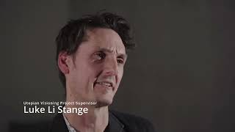

Slide 9
1.
2.
3.
Video Crew
Video Crew
Workshops
Summary
The goal of the workshops was to educate and inform participants on the themes of our project in a fun and interactive way in order to encourage them to explore these topics further

Slide 10
Group: TEENAGERS

Slide 11
Group members:
Silja Kaasinen, Politics & Governance, BA
Monika Riso, Sociology, BA
Yunho Ling, HCI
Shruti Bharati, HCI
Claudia Diaz Reyes, HCI
Darja Djatsenko, MA, Youth Work Management
Valeria Kussova, Psychology, MA
Sven Reintak, English Language and Culture, BA
Supervisor(s)/mentor(s):
Luke Stange
Partner(s):
IZUM youth club
https://clubactive.eu/contact/

Slide 12
PROBLEM, AIM AND IMPORTANCE

Slide 13
GOALS AND PROBLEMS
What was the problem you were solving?
Aim of the project
Give power and tools to the marginalised/minorities: young adults, teenagers
Find ways to end injustices in cities and make them more inclusive; solve problems (Ecological, racial and gender injustices in cities)
Ecopedagogy: Critical pedagogy that aims to end socio-environmental injustices; wants to create a planetary consciousness through revolutionary teaching and learning

Slide 14
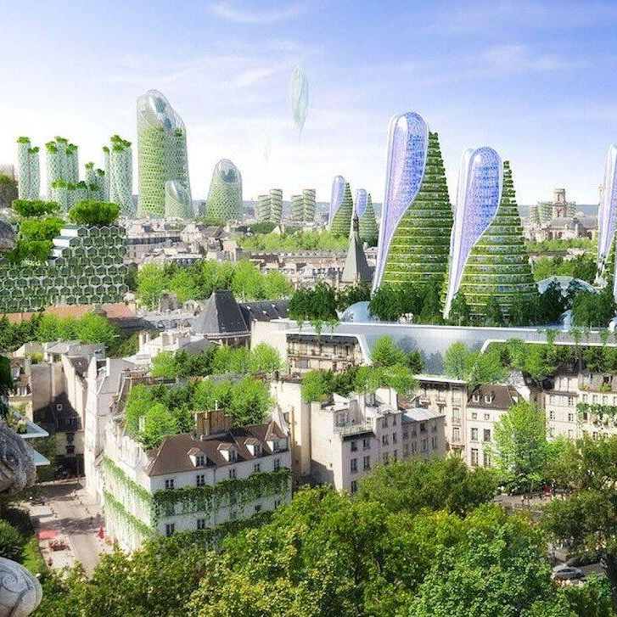
What was the aim of the project?
To inspire teenagers about the future of Tallinn and how it could be made better
What were you aiming to achieve?
Give them new tools to think about issues; inspire them to think of their own solutions; inspire them to be more active in these issues
How did you measure the success of the project?
With results from the feedback questionnaire

Slide 15
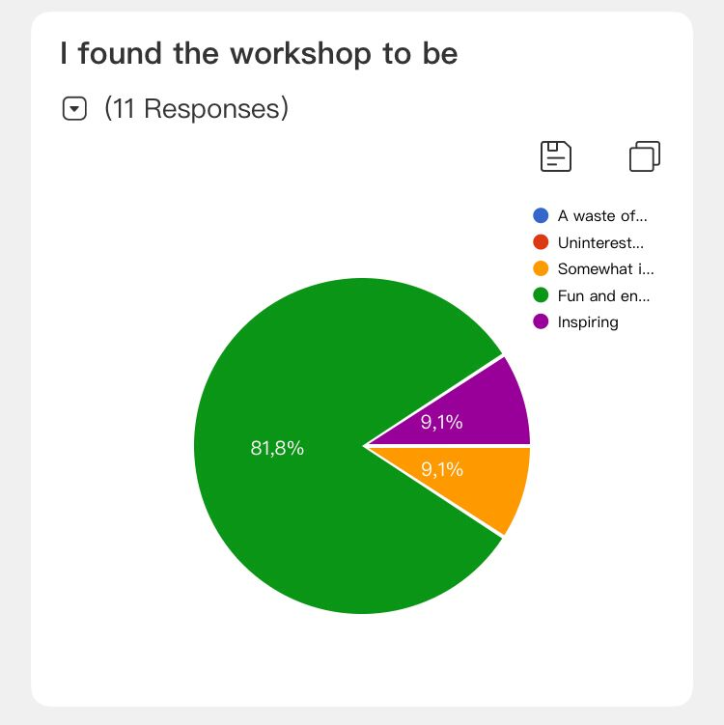
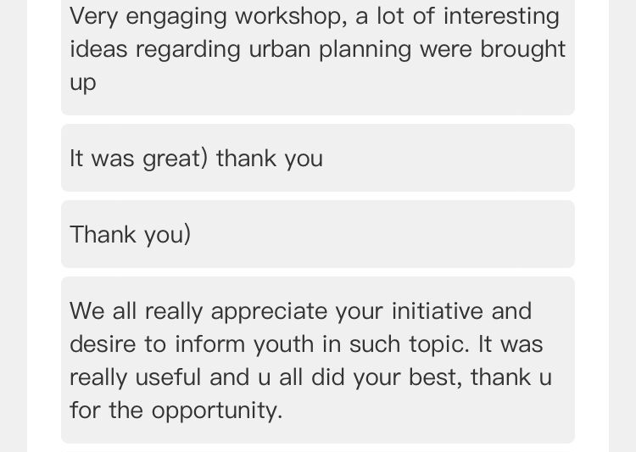
QUESTIONNAIRE RESULTS

Slide 16
ACTIVITIES IMPLEMENTED

Slide 17
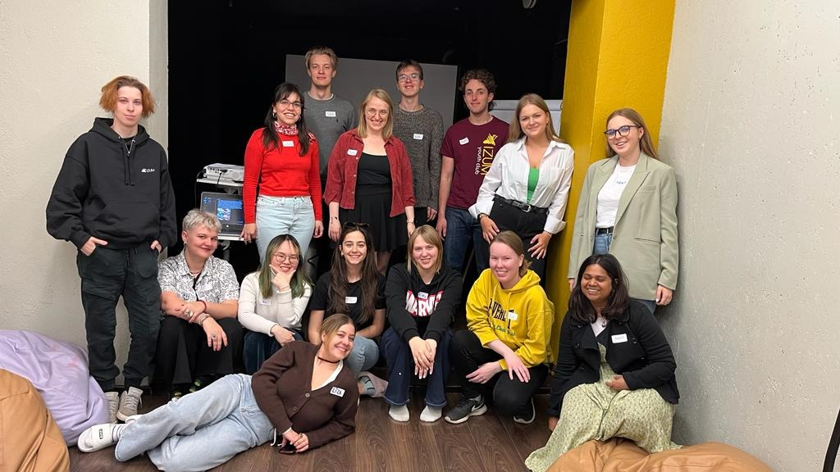
THE WORKSHOP
Details:
Number of participants: 10
Language: English
Date: 6th May 10.00-13.00
Venue: IZUM youth club, Tallinn
An interactive workshop was held with the aim to guide youngsters through an ecopedagogical approach.
Present materials to participants that can help identify the interconnected injustices imposed on marginalized peoples
Run through interactive exercises to help participants to think of solutions and to get them to participate
examples: Coming up with ideas and voting on them; drawing the ideal city; “where do you stand” exercise (agree/disagree, why)
Use of Bluewillow and other programs to get their imaginations running

Slide 18
RESEARCH BASE AND INTERDISCIPLINARY APPROACH

Slide 19
RESEARCH
Which sources/previous research did you rely on in your activities?
In carrying out research on various topics, we relied on a wide range of sources of information, including academic articles, books, government reports, statistical data, and digital publications. We accessed research databases to find academic articles related to the topic at hand. We also consulted government websites and reports for statistical data and policy information. Additionally, We used social media platforms, online forums, and video content to gain a better understanding of public opinions and perceptions
How did knowledge from different disciplines help to achieve the desired result?
We educated ourselves on city planning and sustainability, drawing from various fields such as architecture, psychology, social studies, education, and design. We combined the knowledge from these fields into our materials and workshop to create an educational, fun, and creative environment for participants to build upon their own ideas and visions.

Slide 20
PROJECT RESULTS

Slide 21
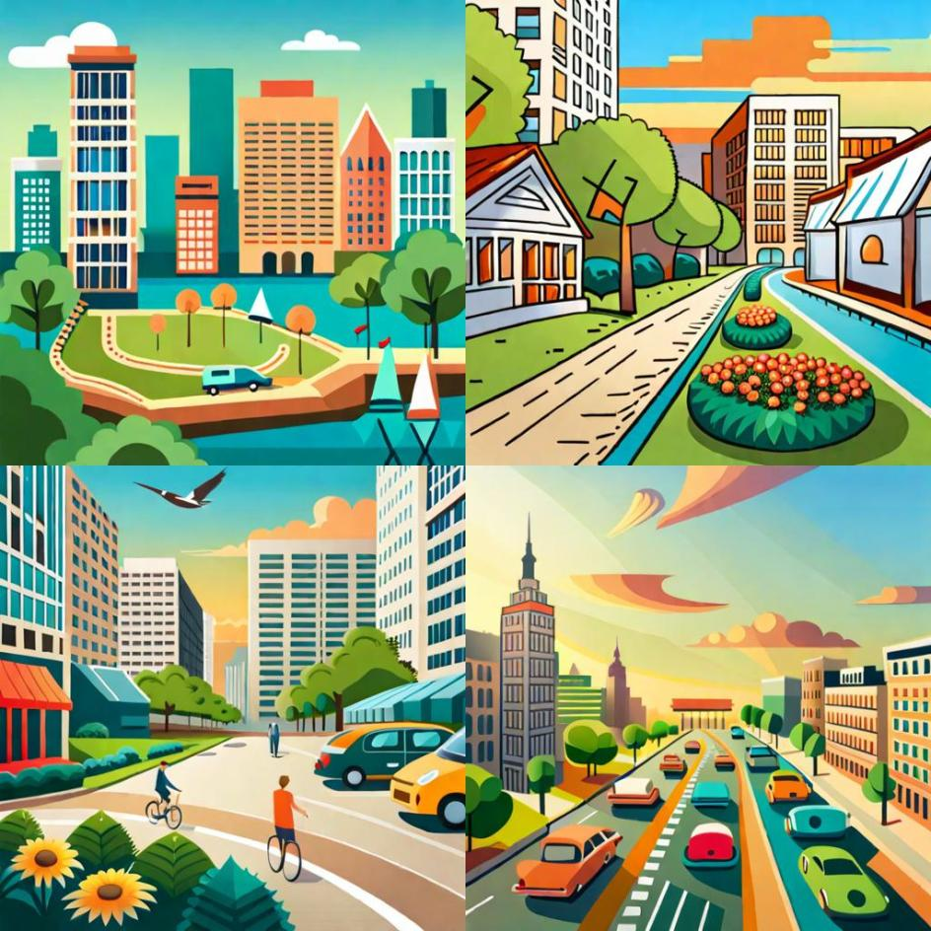
Create an illustration of a busy city with buildings covered in windows and plants. The streets are lined with large, square shaped gardens and the air is filled with the sound of birds and cars. The city is inhabited by a diverse group of people, all working together harmoniously to keep the city running and clean. In the midst of this paradise, there is a growing concern of the lack of parking spots, with too little space for the cars.
A big construction project is taking place in the city. Create an image that shows the people of the city coming together to find a solution to this problem, such as a group of citizens discussing ideas, or a city council meeting to discuss policies. Show the different options that were created to limit the lack of parking spots. More parking spots are introduced into the city, and how the people of the city ultimately come together to make the necessary changes to ensure the city remains the perfect place to live. Finish the image with a view of the city as it continues to thrive and flourish, with the people living in peace and harmony, surrounded by tall buildings, and flowers enjoying the trees with flowers of their beloved utopia.

Slide 22
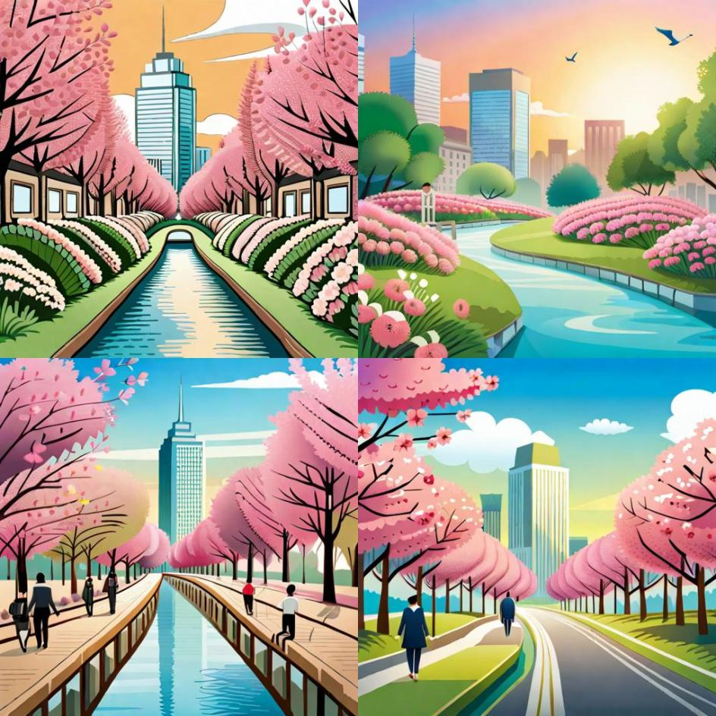
Create an illustration of a busy city with high buildings covered in green trees and flowers. The streets are lined with large, gardens and the air is filled with the sound of birds. The city is inhabited by a diverse group of people, all working together harmoniously to keep the city running. In the midst of this paradise, there is a growing concern of sakura in the city. Create an image that shows the people of the city coming together to find a solution to this problem, such as a group of citizens discussing ideas, or a support groups meeting to discuss policies. Show the different options that were created to limit amount of sakuras into the city, and how the people of the city ultimately come together to make the necessary changes to ensure the city remains the perfect place to live. Finish the image with a view of the city as it continues to thrive and flourish, with the people living in peace and harmony, surrounded by water, grass, and enjoying the sunset food of their beloved utopia.

Slide 23
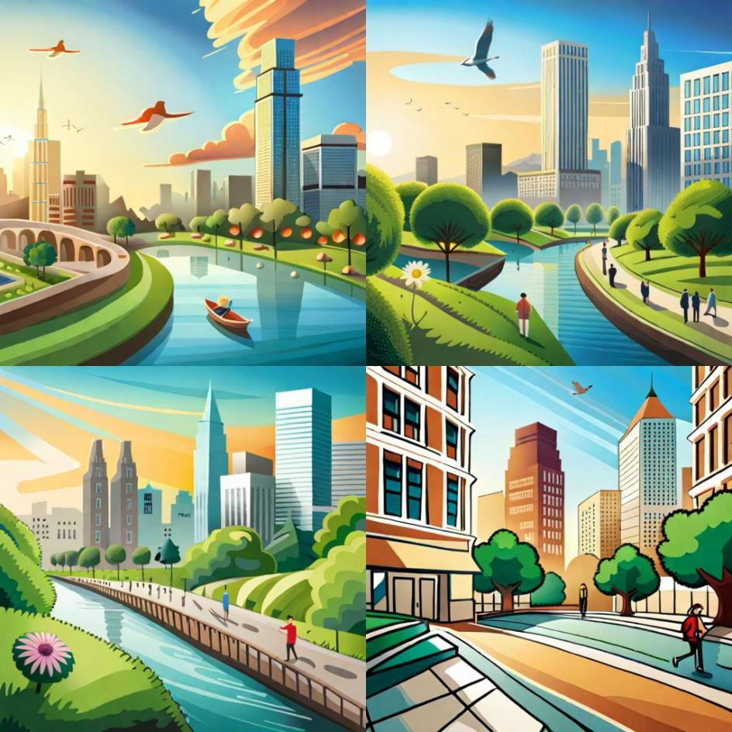
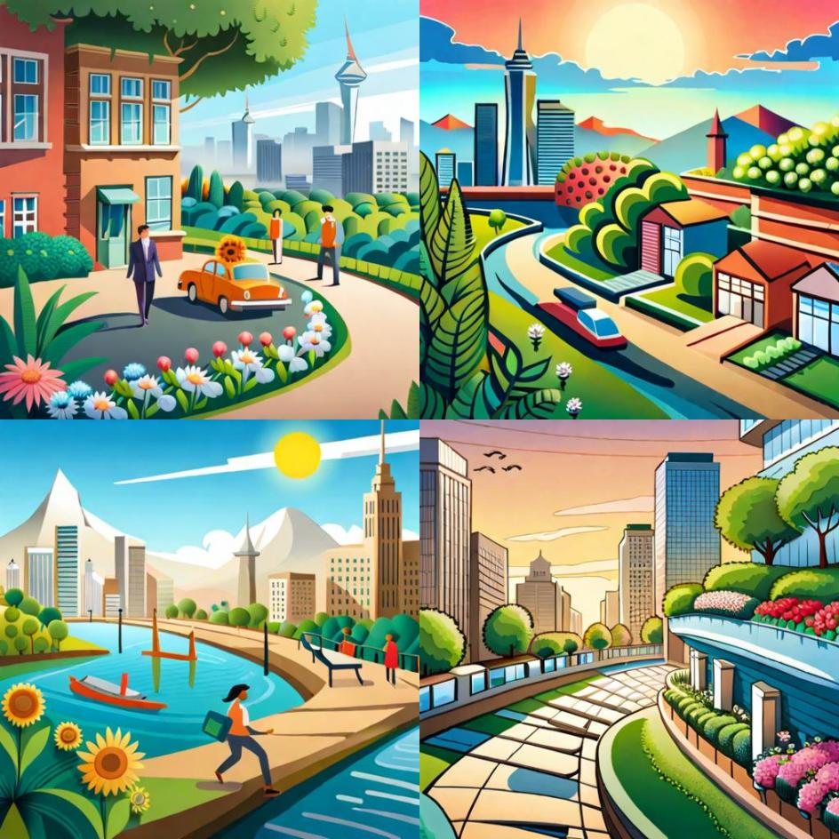
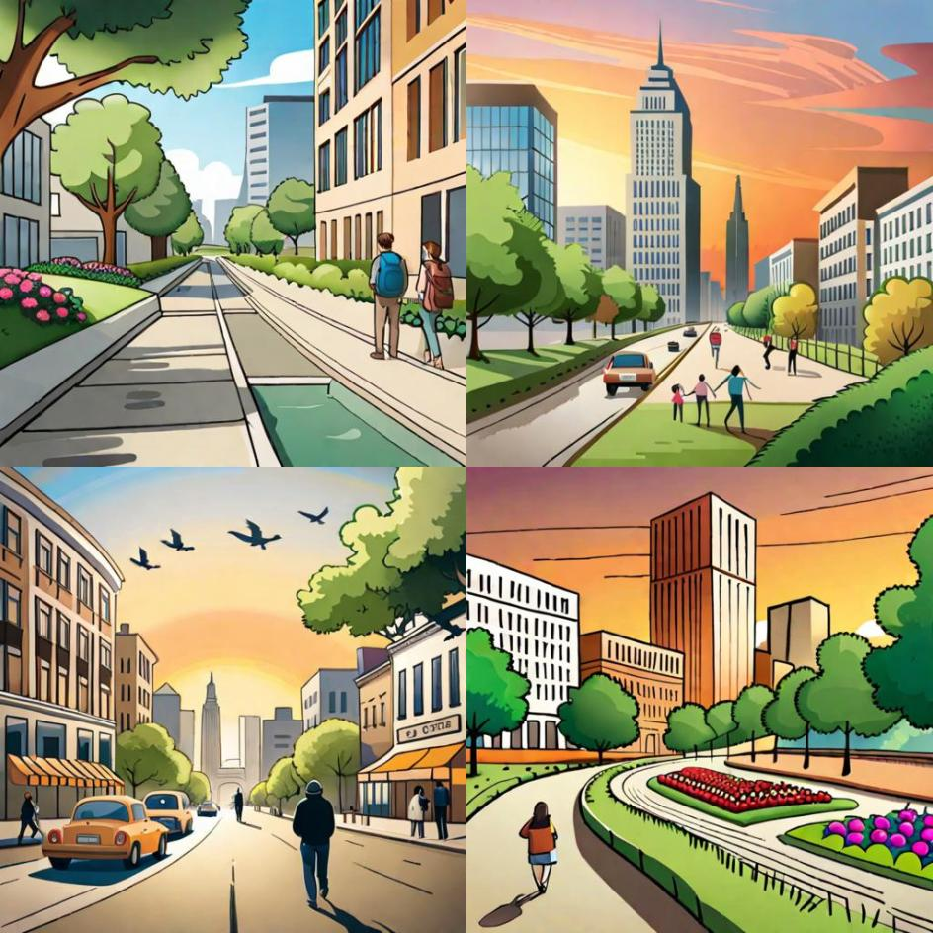
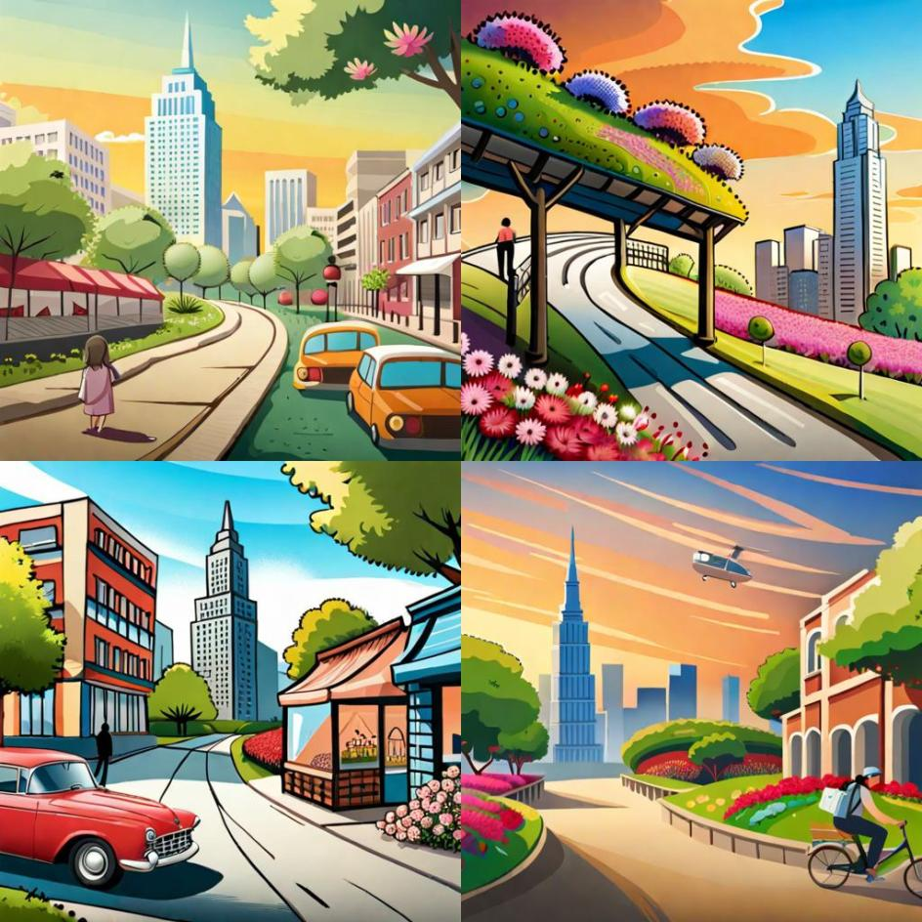
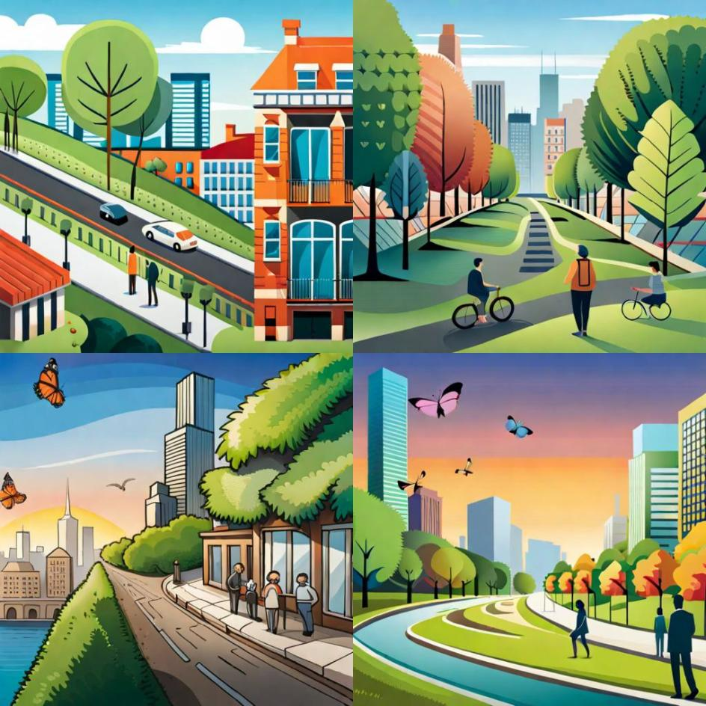
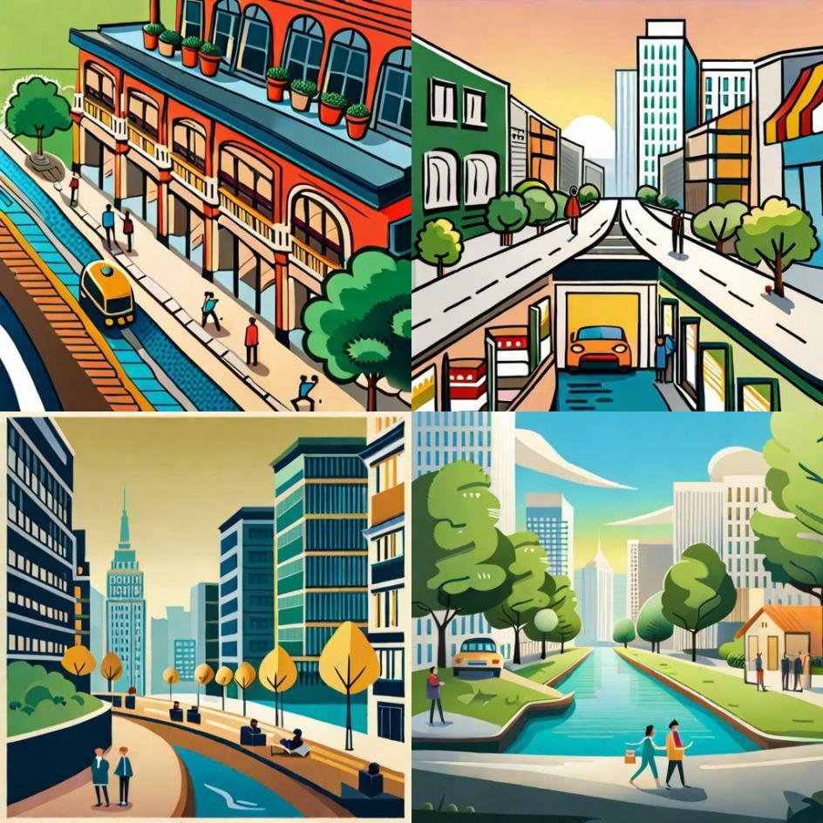
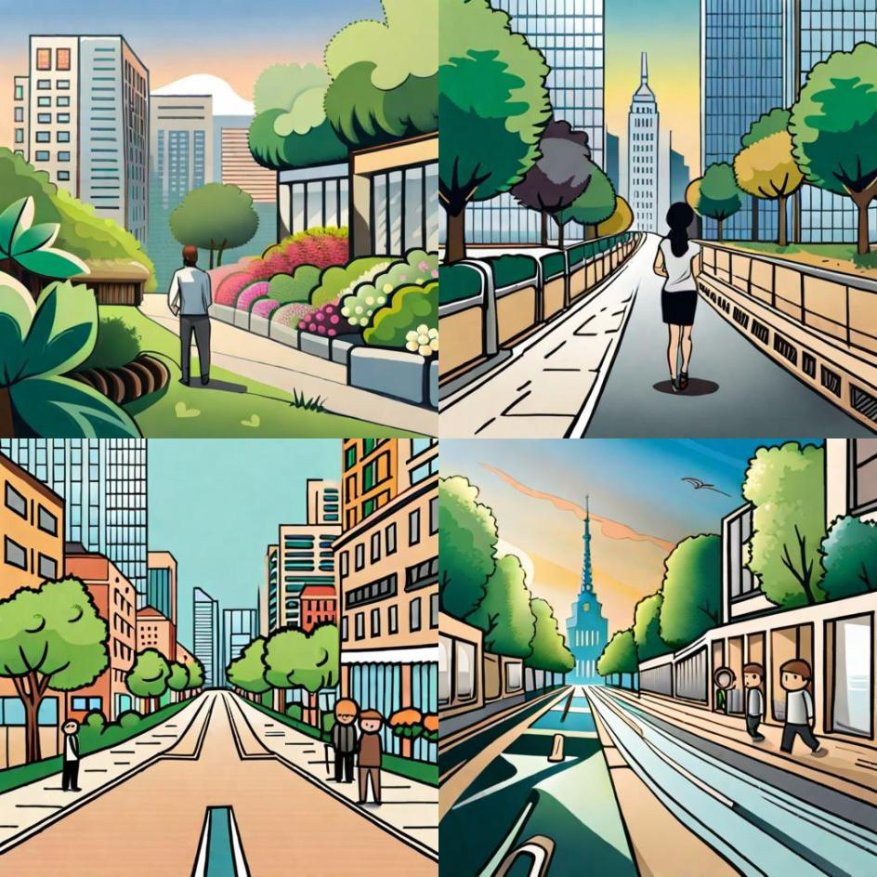

Slide 24
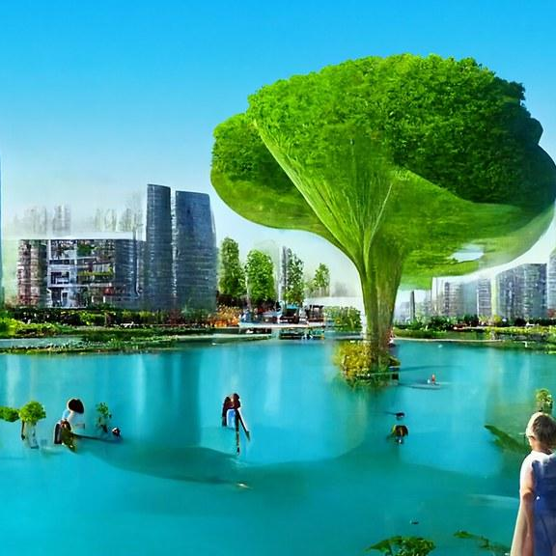
TARGET GROUP
What, how many and how well were created?
1 workshop with 10 active participants
How big was the target group?
The target group consisted of high school students between the ages of 16-17. Target was to have 20 participants; workshop was on Teeme ära -day which competed for participants with our workshop.

Slide 25
CONCLUSIONS

Slide 26
Conclusion and summary
What can you conclude from the results?
Overall, the result of the workshop suggests that the young participants were engaged and motivated to think creatively about the future. The workshop may have given them a sense of agency and empowerment, as they were able to imagine and articulate a vision for their ideal city.
What is the summary?
We created a 3h workshop where we had 10 active participants. We used interactive exercises, games and AI to inspire and teach them about the injustices of Tallinn and solutions for these issues.

Slide 27
Group: YOUNG ADULTS

Slide 28
Group members:
Liisa Kase Mattia Quartana
Milla-Maria Kujala Farhia Omer
Hans Linnutaja Katariina Raid
Burhan Hatinoglu Rynaldo Puusep
Eliza Dombrovska
Akseli Leppänen
Qiqi Shi
Supervisor(s)/mentor(s):
Luke Stange
Partner(s):
Tallinn School of Service
https://eng.teeninduskool.ee/

Slide 29
OUR AIM AND GOALS

Slide 30
Aim and goal of the project for the YA team
Create and interactive workshop based on the themes of our project
Educate workshop participants on the themes of our project through the workshop

Slide 31
ACTIVITIES IMPLEMENTED AND PROJECT RESULTS

Slide 32
The Workshop
We built a range of activities to explore and envision a sustainable and equitable future for Tallinn with the participators. We began with an icebreaker exercise called "Step Right Up," which prompted participants to consider the various privileges and disadvantages that individuals may experience based on factors such as gender, ability, income, and language skills.
We then discussed food, urban agriculture, nature-based solutions, and a multi-species Tallinn. Next, we explored the concept of a 15-minute city through interactive discourse and examples of utopian cities. Students formed groups and discussed the benefits of a 15-minute city and ways to make the 15-minute walk more enjoyable and accessible.
Other activities included exercises focused on rebuilding Tallinn and housing, where students built miniature versions of the city and shared their visions. We also discussed democracy, including the Estonian government's plan to lower the voting age for parliamentary elections to 16. In addition, we explored car dependency using Mentimeter and a fun and educational Kahoot game.
Finally, we had an AI visioning exercise, where participants used AI to build their utopian city using existing pictures of Tallinn and asked the AI what to add. Overall, our workshop encouraged critical thinking, collaboration, and creative problem-solving to envision a more sustainable and equitable future for Tallinn.

Slide 33
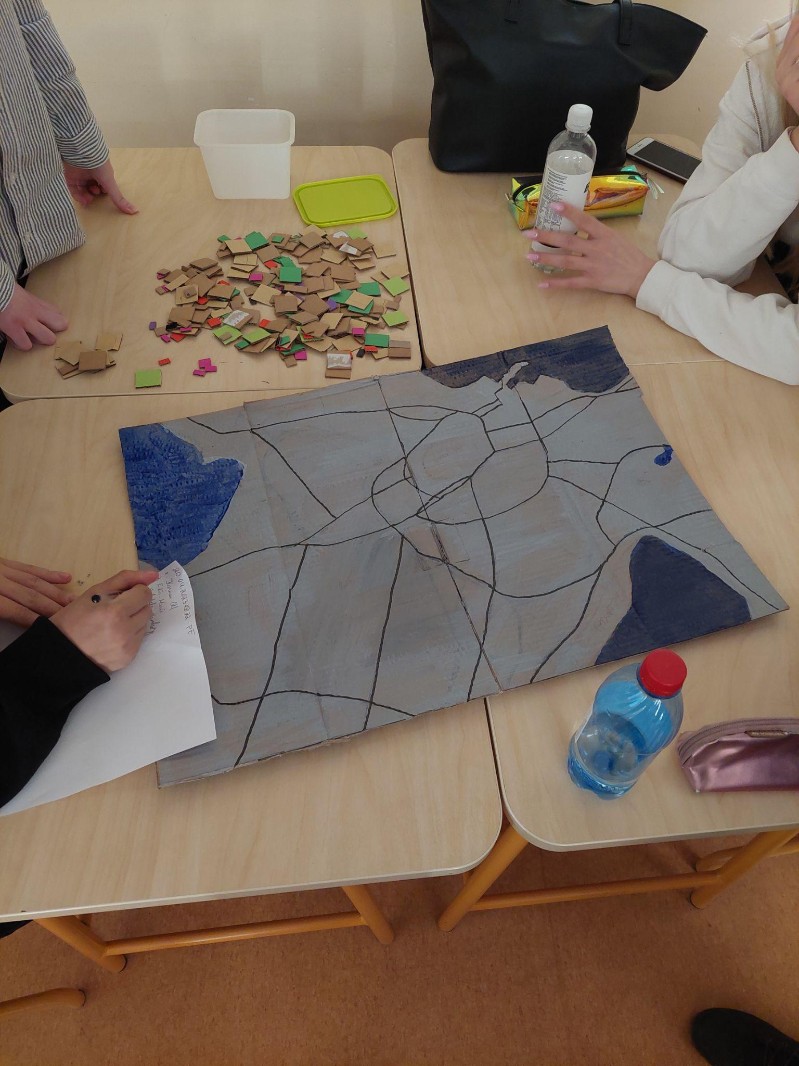
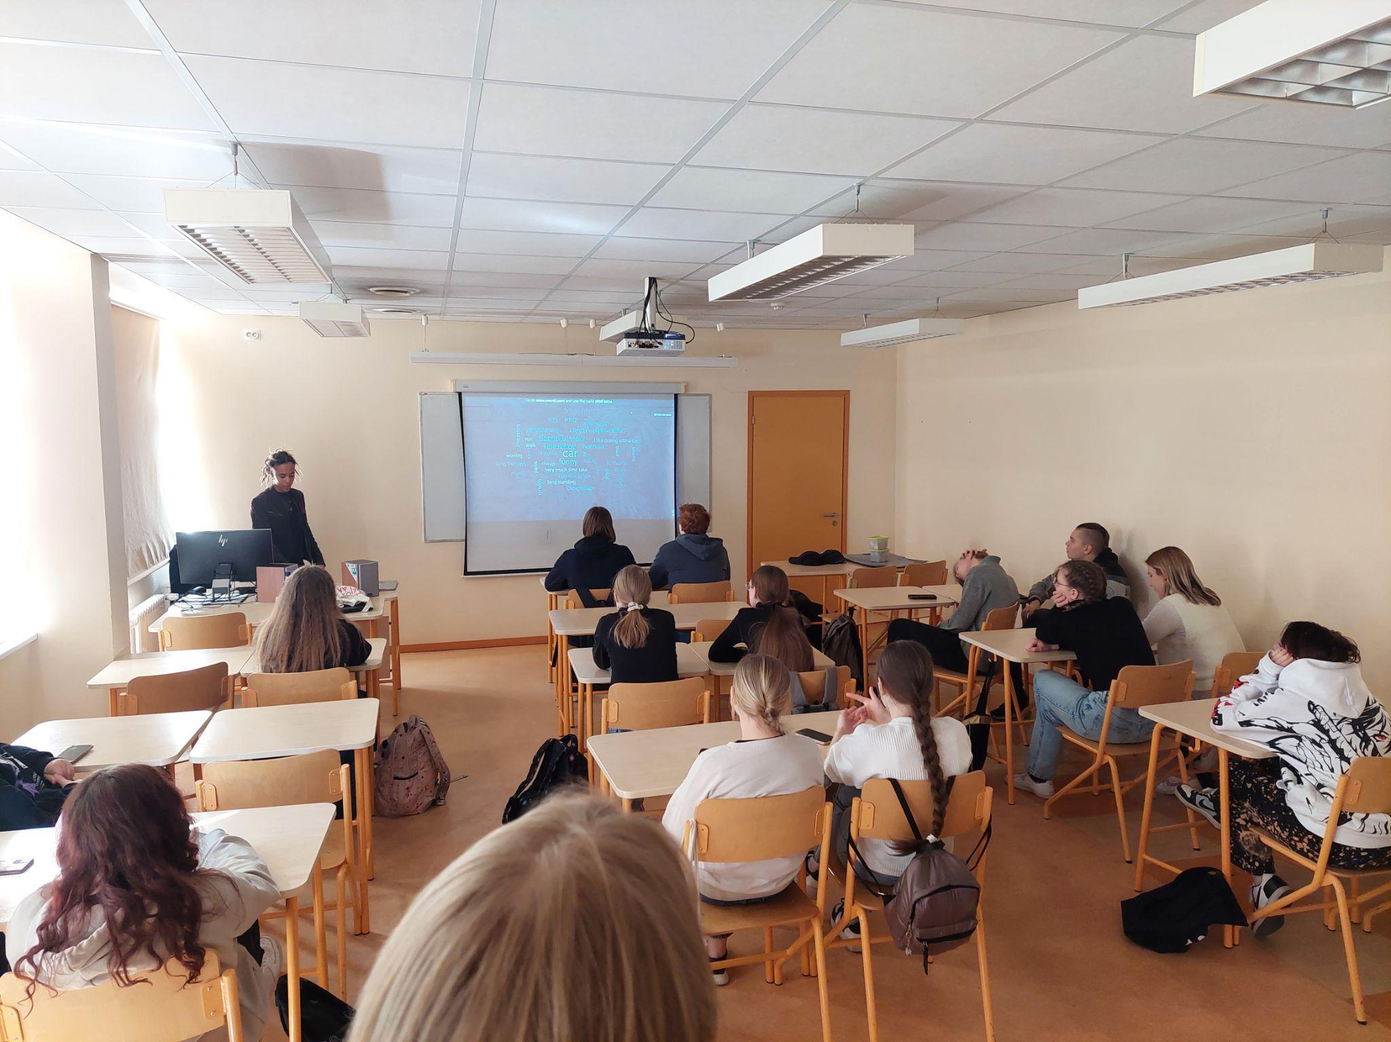

Slide 34
CONCLUSIONS

Slide 35
Conclusion and summary
What can you conclude from the results?
We concluded that it is much harder to host more than one workshop on a single day. However, it did allow us to receive instant feedback and make beneficial adjustments on the spot. There were certain factors that we couldn’t be that prepared for such as lack of audience engagement at certain moments and our own fatigue after the 2nd workshop. If we were to do this again, we could solve these issues by timing the different sections of the presentation more efficiently and adding slight variety to the workshop. Overall we believe that the students had a fun and memorable experience.
What is the summary?
We managed to host 3 separate 90 min workshops, on the 20th of April, in support of a more utopian Tallinn with young adult students who has different aspirations in life being in attendance.

Slide 36
1.
2.
3.
Video Crew
Video Crew
Workshops
Summary

Slide 37
THANK YOU FOR LISTENING

