Slide 1
Utopian visions of Estonia’s media
Members: Karen Aasa, Aurelia Elenora Kristjohann, Kirsi Süda, Oliver Objartel, Anne-Mari Vainura
Supervisor: Luke Li Stange

Slide 2
Problem, significance and goal
Aim is to bring about tangible change on the ground
Spark a vigorous public conversation about what cities can and should be
Create visions of Tallinn’s future

Slide 3
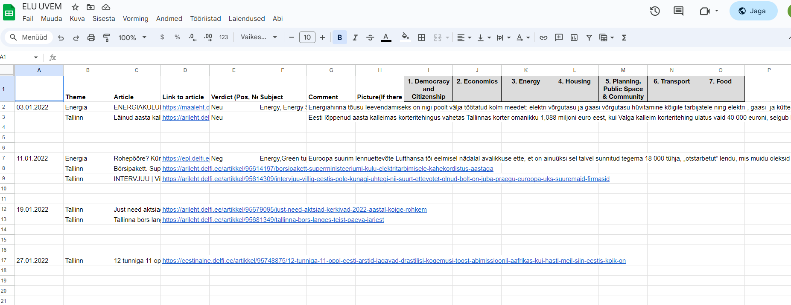
Applied activities
Article search with specific keywords
Content analysis
Picture generating AI

Slide 4
Research base and interdisciplinarity of the project
https://iopscience.iop.org/article/10.1088/1748-9326/ac14eb
This research is something that we based our first steps on
Mostly helped to start the research off somewhere

Slide 5
Results
Found over 350 articles collectively over severala outlets
Partial content analysis done on Pealinn
AI generated pictures for 3 topics

Slide 6
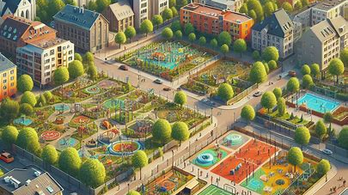

Slide 7
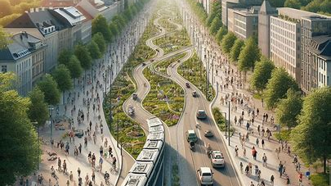

Slide 8
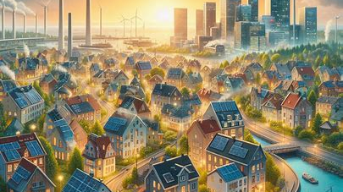

Slide 9
Conclusions
Pealinn has a very beautiful and an almost perfect vision of Tallinn’s future

Slide 10
Thank you!
Name
Name@tlu.ee

