Slide 1
Unifying Through Language
Supervisor: Ele Arder
Project team:
Grigori Komaško, Noémi Hartmann, Eliina Katriin Sulaoja, Sergei Valiulin, Eda Edovald, Weikang Fu, Sirli Uuspõld, Kristofer Nicolas Ild, Mykhailo Stavrovskyi, Amelia Carmelle Neame, Burcu Gökdağ, Nail Türkoğlu

Slide 2
Represented studies
Digital Learning Games
Communication Management
Public and Business Management
Theory of Culture
Translation
Psychology
Estonian Studies
Asian Studies

Slide 3
Problem, significance and goal
texts/programs focusing people developing their Estonian skills are not common
making learning Estonian language (and culture) more relatable and interactive
created the final product to minimize the problem and reach our goal

Slide 4
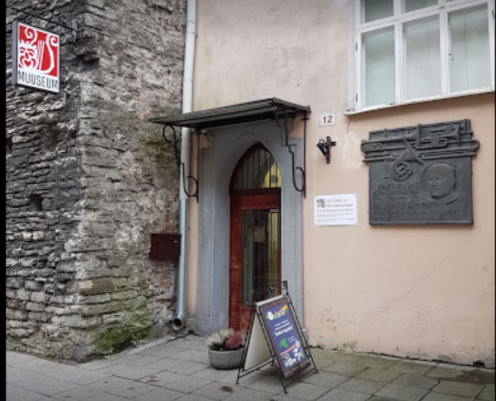
Stakeholders
Theatre and Music Museum of the Estonian History Museum
Estonian learners (A2 & B1 language proficiency levels)
Language learning institutions (indirectly)
Museum visitors

Slide 5
Exhibition
Celebrating the 100th jubilee of Estonian Theatre and Music Museum
Opening in 2024
Showcasing 100 items connecting to 100 untold stories about Estonian music and theatre history
Themes of love, nature, death, innovation, politics, etc.

Slide 6
Interdisciplinarity
Two main groups: content & design
Content group: Estonian speakers
Design group: Estonian learners
Estonian-speaking sub-group (for deciding which items make for good sections in a newspaper, and which sections each would best suit)

Slide 7
Tasks and responsibilities
Brainstorming and deciding on form of final product
Creating user personas, deciding on exact items and pitching ideas for suitable newspaper sections Forming content and design groups
Creating content and putting together design Getting feedback from B1 Estonian speakers
Brainstorming
Analysing materials from the museum
October
December
September
November
Visiting the museum
Establishing theoretical framework and vocabulary overview for A2/B1
Analysing previous years works
Presenting mid-term report
Generating pictures with AI
Adding a crossword puzzle
Putting together portfolio
Working towards final presentation

Slide 8
Steps
Researching and writing the theoretical background
Creating user personas
Creating end product content
Testing the content on the target group
Designing the end product

Slide 9
1.
‘Theoretical Bible’
Language learning and gamification
3 sources:
Language levels
Methodology of language learning
Theoretical background of gamification and media participation

Slide 10
2.

Slide 11
3.
Content group created texts for the articles and thought of the questions for the crossword puzzle
Made sure the texts are A2-B1 level appropriate
Items list provided by the museum

Slide 12
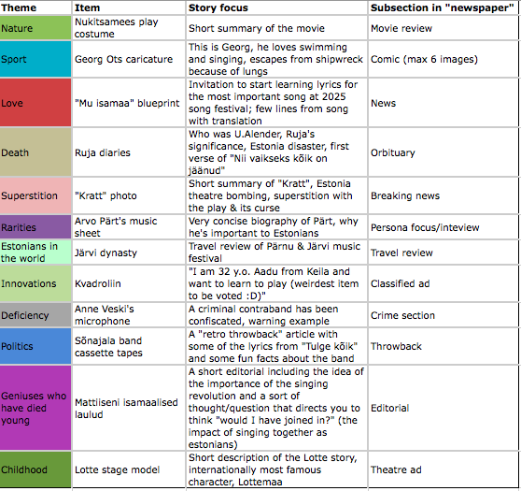
Items selected by voting
Story focus and related subsections were prepared by the content team
Design team created the visual and editorial parts of the subsections

Slide 13
4.
B1 level Estonian class in Tallinn University
7 students took part in the test
Feedback for newspaper content
Mostly: understandable and interesting enough
Some texts were difficult to read due to long words and large amount of numerals
Content changes based on the feedback

Slide 14
5.
A newspaper as an interactive and pedagogically appropriate material
Articles in A2-B1 level Estonian
Content & design team
Pictures are AI generated

Slide 15
Final Product: Aja Leht

Slide 17
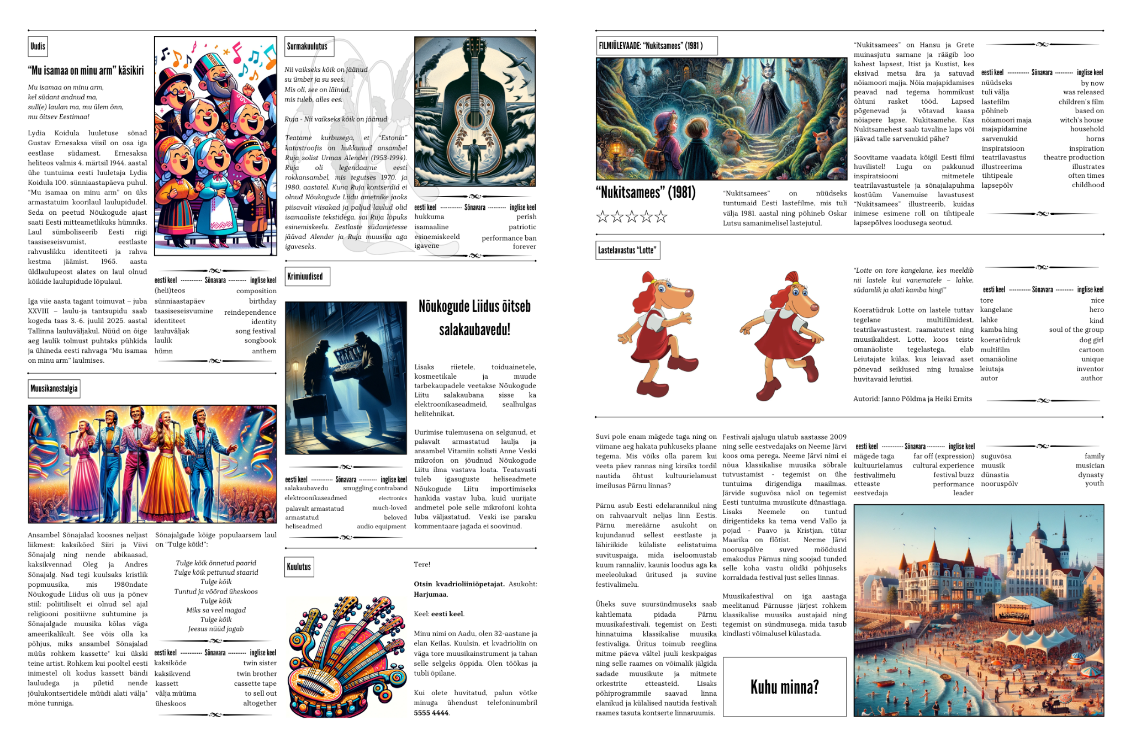

Slide 18
Conclusions
Good communication (team members, stakeholders)
Fun and useful project
Project is subject to further testing and improvement based on feedback in the future

Slide 19
Thank you for listening!

