Slide 1


Citizen engagement actions to provide humanitarian aid or educational support to Ukrainians in Estonia and Ukraine
Supervisors: Lianne Teder, Larissa Jõgi, Triin Roosalu

Slide 2
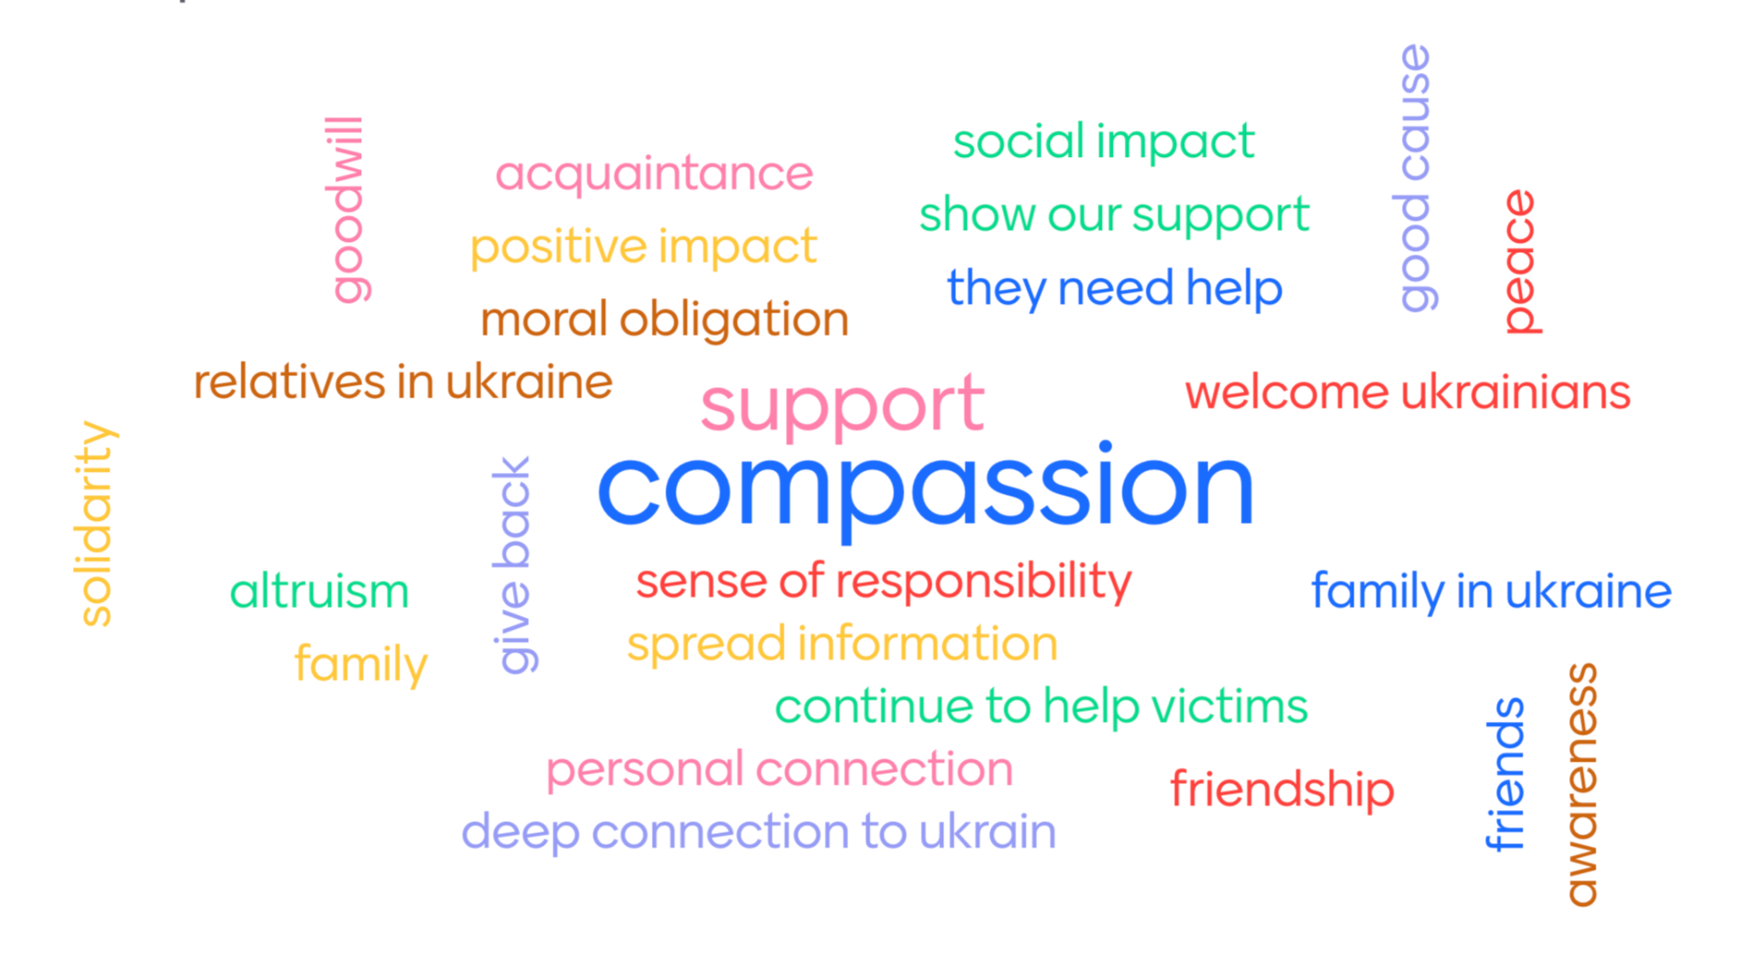
Text

Slide 3
01
02
PROJECT GROUPS
03
Survey
Language
Culture

Slide 4
SURVEY

Slide 5



The primary aim of this project was to develop, evaluate, analyze, and report support activities aimed at encouraging citizens to provide humanitarian aid and/or educational support to the Ukrainian community in Estonia.
Researched theory
Survey
Recommendations
Strengths
Social Integration
Academic Support
Enhance Language Support
Refine Information Channels
Cultural Orientation Programs
Prioritize Mental Health Services
Administrative
Processes

Slide 6
LANGUAGE

Slide 7

Text

Slide 8
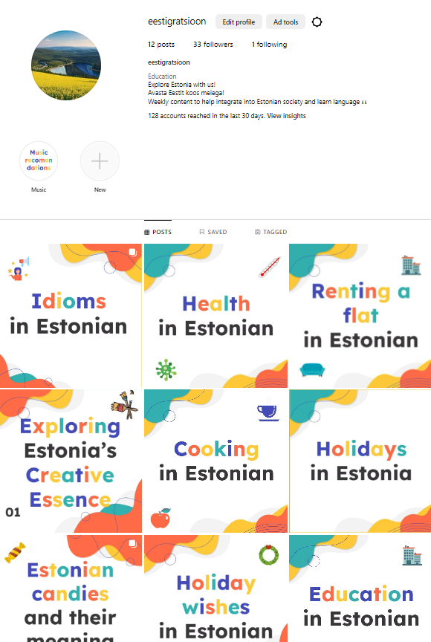


Slide 9
CULTURE

Slide 10

Text

Slide 11
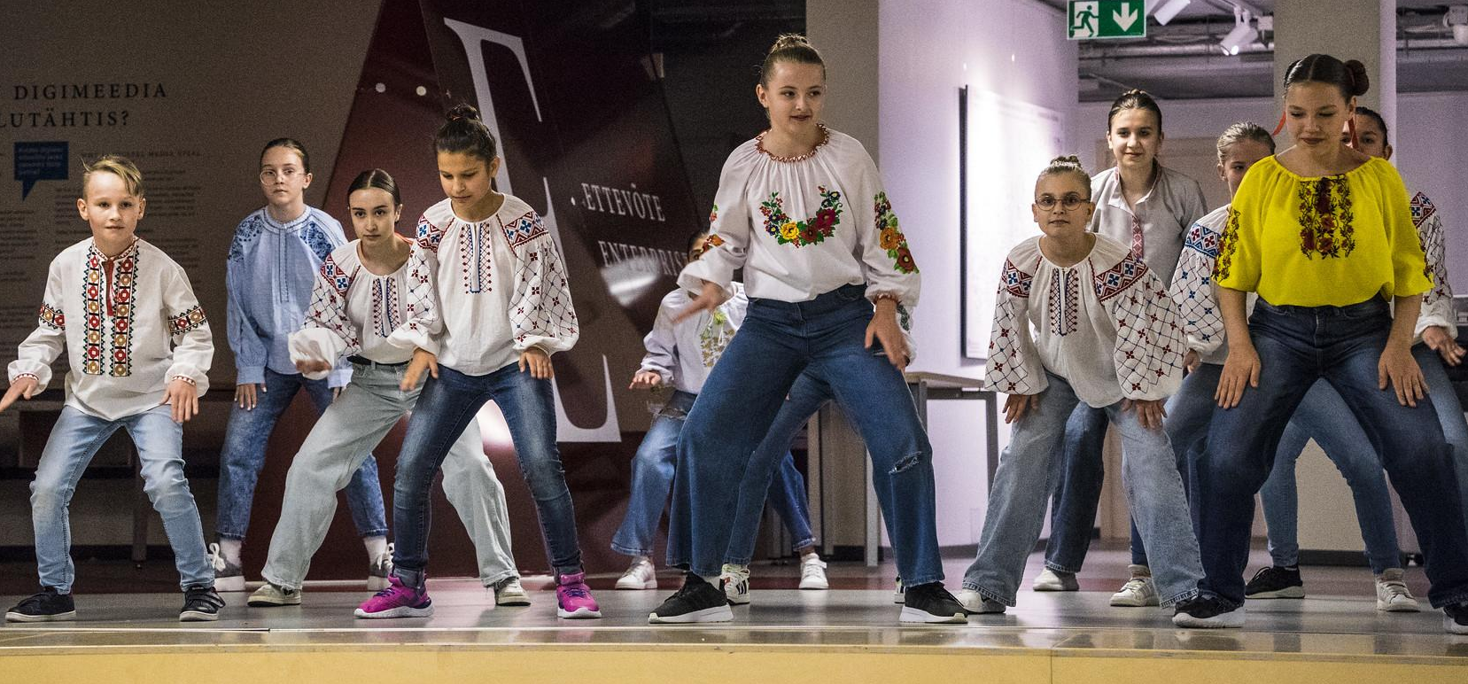
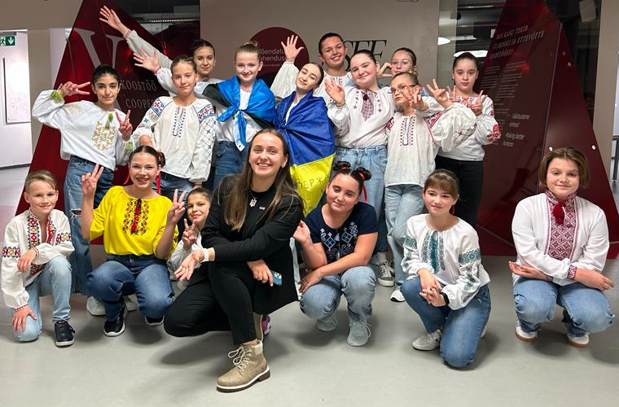
EdTech Hack 2023
Special thanks to Janika Leoste!

Slide 12
THANK YOU FOR YOUR ATTENTION!

