Slide 1
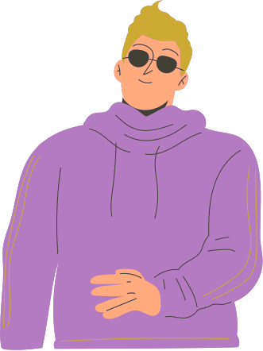

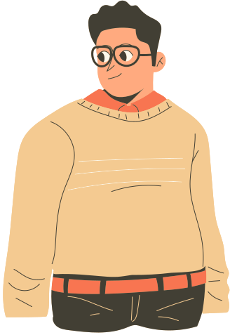
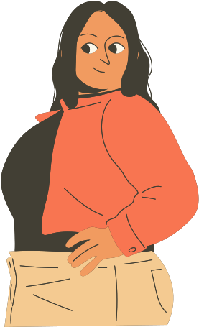

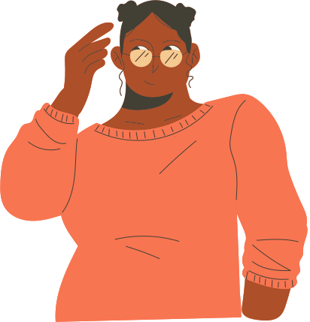



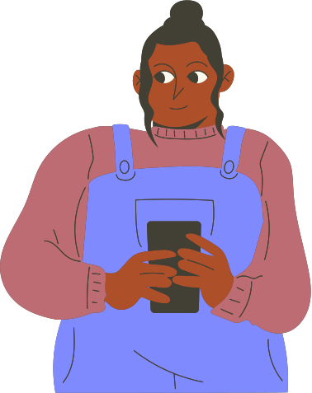

Cultural Connections
Mapping Networks of International Students in Estonia🇪🇪

Slide 2
Project Members
Students:
Akemi Hashimura
Daniel Christopher Scheibe
Joseph Kalu
Lynette Kariwo
Tinashe Luisa Munemo
Venika Krishna
Supervisor:
Maliheh Keshmiri

Slide 3
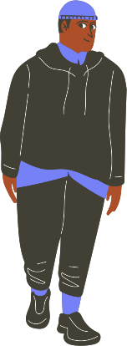
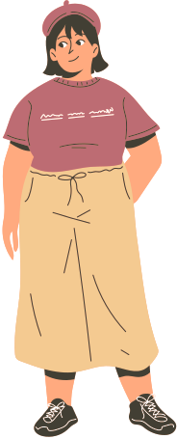
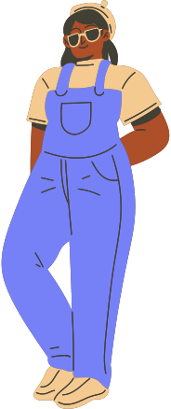
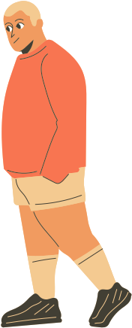
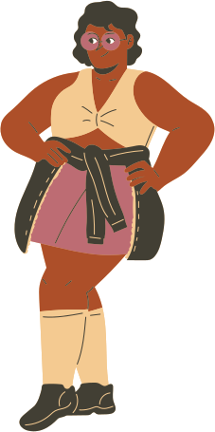

Problems
International students often find it challenging to integrate into the local environment when they first arrive.
How international students find their community and adapt the new life in Estonia is not well known.

Slide 4
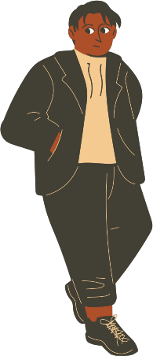

Project Goals
To understand:
How the international students find their own community in Estonia
How are they accepted by local communities

Slide 5


How do international students from diverse backgrounds engage with communities in Estonia, and how does this experience impact their sense of identity and cultural exchange within Estonian society?
What are the factors affecting the integration of international students into Estonian local communities?
Research questions

Slide 6
Methodology
01
02
03
Semi-structured interview
&
Filming
Literature review
Online questionnaire

Slide 7
01
Literature review
All the articles delve on the fact that researching data requires a methodology and stressed over the importance of forming cultural communities.
Overall, the articles revealed that:
the use of Social networks, leisure activities & cross cultural networking can bring communities together
Students can also produce and share content that represents their cultural experiences and opinions
networks are often formed by students with co-nationality. In a scenario where the majority of international students are from a specific country, minority groups cluster together.
Social networks and the digital journeys of international students can have real impacts on the students in their capacity to navigate both in their academic worlds and everyday lives abroad

Slide 8
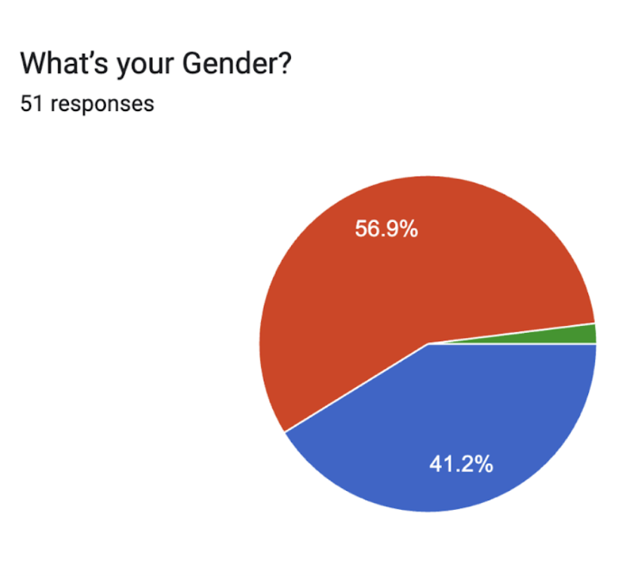
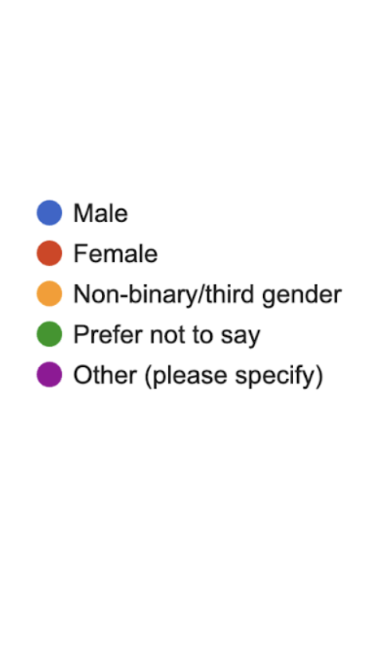
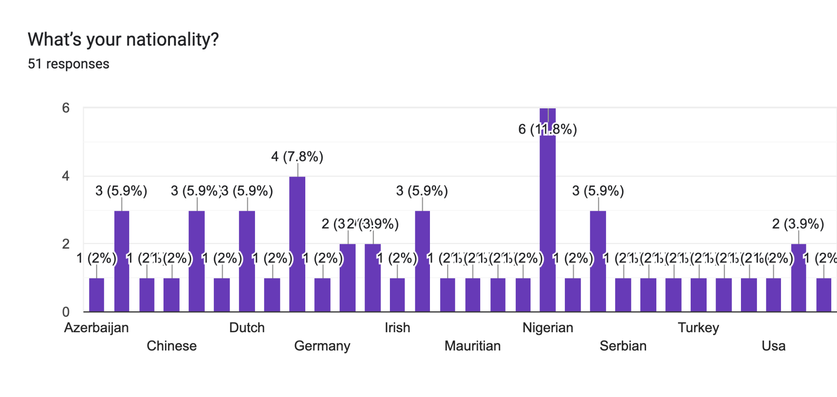
02
Questionnaire
We created a questionnaire with Google Forms, recruited participants from online media such as WhatsApp, Facebook and Telegram and sent them the questionnaire.
We had a total of 51 responses from university students in Tallinn and Tartu.

Slide 9
02
Questionnaire
Key findings
Most respondents had positive experiences engaging with communities in Estonia, they’ve made friends and have been more culturally aware, through a small fraction felt excluded.
Key challenges international students face include language barriers, lack of communities, expensive and limited events, and difficulties connecting with Estonian students.
Online platforms were seen as crucial for finding events, though some content is only in Estonian.
Participating in communities has helped broaden their horizons about Estonia.

Slide 10
03
Interview & Filming
Selected event: Weekly Beerpong tournament in the Bar Gruuv
Method: Six semi-structured qualitative interviews with pre-selected questions
Participants: Five Erasmus students and one Estonian student co-organizing the event
Material: Audio recorder, smartphone camera, document with interview guide
Shooting: 17.04.2024 from 18.30-21.30 in Gruuv

Slide 11
03
Interview & Filming
Various communites have emerged from the weekly Beerpong tournament
The communities consist mainly of Erasmus students who use the tournament as a regular event that keeps the community together
The participants emphasize the importance of the first ESN events, which form the foundation of the current community. At the same time, they also say that the community has changed over the last few months
In contrast to university courses, the Beerpong tournament is used as a place for interaction between international students and Estonians

Slide 12

03
Interview & Filming
Link to the movie

Slide 13
Conclusions
Online platforms are commonly used to find upcoming events.
ESN network is one of the helpful communities to bridge international students and local students.
Participating in one event can lead to finding another new contacts and events.

Slide 14
Suggestions
1
Use online platform to find events
2
Let’s attend one event anyway!
3
You will be able to find new connections :)

Slide 15
Suggestions
However
It turned out that there are not many active communities targeting international students in Estonia.
We need a wide range of new activities and events in order to provide international students more options which fit a variety of students’ cultural background and their interest.

Slide 16
Limitations
The data collection period was from March to April.
However, most international students come to Estonia at the end of August and January.
We didn’t access for events being held only during new semester seasons.
We focused on communities and events whose main participants were students in this project.
Future studies should broaden the scope of target communities not to
limited to students’ communities.

Slide 17
List of Article Sources
Chang, S., Gomes, C., Platt, M., Trumpour, S., McKay, D., & Alzougool, B. (2022). Mapping the contours of digital journeys: A study of international students’ social networks in Australian higher education. Higher Education Research & Development, 41(6), 1821-1837. https://doi.org/10.1080/07294360.2021.1962812
Mogesnes, K. (2014) Henry Jenkins, Sam Ford & Joshua Green: Spreadable media: Creating Value and meaning in A Networked Culture, New York: New York University Press. 2013. MedieKultur Journal of media and communication research, 30(56), 191-194. https://doi.org/10.7146/mediekultur.v30i56.1605
Stodolska, M. (2007) Ethnic enclosure, social networks, and leisure behaviour of immigrants from Korea, Mexico, and Poland, Leisure/Loisir, 31(1), 277-324. https://doi.org/10.1080/14927713.2007.9651382
Taha N & Cox A (2016) International students' networks: a case study in a UK university. Studies in Higher Education, 41(1), 182-198. https://doi.org/10.1080/03075079.2014.927851
Wang, X., Alauddin, M., Zafar, A, U., Zhang, Q., Ahsan, T., & Barua, Z. (2023). WeChat Moments Among International Students: Building Guanxi Networks in China. Journal of Global Information Technology Management, 26(1), 47-76. https://doi.org/10.1080/1097198X.2023.2166752

Slide 18
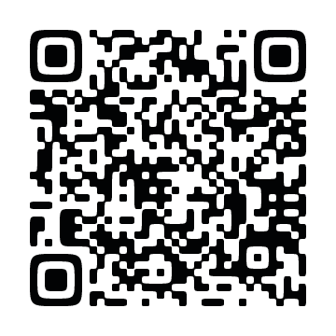
Link to our portfolio
https://docs.google.com/document/d/1oyXiRGE7bF93IUmrjCDeMOGo1YyoQPg8g5RXa98CquQ/edit?usp=sharing

Slide 19
Thank you for listening!

