Slide 1
Banned Books Seminar
Developing a Seminar on Censorship for Educators and Librarians
May 2025

Slide 2
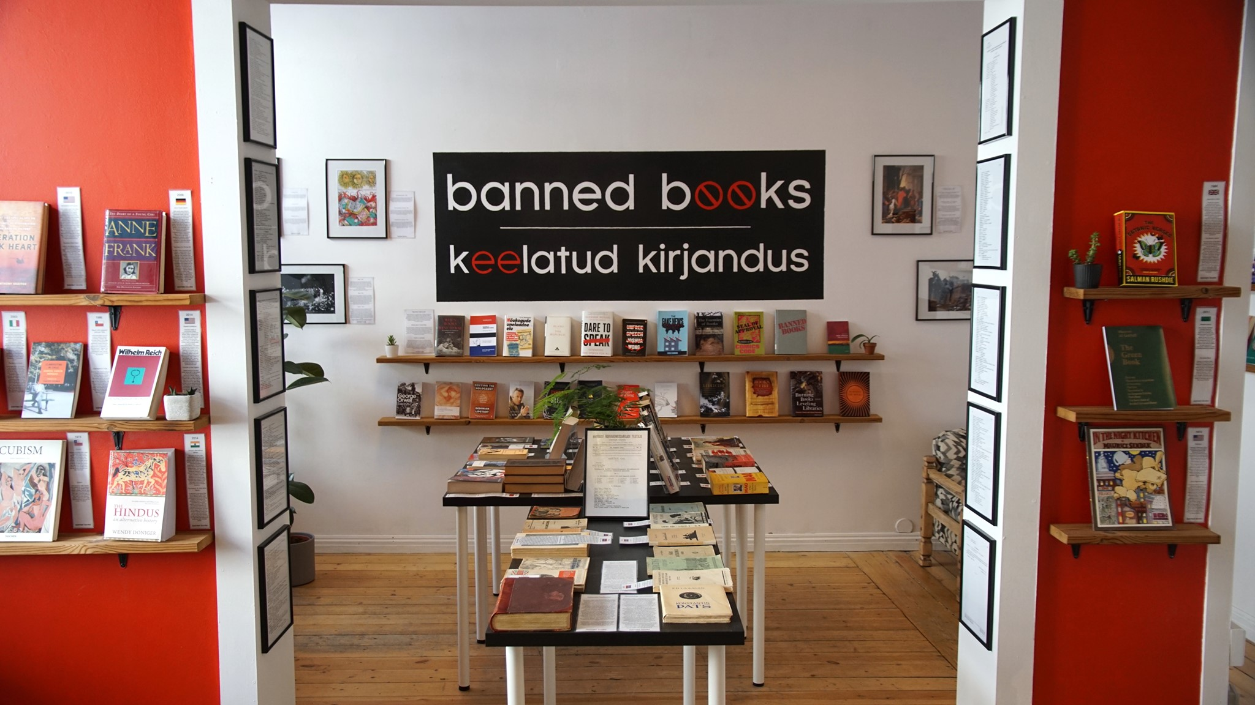



/bannedbooksmuseum
/bannedbooksmuseum
/in/josephdunnigan1

Slide 3
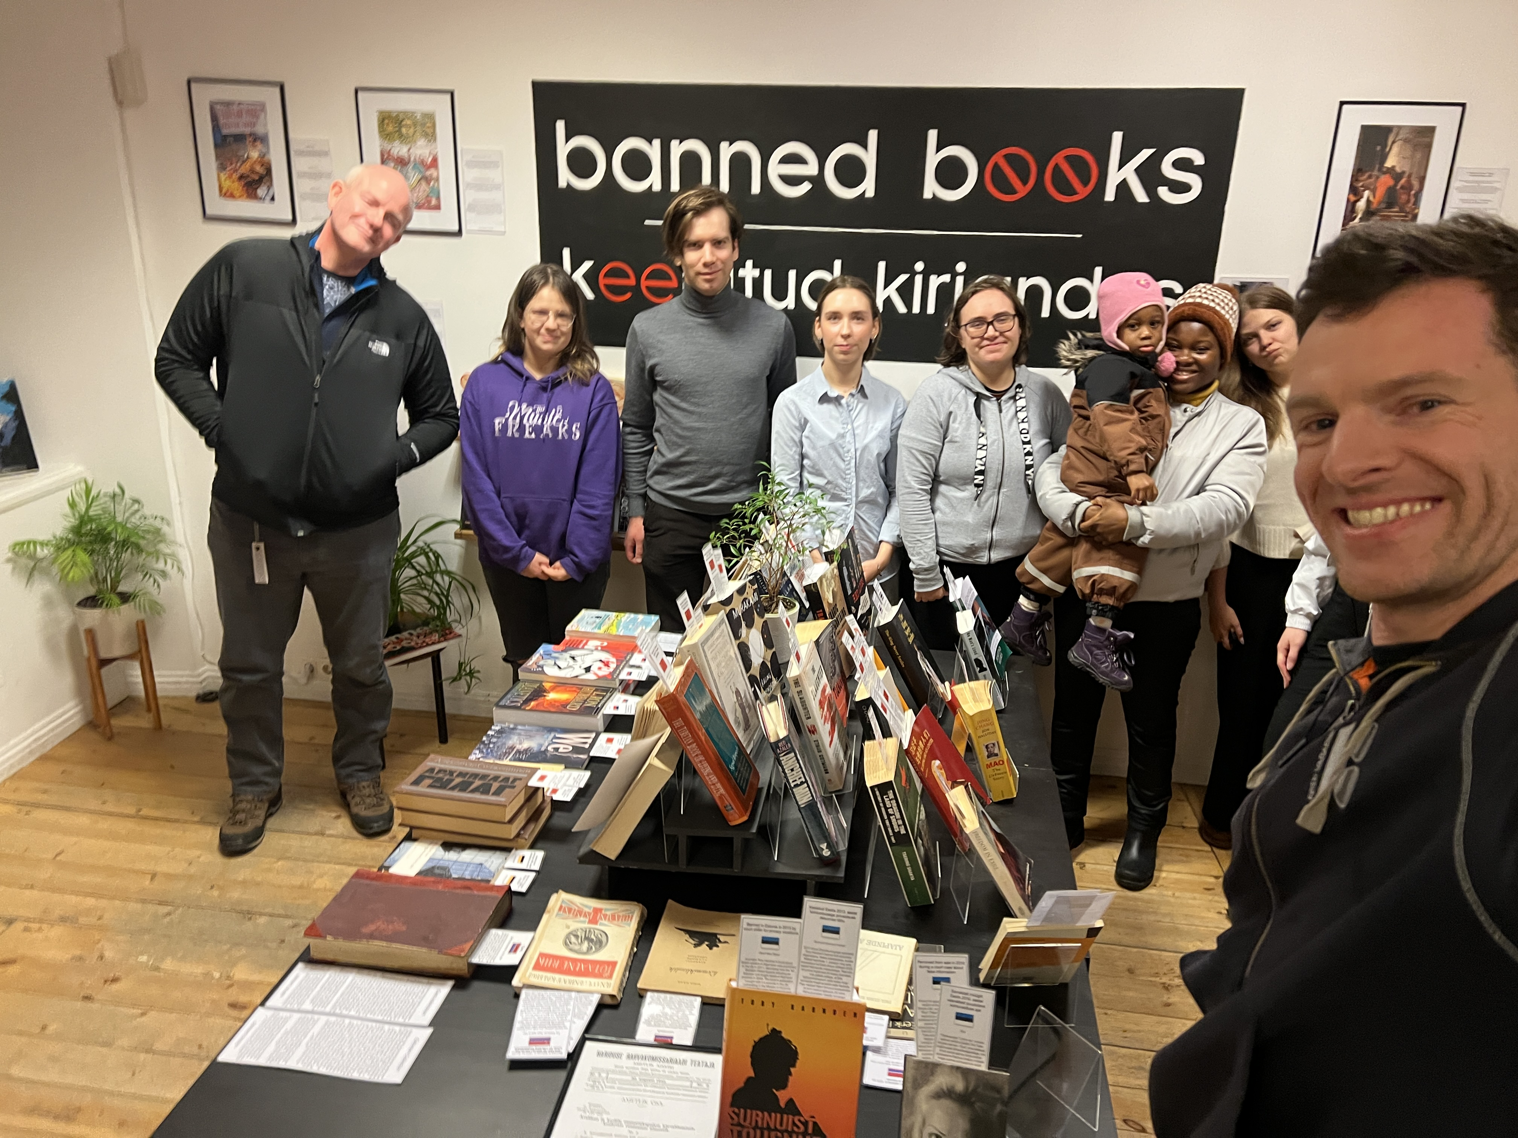
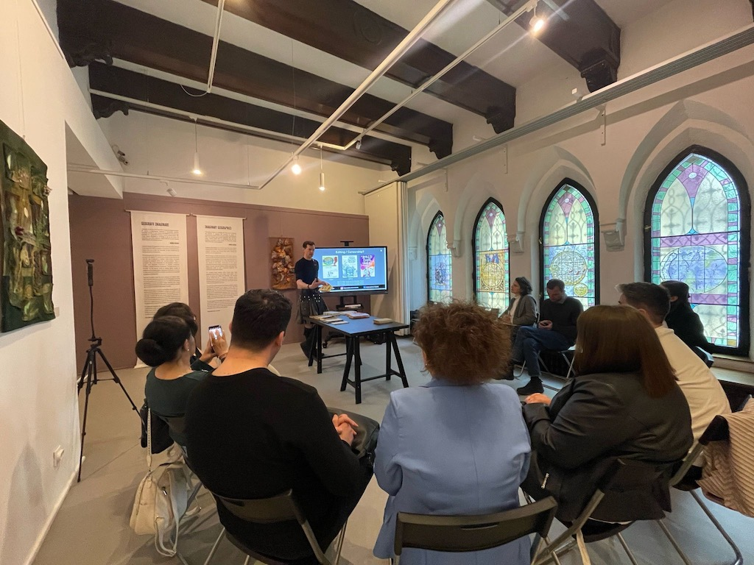
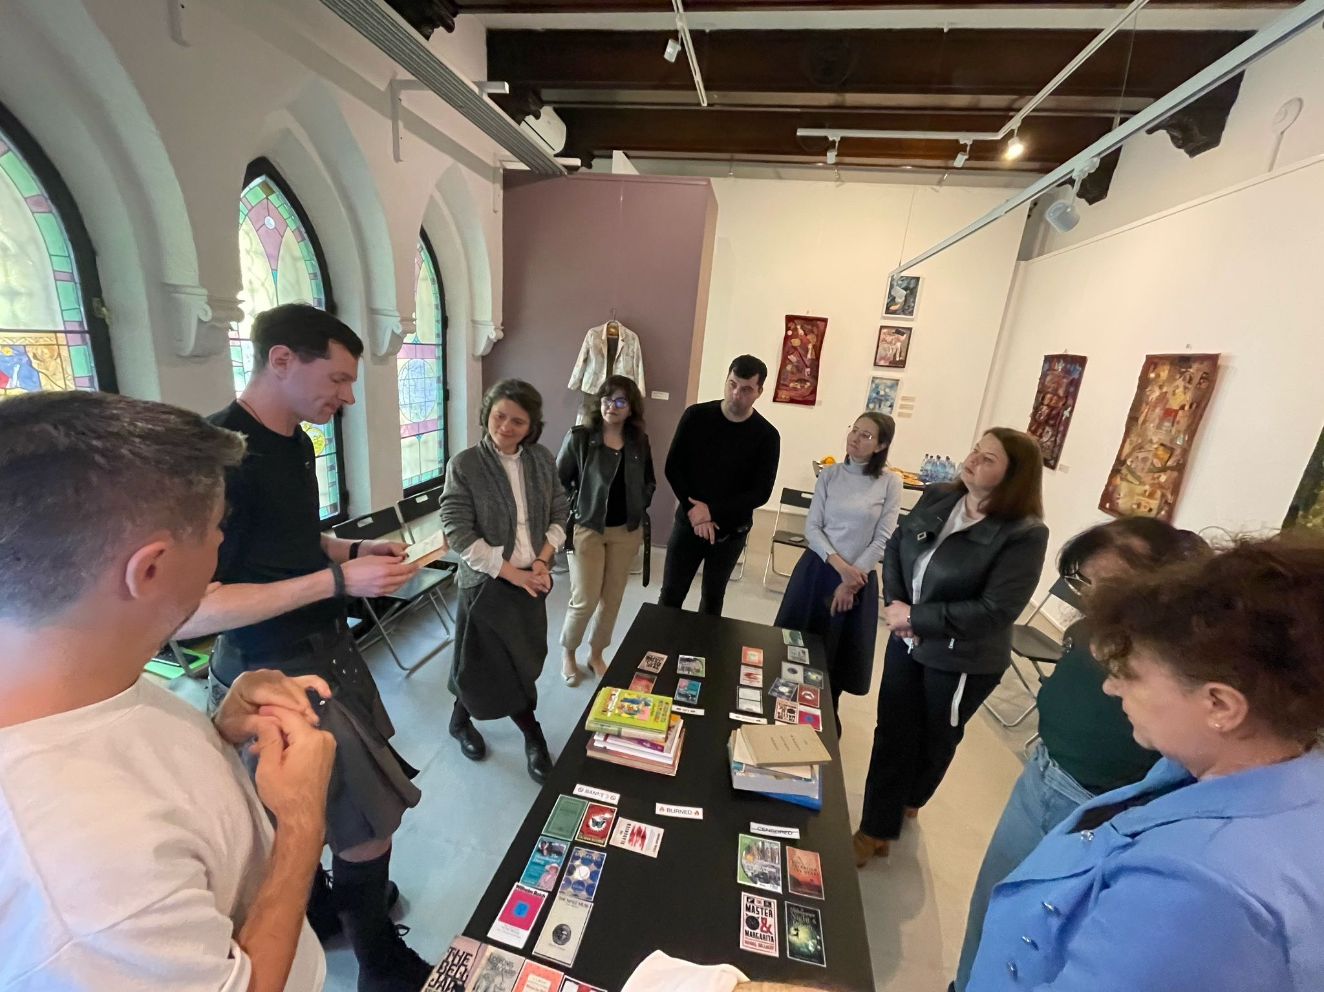
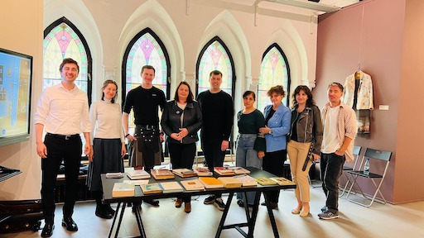
/bannedbooksmuseum
/bannedbooksmuseum
/in/josephdunnigan1

Slide 4
Co-Creation Team; Elis Vaher & Kertu Säsil Aas
Seminar Team: Liisa Toonekurg & Kristlin Ringas
Research Team; Ivan Frolov & Robert Drew Trumpis
Marketing Team; Elise Britta Aidla
/bannedbooksmuseum
/bannedbooksmuseum
/in/josephdunnigan1

Slide 5
Co-creation team
Erialasid Lõimiv Uuendus
Elis Vaher, Kertu Säsil Aas
Tallinna Ülikool
2025

Slide 6
The Questionnaire
figuring out what exactly they’re lacking knowledge in
what topics they would like to know
forms of censorship, the process of censoring a book
some specific examples
what format would be best and why
1 hour online/in-person
in sessions
their feelings, opinions about book censorship
if they feel comfortable talking about this topic

Slide 7
The Questions
How much do you come in contact with censored books in your job?
Is knowing about censorship important in your job?
What would you like to know more about censorship?
Do you know if and how censorship rules differ in different countries?
What do you think about censoring books, do you think it’s necessary?
Would you like information on censored books online or as a seminar? How long should it be?
Is censorship even talked about in your workplace? Has it ever come up?
How do you think book censorship impacts a country’s literature world?*
bonus question
Are there any topics you think should be censored?
Are you comfortable talking about censorship in your workplace? is it even talked about?

Slide 8
Questionnaire
Answers:
- 26 respondents from Romania
- 4 respondents from Moldova
- 1 respondent from Estonia
- 1 respondent from Holland
- 1 respondent from the USA
Difficult to make conclusions
difference in respondents’ group sizes
unequal representation from some countries
Changes in questionnaire
Didn’t have time for Kazakhstan
interviews and written questionnaires

Slide 9
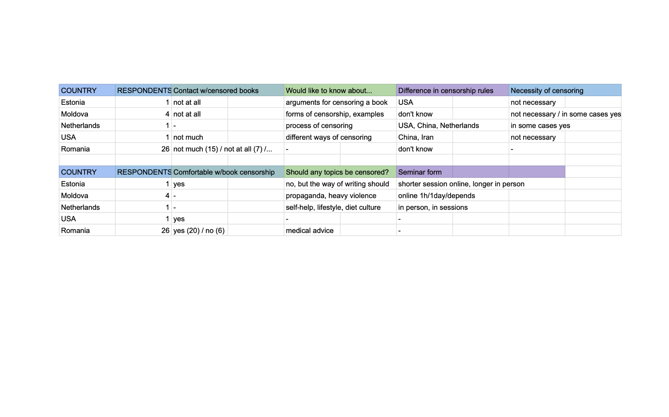

Slide 10
The goal of the project
Main goal: conduct seminars and educate people on the topic
Our team’s goal: conduct interviews to help with making the seminar
Actual outcome:
- Conducted interviews, but this data wasn’t used as we had hoped
- Difficult to make conclusions due to respondent numbers being so different
- Difficult to make conclusions due to the questionnaire being changed
- Main goal was achieved, co-creation’s team goal changed
- Seminar was successful

Slide 11
What we learned
Conducting interviews
contacting the librarians
Making questionnaires
figuring out the most important questions
Communication
between ourselves & other teams
Time management
Data analysis and concluding
What to do when we get stuck

Slide 12
Seminar Team
Liisa Toonekurg & Kristlin Ringas

Slide 13
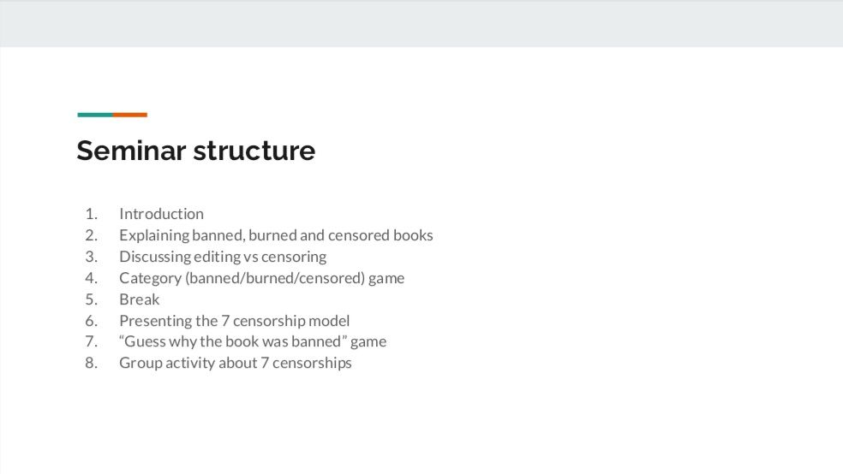
/bannedbooksmuseum
/bannedbooksmuseum
/in/josephdunnigan1

Slide 14
Research Team
Ivan Frolov & Robert Drew Trumpis

Slide 15
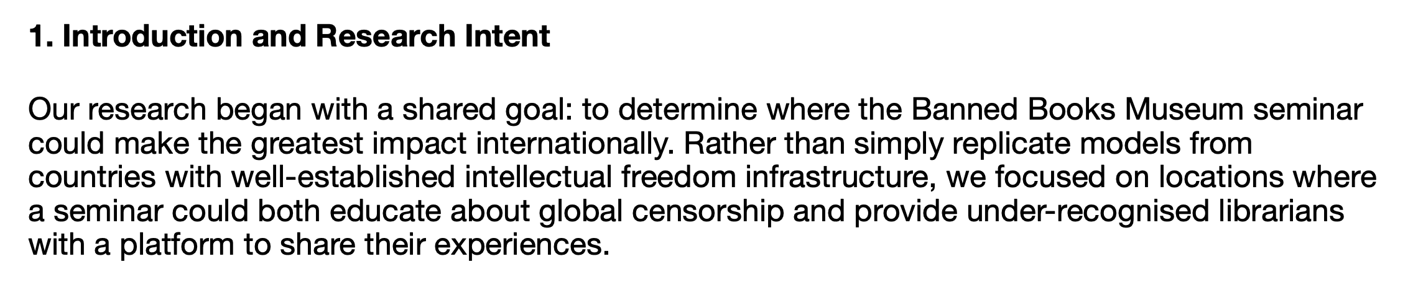
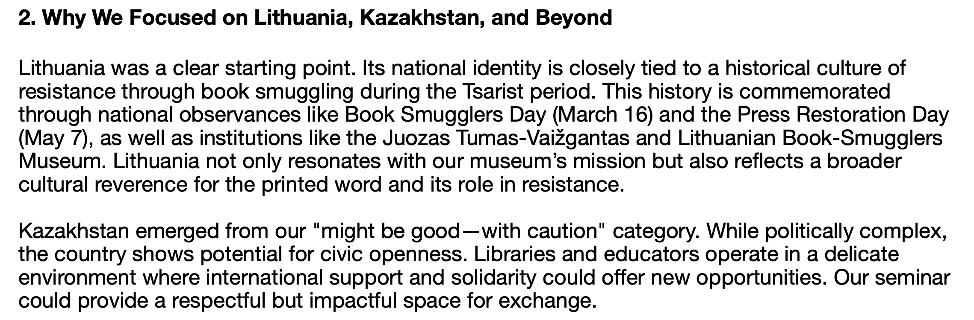

Slide 16
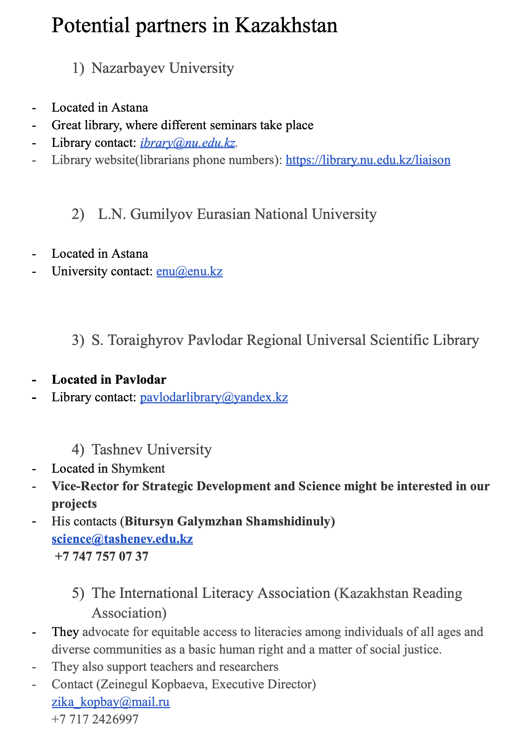

Slide 17
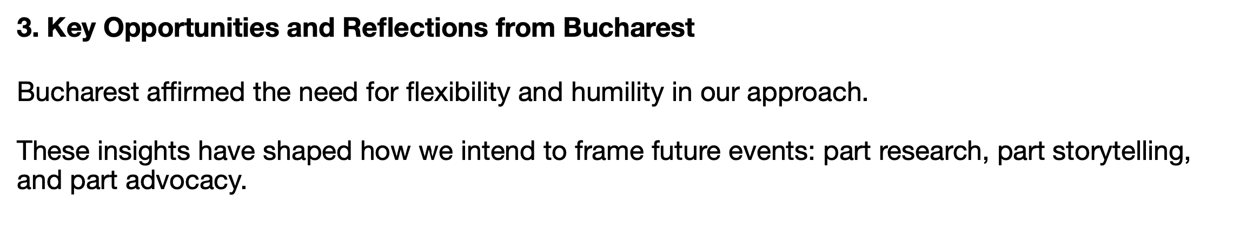
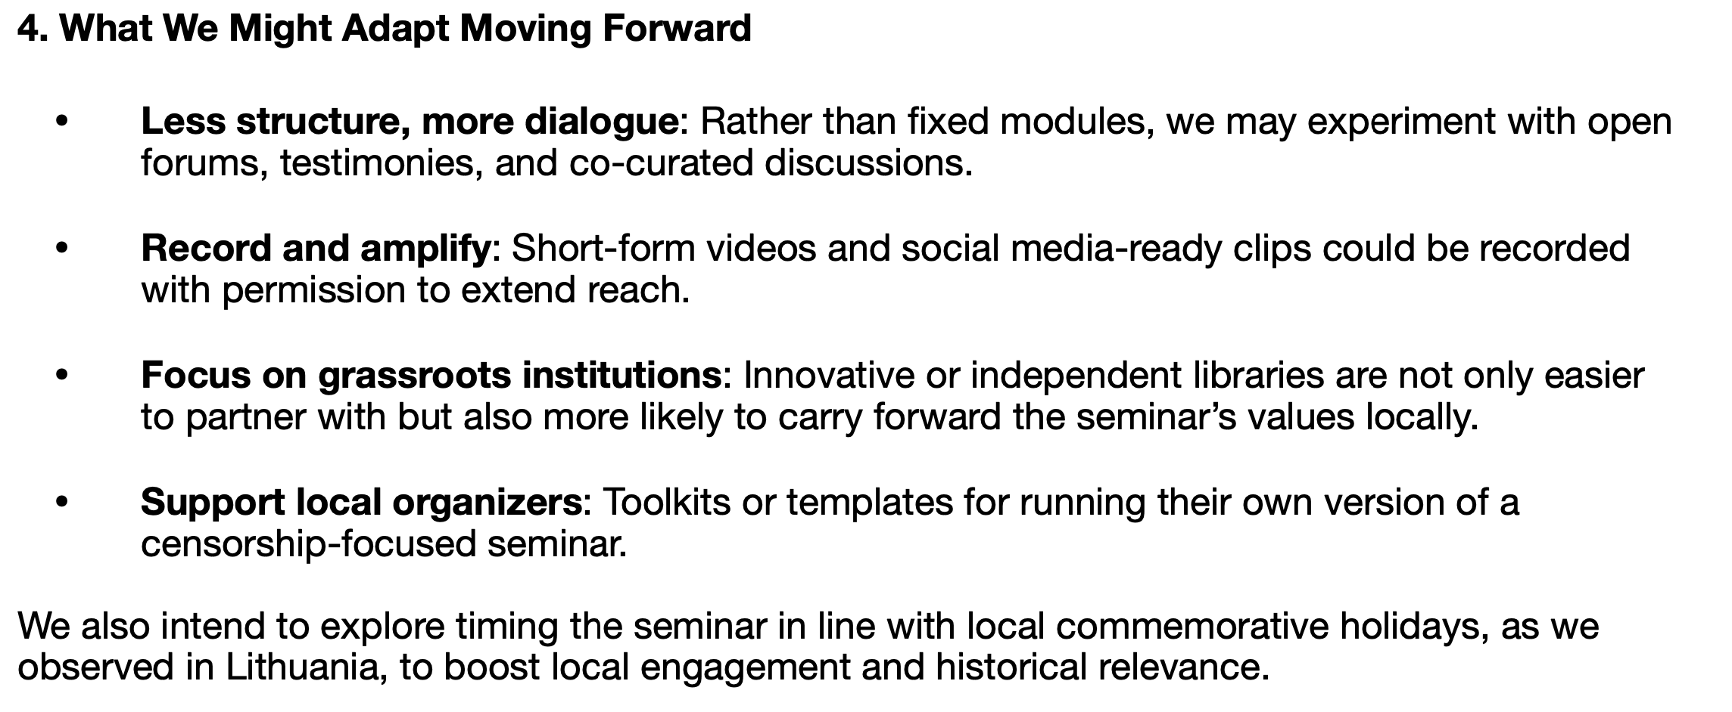

Slide 18
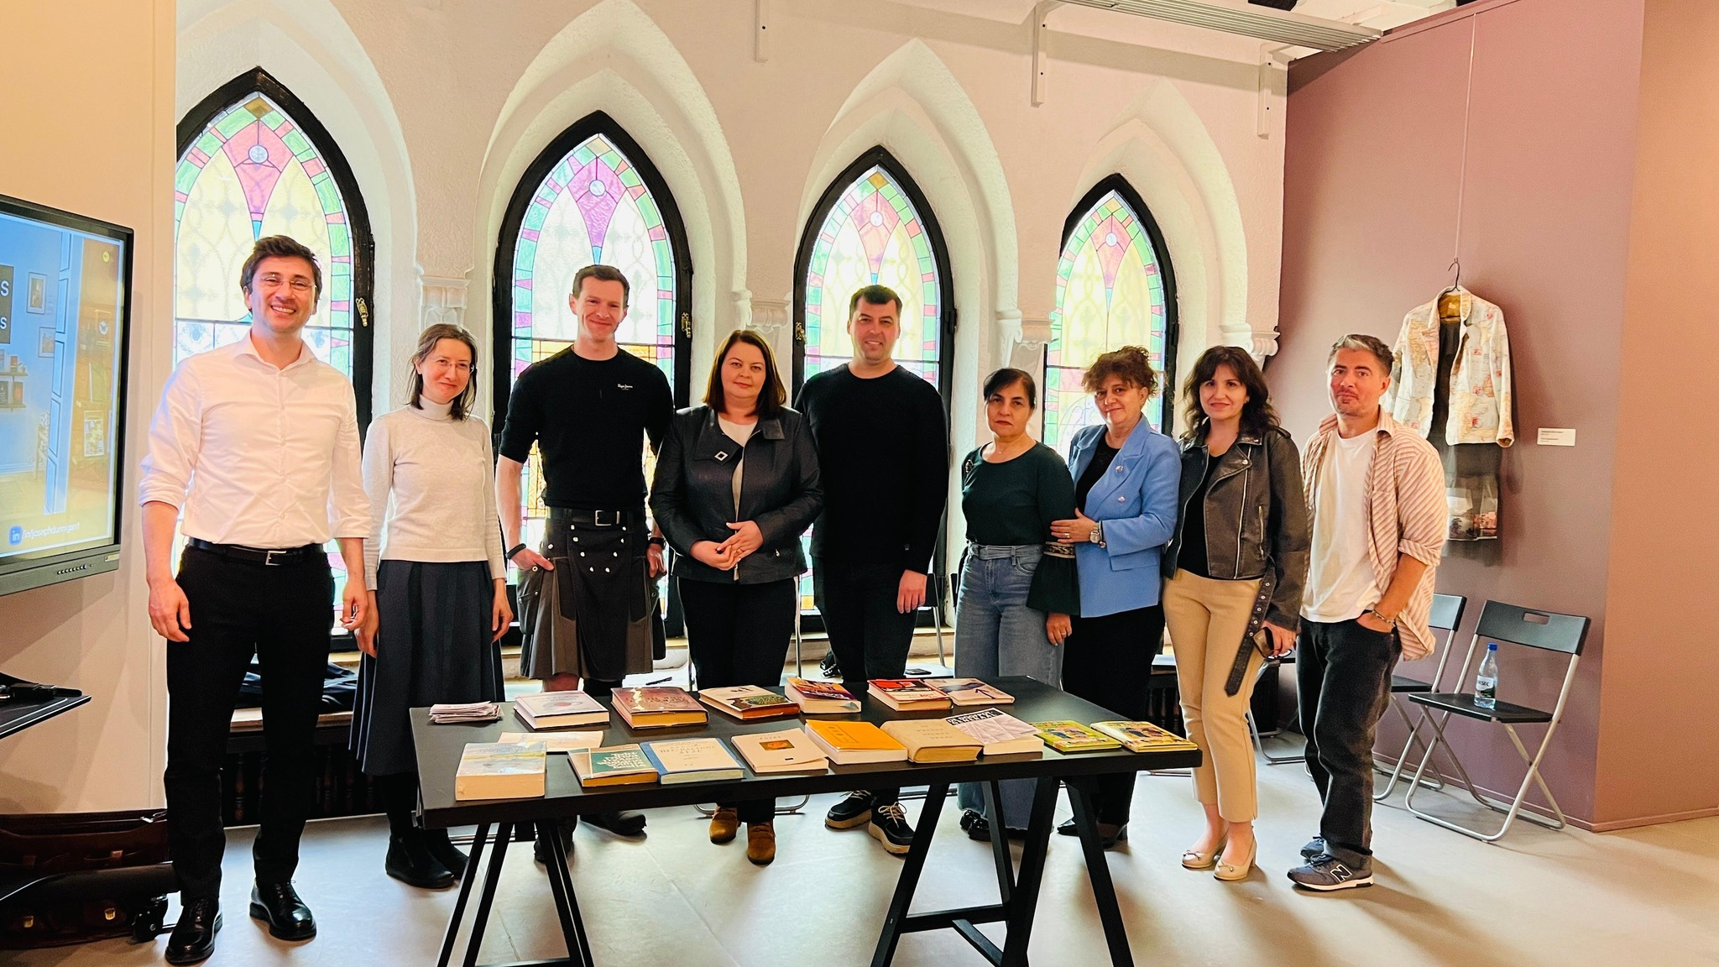
/bannedbooksmuseum
/bannedbooksmuseum
/in/josephdunnigan1

